Slide 1
An Amicus Brief:
3D-ASICS for X-ray Science
Robert Bradford
Advanced Photon Source Detectors Group
Argonne National Laboratory
15 November, 2013

Slide 2
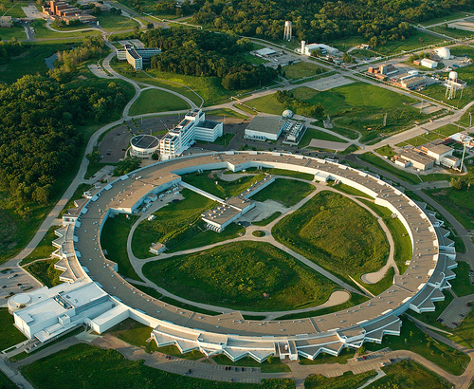
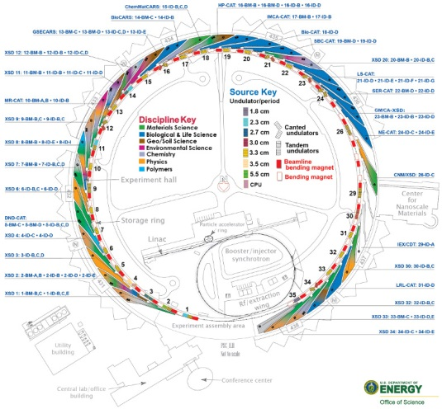
A little background: X-ray Science
Advanced Photon Source:
Light source up the road…
Largest user facility in the US
Very broad scientific user community – biology, chemistry, material science, physics…
~80 different experimental end-stations on ~30 beamlines
Many simultaneous experiments using variety of techniques
Detector needs very diverse, no “one-size-fits-all” solutions
Experiments compromise between speed (frame rate), temporal resolution, energy resolution, spatial resolution, and dynamic range
Widely acknowledged that detectors do not meet current needs

Slide 3
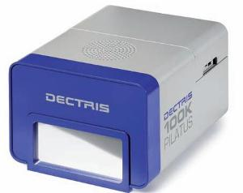
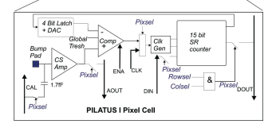
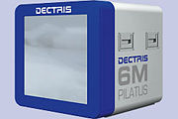
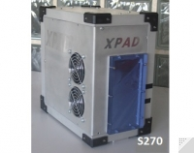
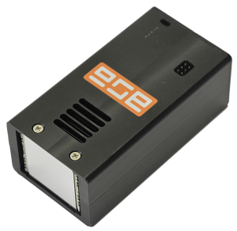
A little background: ASICS in X-Ray Detection
http://www.azonano.com/article.aspx?ArticleID=2631
Custom ASICs have become commonplace in synchrotron science during the past ~7 years:
“Hybrid pixel detectors” for x-rays are natural extension of silicon detector work done in HEP
Much of work done in Europe building off of LHC
Many commercial detectors based on single photon counting:
PSI Pilatus – 2006
Licensed to Dectris – very successful
Many efforts in Europe
Most important detector at APS for past ~5 years
Easy to use, robust, good SNR…
~50 systems costing $10-15M
C. Broenimann, et al. J. Synchrotron Rad. (2006), 13, 120-130.
http://lima.blissgarden.org/camera/pilatus/doc/index.html
http://www.amscins.com
http://www.imxpad.com
Notes:
Probably the most important detector at the APS right now.

Slide 4
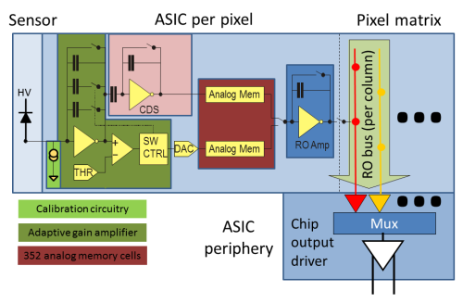
Simple Example - AGIPD
Analog detector with integrating logic for European XFEL
Adaptive gain:
Sensitivity to single photons or 10⁴ photons
http://photon-science.desy.de/research/technical_groups/detectors/projects/agipd/
Analog storage –
Buffers 352 images to permit 4.5 MHz frame rate.
ADC handled off chip.

Slide 5
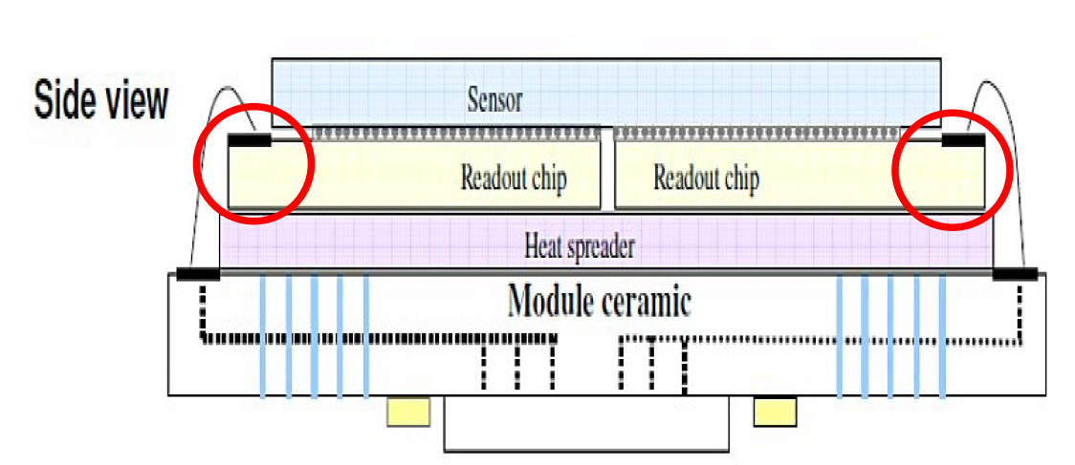
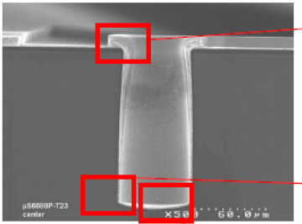
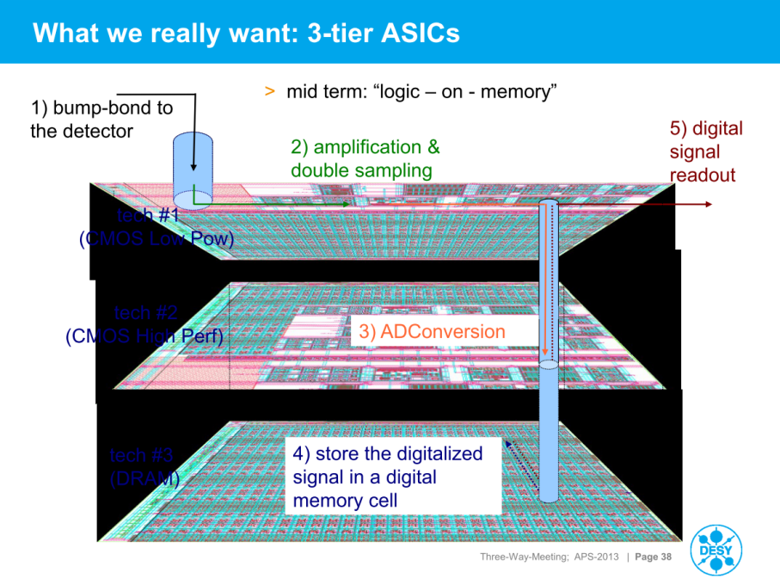
Platform being refined for gapless coverage.
Next iteration of AGIPD: 3-tier ASIC
TSV being explored with existing Medipix3 Chips
http://aps.anl.gov/Users/3Way/presentations/Graafsma.pdf

Slide 6
3D ASICS
Huge potential for impacting x-ray science
Seen as a key step forward for x-ray detectors:
Edge-less sensors without gaps in coverage
Smarter pixels for technique specific detectors with fast in-ASIC analysis capability
Spatial resolution is key to many experiments
Hybrid pixels typically ~50-200 μm
CCDs and CMOS can provide 5-30 μm pixels
Overcomes key compromises
3D ASICS: intelligent pixels + spatial resolution + high frame rates +???

