Slide 1
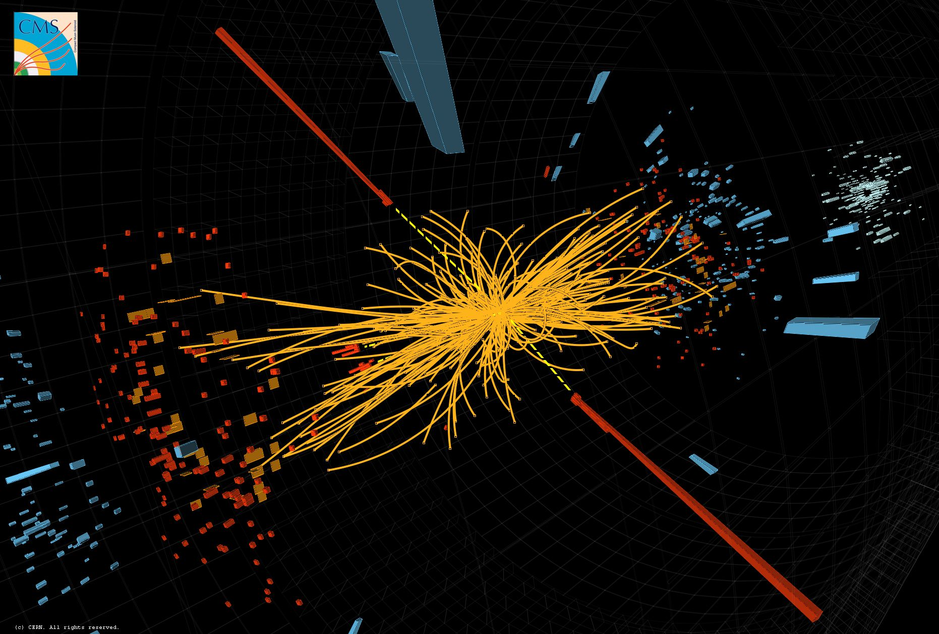
3D Electronics for Particle Physics
Challenges
3D Integrated Circuits
Bonding and thinning
3DIC Run
Applications
  Track triggers
  Large Area Devices
Prospects

Slide 2
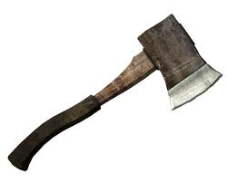
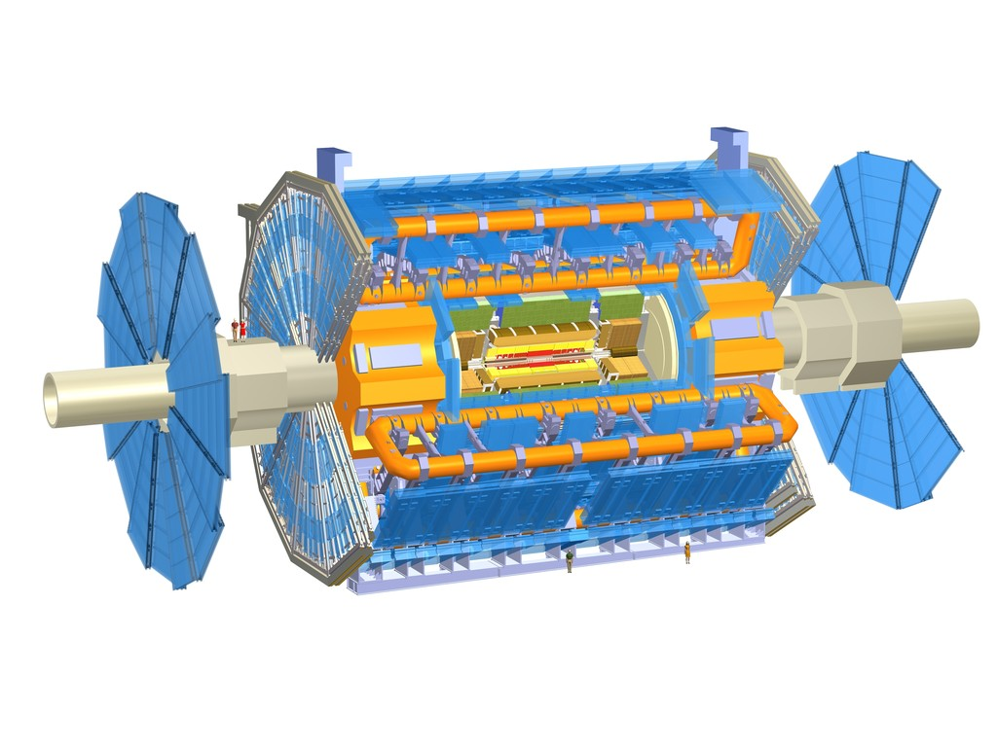
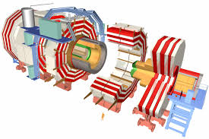
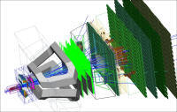
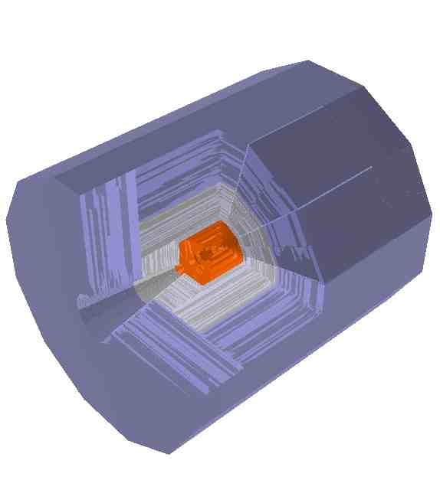

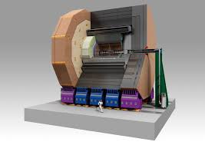
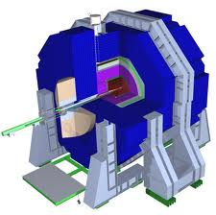
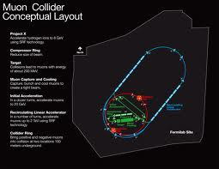
The Future
LHCb
Atlas
CMS
LHC proton-proton collider upgrades
Silicon tracking replacement
Muon Collider
ILD
SiD
New generations of experiments
For lepton colliders

Slide 3
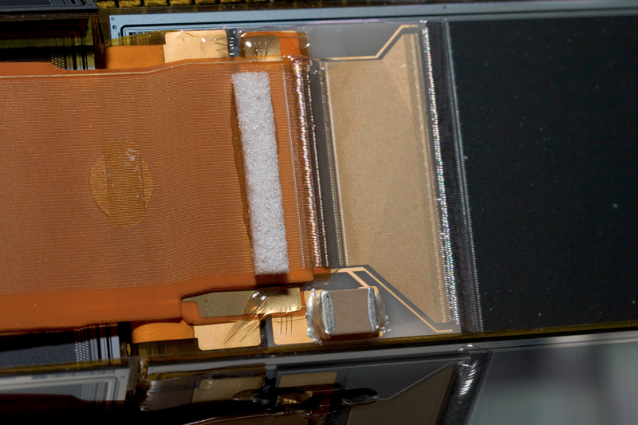
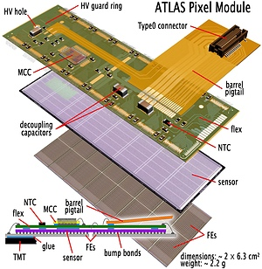
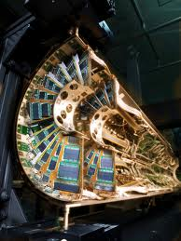
Silicon Tracking
D0 Layer 0
Building these devices is essentially an electronics packaging problem, an unusual one…
With billions of channels, 100’s m² surface area
With tbyte/sec bandwidth
Cooled to -20 deg C
With minimal mass
Arranged to give us the information we need to do physics
Analog cable
Flex foldover

Slide 4
Challenges for Tracking detectors
Detector requirements are set by the accelerator environment
● ● Linear Collider Vertex Detector – precision
  Superb impact parameter resolution ( 5µm ⊕ 10µm/(p sin^{3/2}𝚹) )~15 micron pixels
  Transparency ( ~0.1% X0 per layer ) – 93 microns of silicon
● ● ● ● ● Muon Collider – processing to deal with harsh background environments
  1-3 TeV muon collider on Fermilab site
  Substantial Huge detector and radiation backgrounds
  Fast timing and high precision for background rejection
● ● ● CLIC – speed and precision
  ILC + ~ns time resolution
● ● ● HL-LHC – large scale, high speed, harsh environment
  100-200 int/25 ns crossing, track trigger required
  On-detector background rejection
● ● ● X-Ray Imaging – speed and density
  Variety of challenges – timing
● ● ● ● ● Intensity frontier
  Thin, fast (100’s of ps resolution) electronics
<25 micron pixels
50-100 micron thick sensors
Large area ~ 100 m²
<ns time resolution
Radiation hard

Slide 5
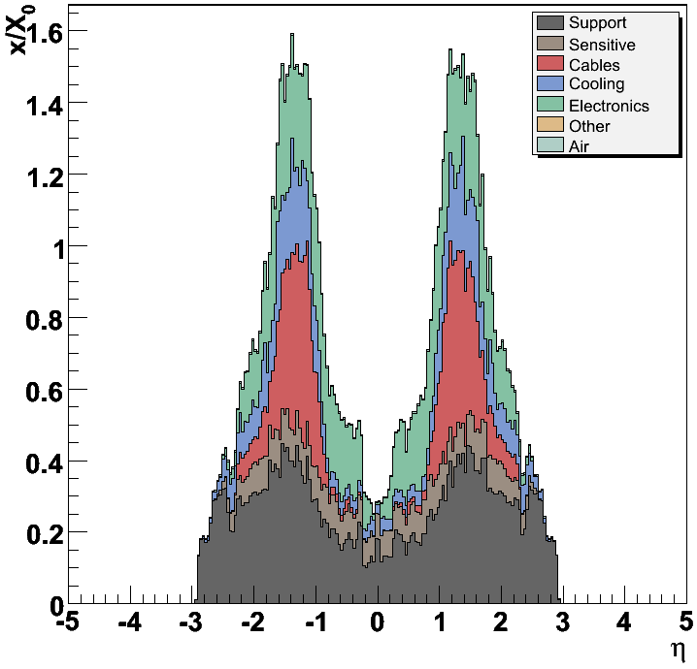
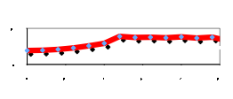
Detector Mass Challenge
Mass directly affects performance - reducing mass is a central goal for the future
Mass Drivers:
Cooling and associated infrastructure – directly related to power dissipation and radiation damage which forces low temperature operation
Supports
Cables, interconnects and electronics
CMS as built
This is a central
limit to the performance of LHC detectors
sensors
ILC Goal

Slide 6
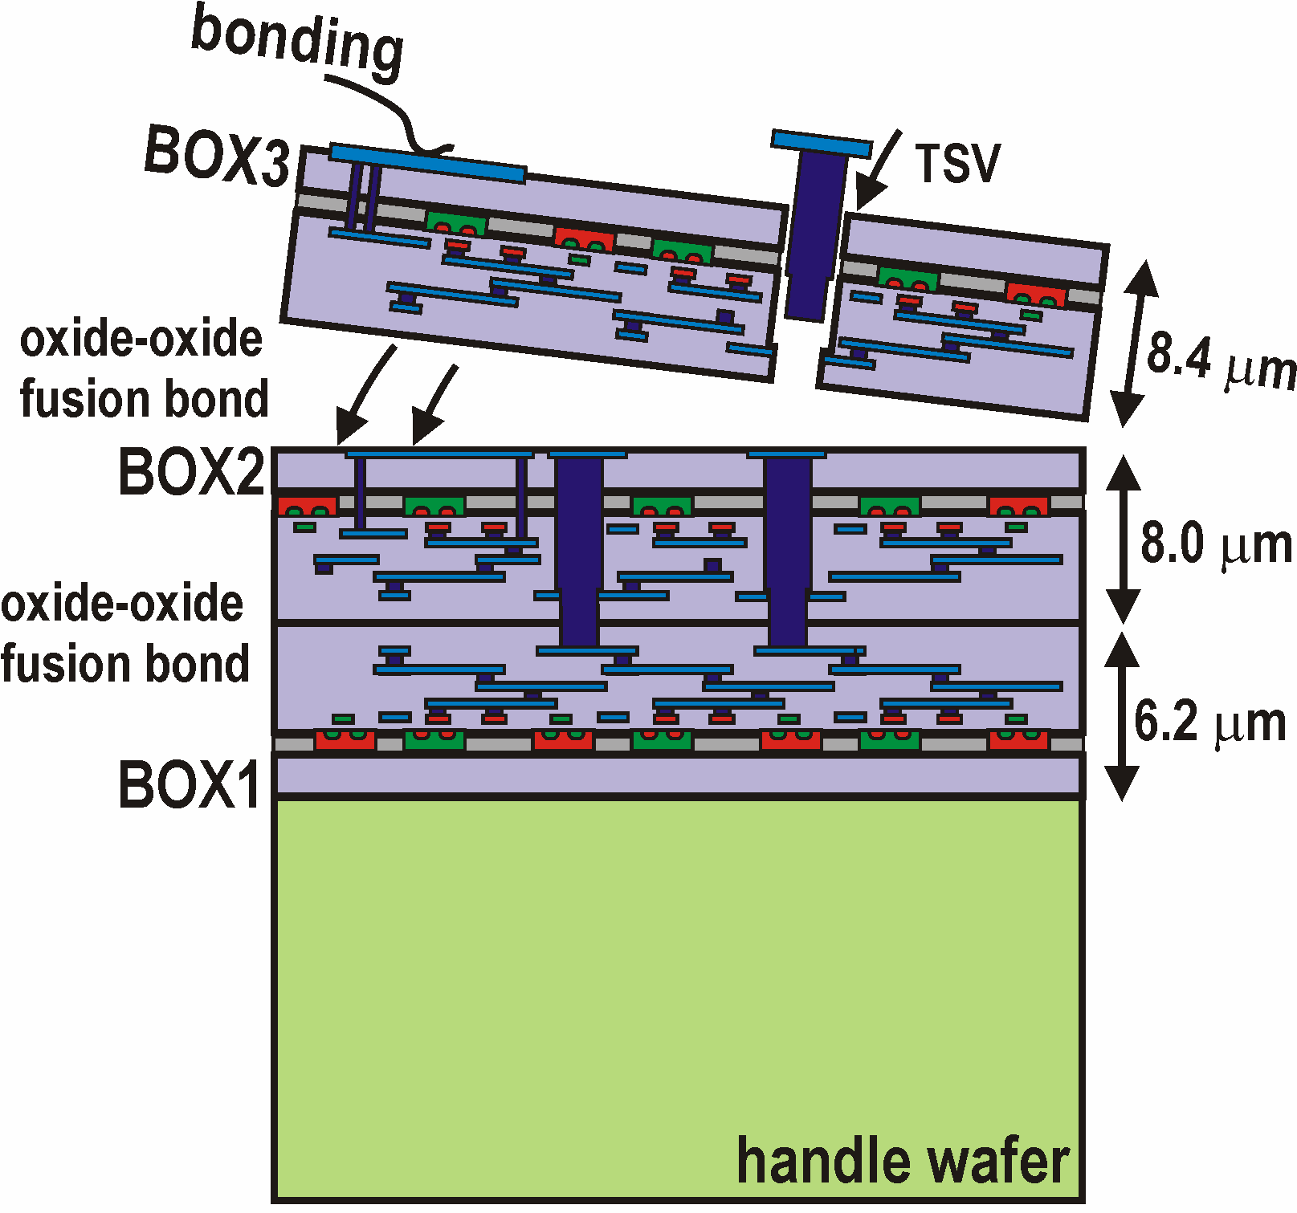
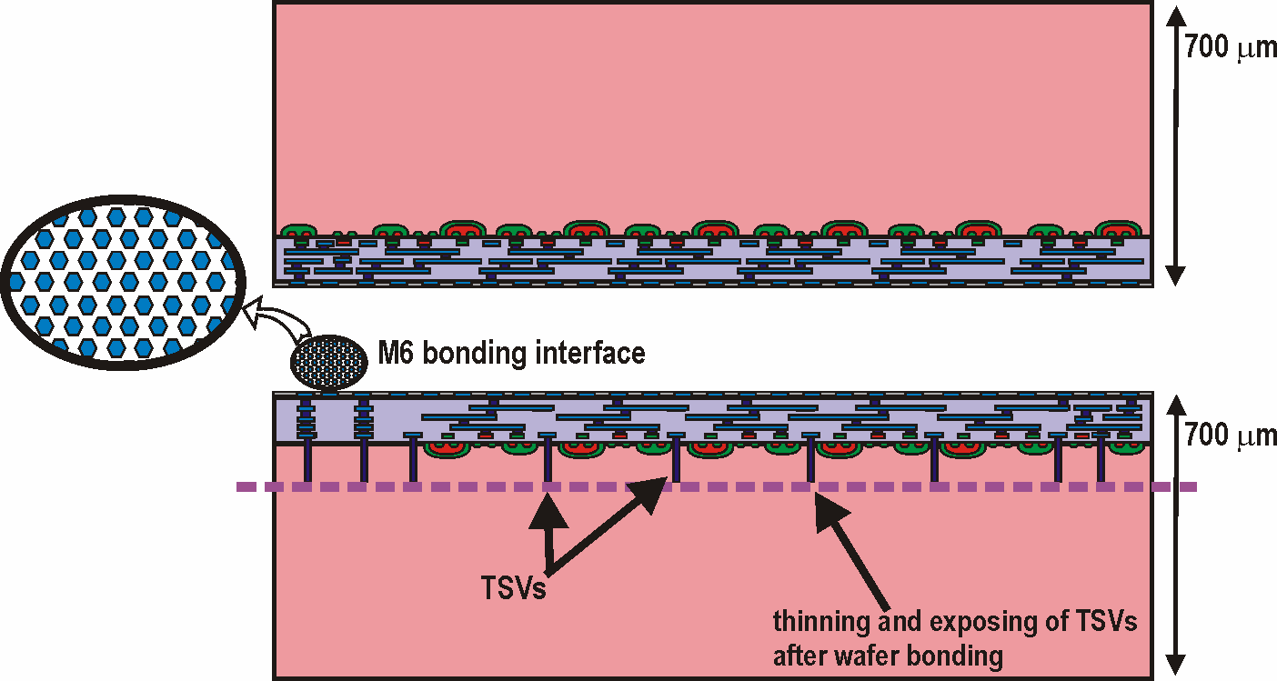
3D Integrated Circuits
Via-last
A chip in three-dimensional integrated circuit (3D-IC) technology is composed
of two or more layers of active electronic components using horizontal intra-tier
and vertical inter-tier connectivity routing
Through Silicon Vias (TSV): small diameter vertical connectivity (not only to build electronic chips but also for attaching detectors to readouts)
Bonding: Oxide-, polymer-, metal-, or adhesive strengthened- (W-W, C-W or C-C)
Wafer thinning: aggressive and ultra-precise
Back-side processing: metallization and patterning
Back-Face
Face-Face
MIT-LL
3D-IC process
FDSOI oxide-oxide bonding
First wafer
Via middle
Face-Face
Tezzaron 3D-IC
bulk CMOS Cu-Cu thermocompression or DBI bonding
TS Vias (φ=1μm)

Slide 7
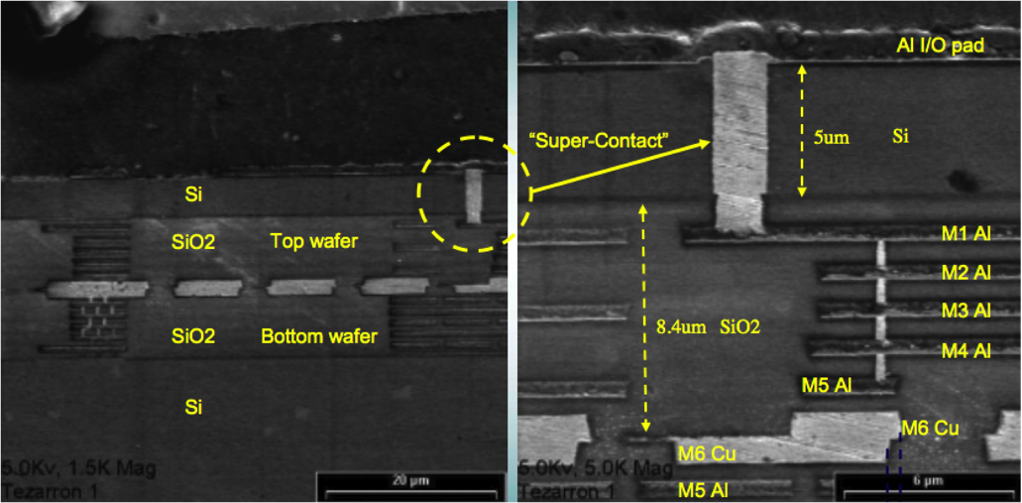
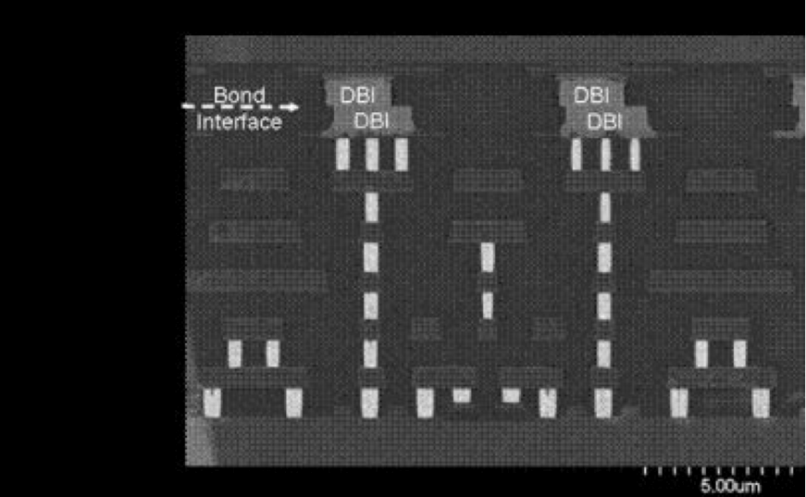
3D Interconnect
Copper bonded two-tier IC
(Tezzaron)
Technology based on:
Bonding between layers
  Copper/copper
  Oxide to oxide fusion
  Copper/tin bonding
  Polymer/adhesive bonding
  Cu stud
Through wafer via formation and
metalization
8 micron pitch, 50 micron thick oxide bonded imager (Lincoln Labs)
8 micron pitch DBI (oxide-metal) bonded
PIN imager (Ziptronix)
IBM 3D stacked
Memory chips
Cross-section of the TI XAM3715, a 45nm applications processor mounted on a BGA substrate

Slide 8
3D For Particle Physics
Why is 3D technology important for HEP? – We care about bonding sensors to complex analog/digital electronics
It enables intimate interconnection between sensors and readout circuits
  Subpixel readout and control of SiPMs
It enables unique functionality
  Digital/analog/ and data communication tiers
  Two layer micro/macro pixel designs which can provide high resolution with minimal circuitry
  Can correlate information to help defeat noise
Wafer thinning enables low mass, high resolution sensors
Bonding technologies enable very fine pitch, high resolution pixelated devices
Commercialization of 3D can reduce costs for large areas
Unique circuit/sensor topologies (CMS track trigger)

Slide 9
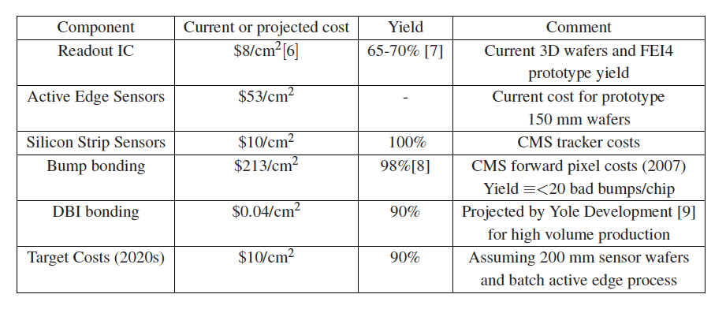
Bonding Costs and Yields
<$1/cm²?
Current and projected costs and yields for sensor/readout integration technologies

Slide 10
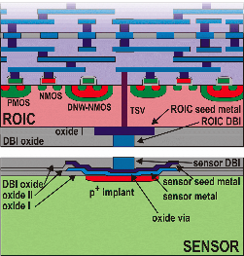
3D – Sensor/ROIC Bonding
<25 micron pixels
50-100 micron thick sensors
Large area ~ 100 m²
ns time resolution
Radiation hard
A promising fine pitch bonding technology
the direct bond interconnect (DBI)
oxide bond process from Ziptronix – now licensed to Novati
  No bump bonds – planar resulting wafer
  Very fine pitch - 4 microns used for 3D Tezzaron wafers
  Mechanical strength enables
  aggressive post-bond thinning
  Uses standard IC processes - CMP and
  metalization
  Can withstand high temp.
Wafer-wafer bond can be reworkable
In principal can be low cost

Slide 11
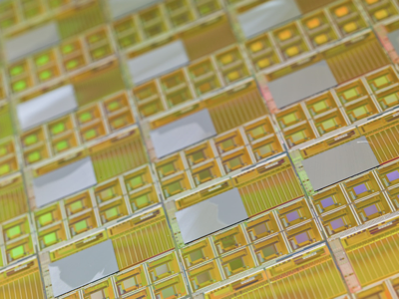
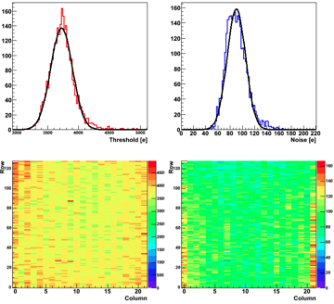
Oxide Bond Demonstration
Initial work was based on existing ROIC wafers from BTeV and sensor wafers from MIT-LL.
  Sensor chip to FPIX wafer bond
  Sensors ground to 100 microns - 8 V depletion
  100% connectivity on sensors without obvious bond voids
  No degradation in s/n
  Radiation hard to >10 MRad
Process used for 3D wafers, planned for track trigger, active edge, x-ray imaging work
Threshold
Noise

Slide 12
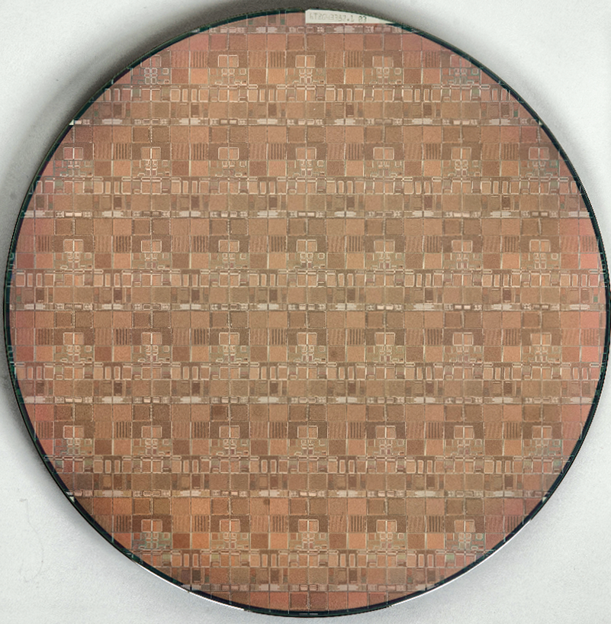
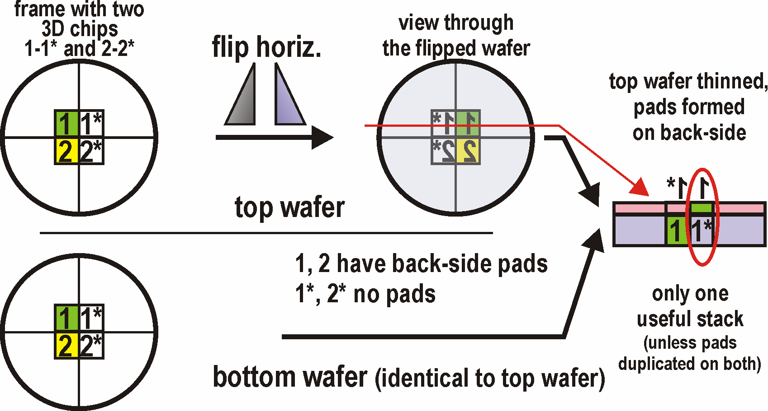
‘Fermilab’ 3D-IC run
130nm GF/Tezzaron wafer - FNAL MPW before
3D bonding; single mask set used to fabricate
top and bottom tier chips on the same wafer;
Bonding by flipping wafers over symmetry line
Initial (small) efforts started with MIT-LL 3D process in 2006 (DARPA 3-tier 3D run):
3D-IC Consortium established in late 2008, now 17 members; 6 countries: USA, Italy, France, Germany, Poland, Canada) + Tezzaron – various goals among members, activities going at slower pace but progressing
Fermilab organized first 3D-IC MPW run for HEP
Designs in: 05/2009; Chartered (GF) 130nm
  Fermilab had a role of silicon broker
  Many challenges in working with cutting edge technology: design mistakes, incompatibility of software tools (Tezzaron not Cadence), lack of 3D oriented verification, handling of databases >10GB, shifting GF requirements (DRC), changing personnel at GF, slow progress through fab etc.
MPW frame accepted for fab in 03/2010
LEFT (bottom)
chips
Right (top)
chips
12

Slide 13
‘Fermilab’ 3D-IC run
Ziptronix / licensed to Novati
Tezzaron / Novati
Difference between Cu-Cu thermocompression and Cu DBI wafer bonding methods:
  Cu-Cu not reworkable, bonding established by fusing metal pads, forgiving on surface planarity
  Cu DBI reworkable shortly after bonding, bonding established by chemically fusing oxide surfaces, must be ultra planar
13
CMS review, March 18-19, 2013

Slide 14
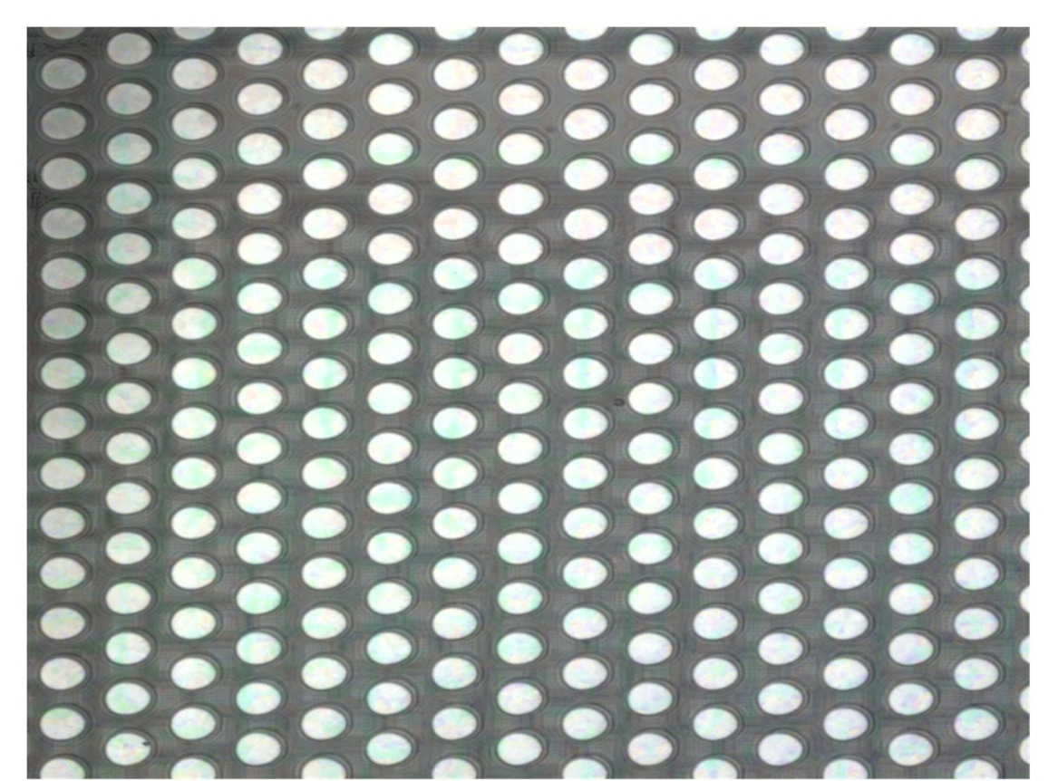
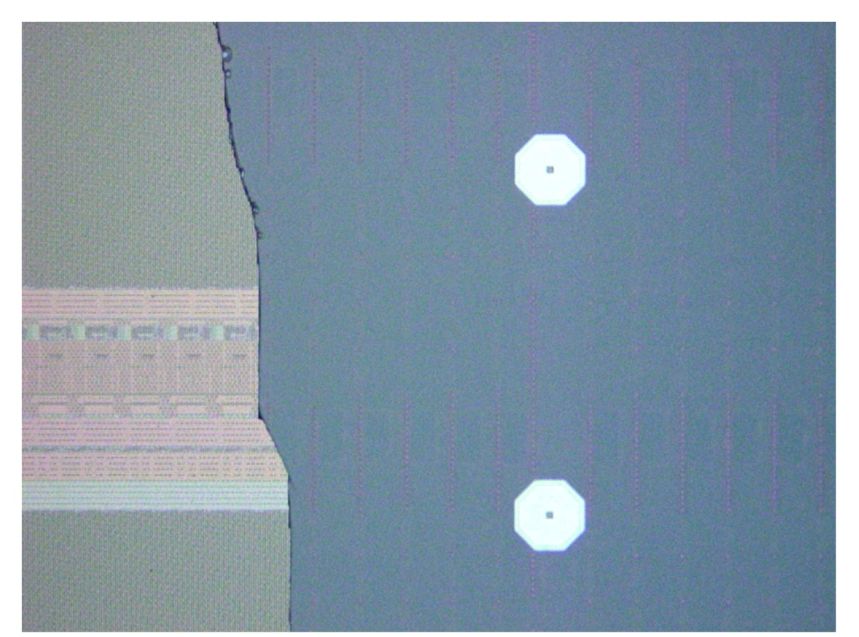
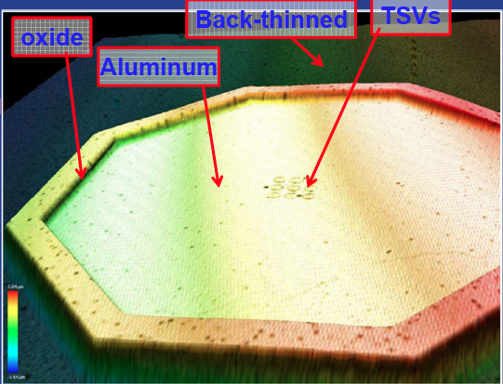
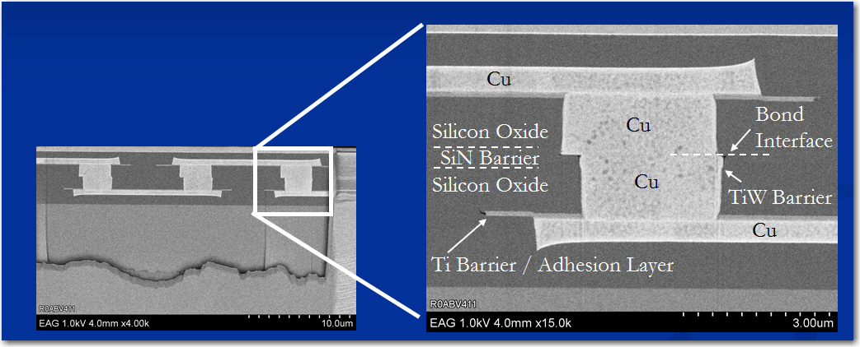
Ziptronix DBI bonding array
Interconnect
array
Bump bond pad
6 micron thick top silicon
4 micron
pitch
DBI Copper
pillars

Slide 15
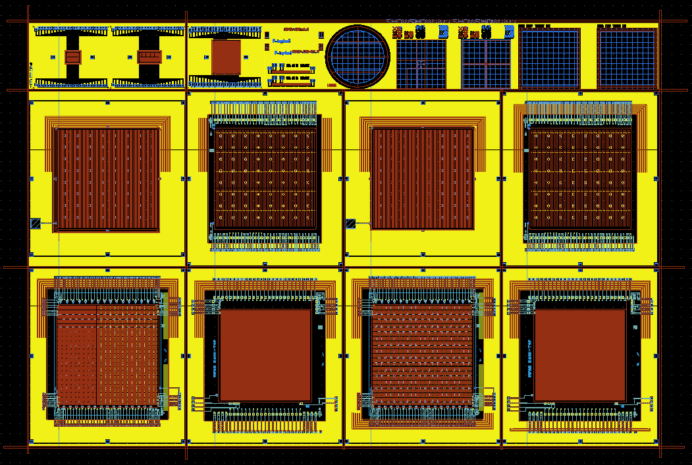
Current Fabrication
Oxide bond 3D chips to BNL sensors to form integrated sensor/electronics assemblies – in process now
  This will complete our initial 3D work with Tezzaron and Ziptronix
  Should provide VIP(ILC), VICTR(CMS), and VIPIC(X-Ray) assemblies
4-Layer stack of sensors
And electronics
sensor
Bump bond
VICTR
VICTR
TSV
DBI bond
TSV
DBI bond
VIPIC
VIP
VIPIC
VIP
sensor

Slide 16
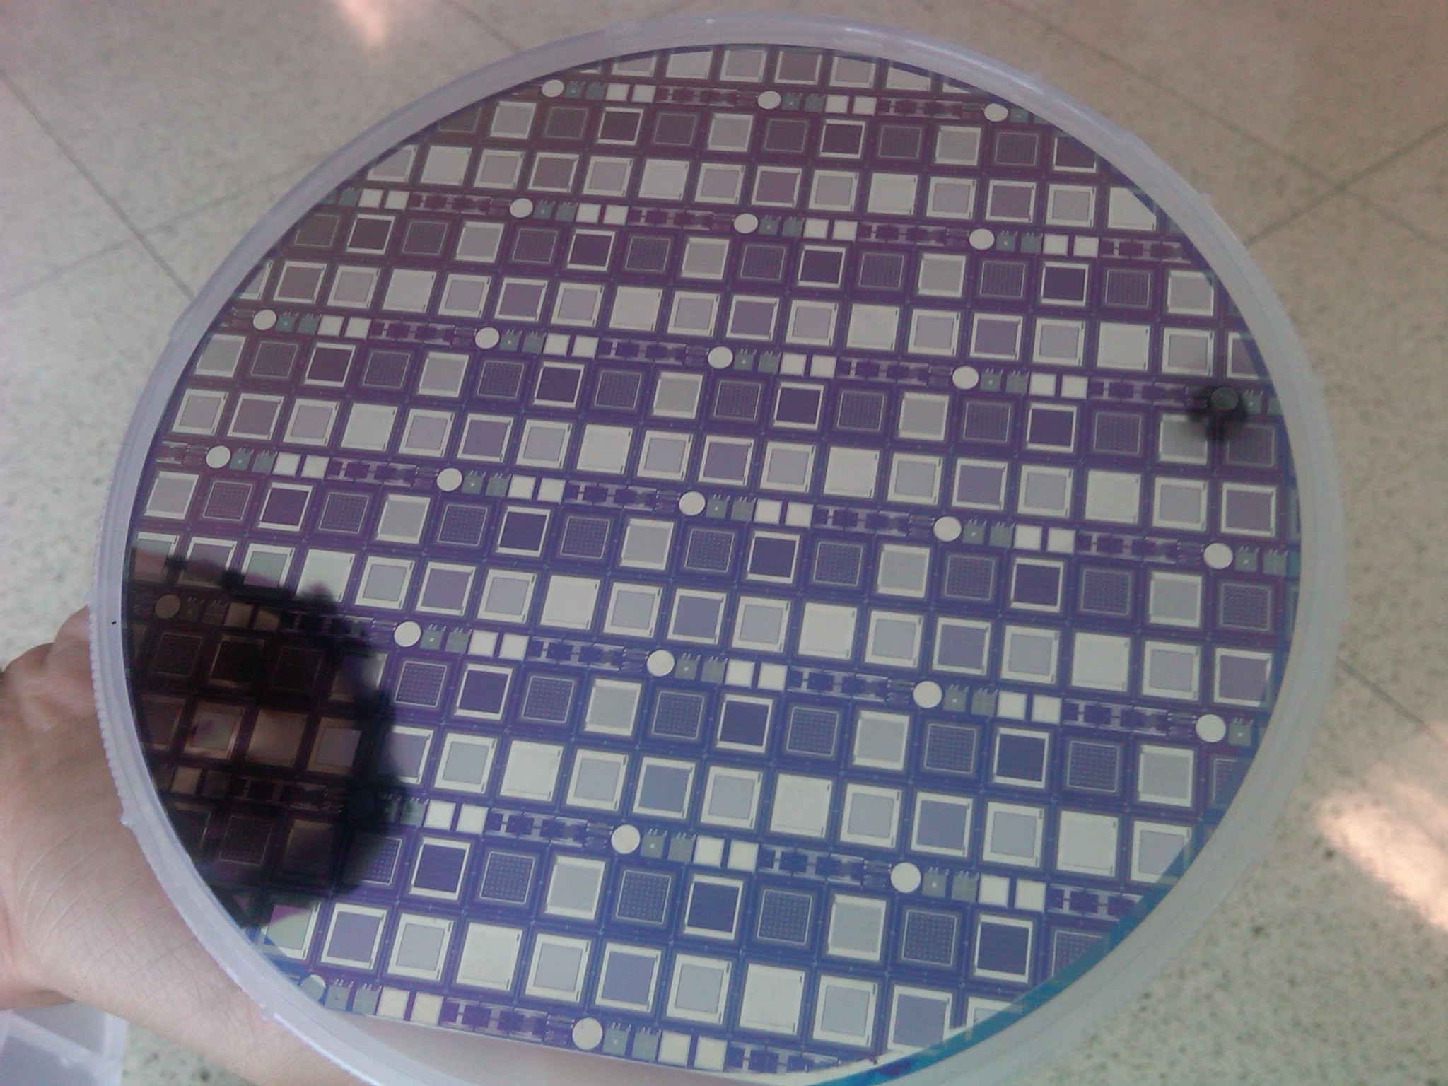
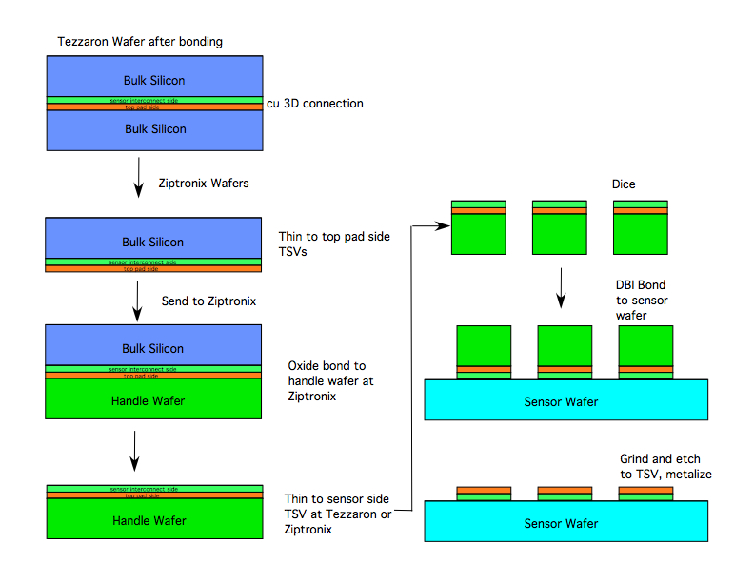
Chip-to-Wafer bond
Next step – DBI bond ROICs (VICTR,
VIPIC, VIP) to BNL sensor wafer

Slide 17
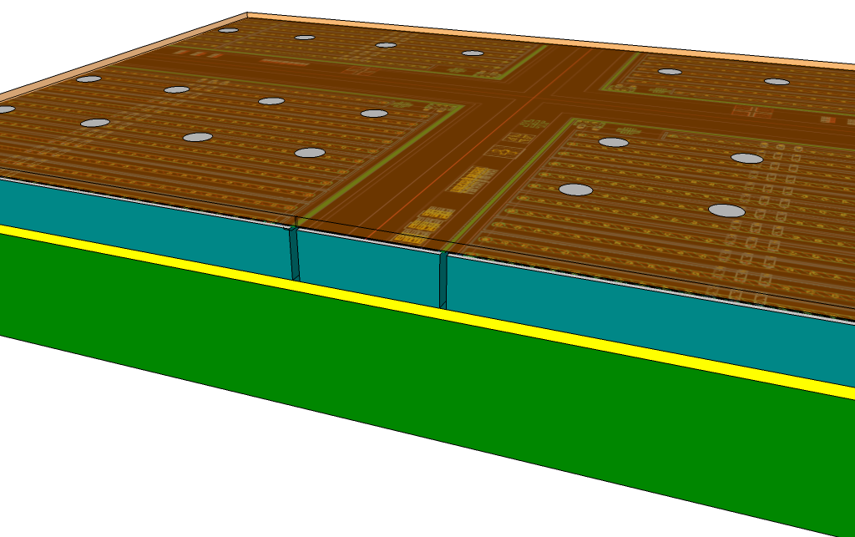
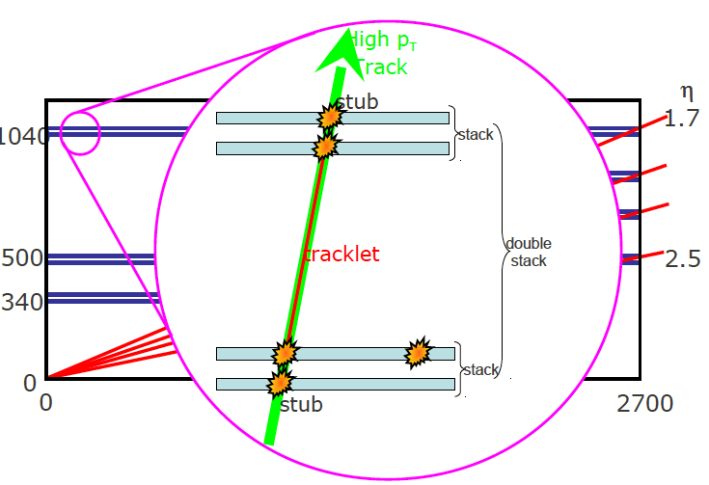
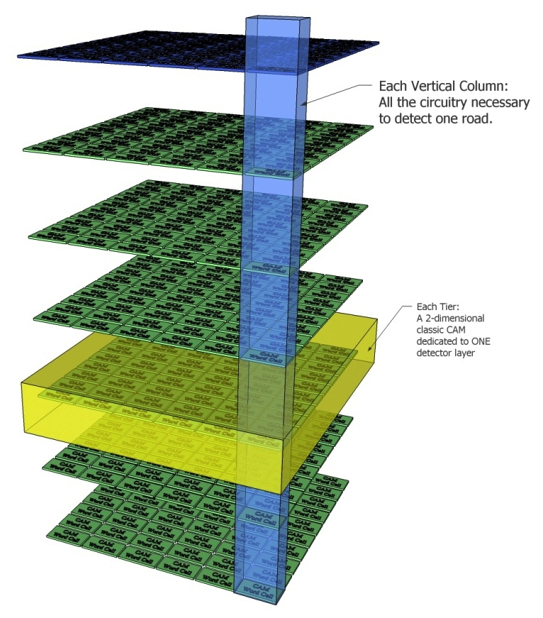
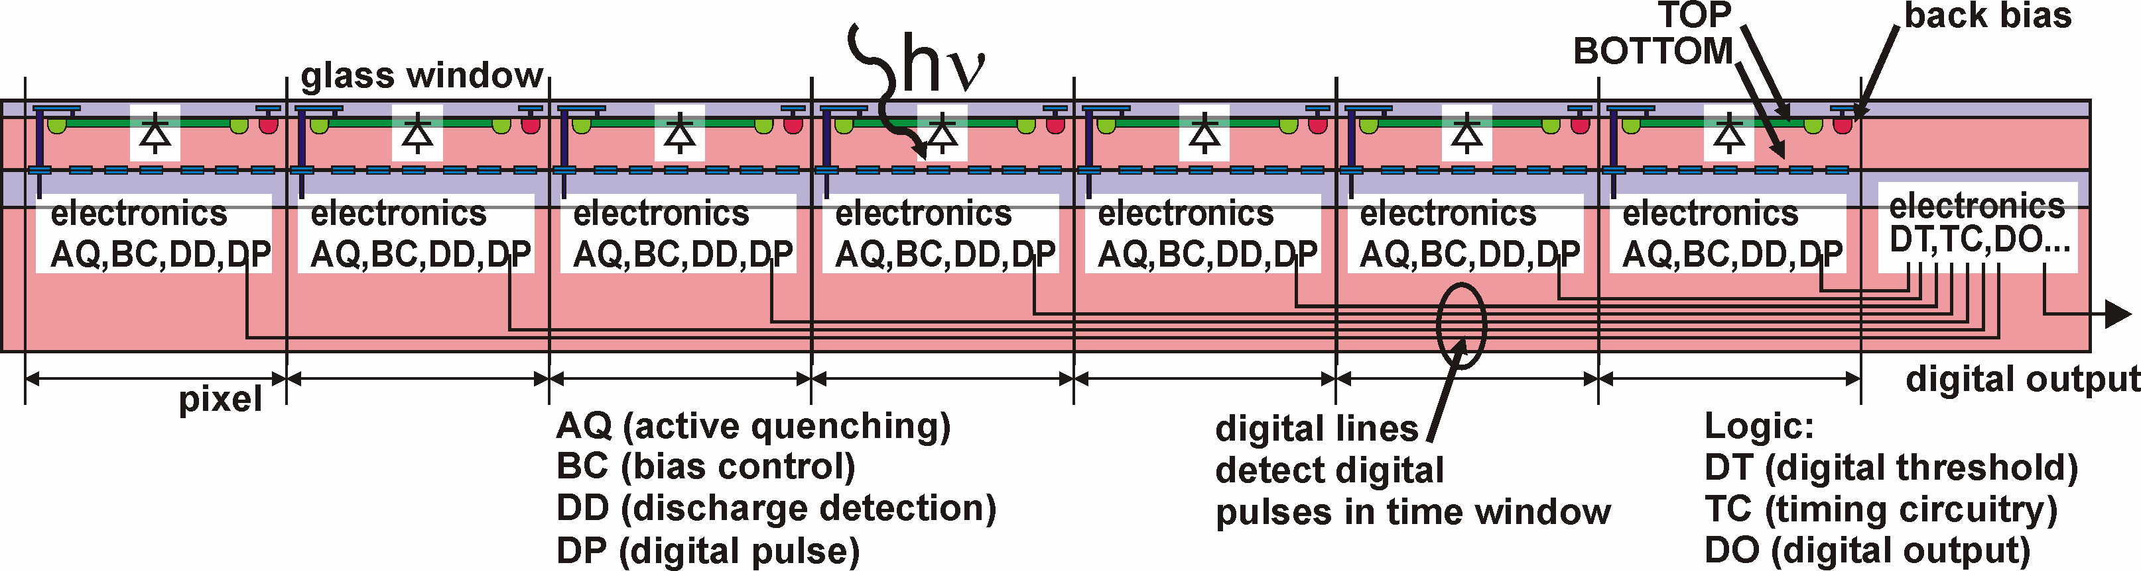
Opportunities in 3 Dimensions
readout
IC and pads
200 micron
Buried
oxide
sensor
trenches
Combine active edge and 3D
electronics to produce tiled sensors
combined with ROICs for large area arrays
Handle wafer
CMS Level 1 track trigger
- Correlate hits in adjacent layers
to filter out low momentum tracks
Use two layers of 3D SiPMs to produce fast, low power, low noise trackers
CMS – Use stack of
3D tiers to emulate
tracker layers for
CAM –based track
recognition
Use TSVs to connect each SiPM subpixel to quenching,
timing, and control electronics

Slide 18
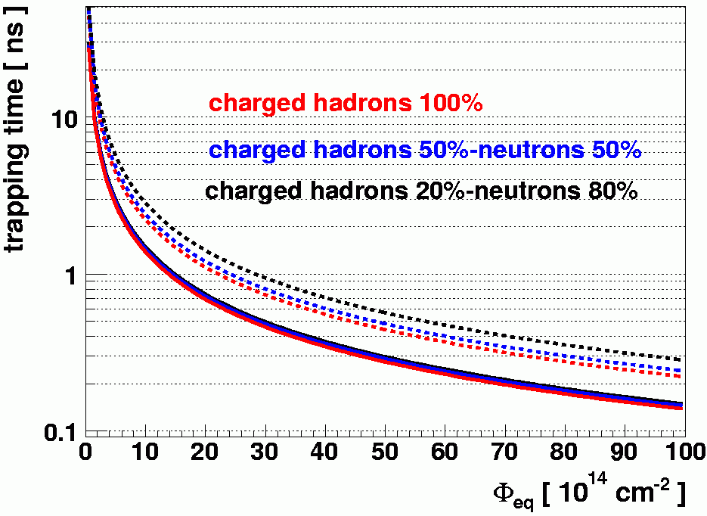
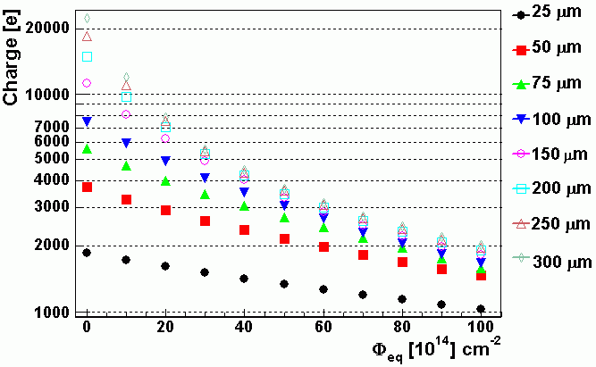
3D - Thinned Detectors and Radiation Tolerance
Radiation reduces the mean free path of charge carriers in silicon
  Thinned detectors collect almost as much charge as thicker detectors after irradiation
  Depletion voltage is much lower (V_{d}~thickness²)
  Leakage current is lower ~ t
Of course the initial signal is 3-6 times lower …
3D thinning and interconnect technologies enable fabrication and handling of these thinned devices
3D detectors (Parker, Kenny) address this problem using deep etching 3D technology
(G. Kramberger)

Slide 19
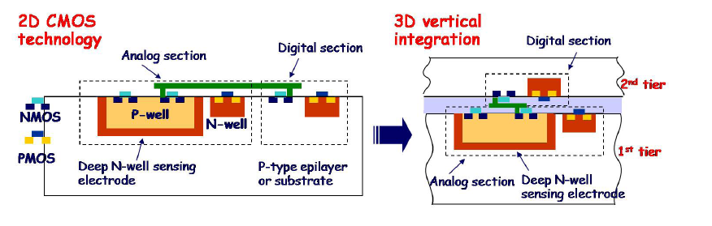
3D For MAPS
Eric Fossum will be talking at Fermilab about Monolithic Active Pixels – MAPS – at the inventors meeting next week
This technology is also promising for HEP – planned for ALICE upgrade and installed in STAR
Major issues for HEP – analog-digital coupling in thin layers and parasitic charge collection in PMOS transistors
Can be solved by putting digital on top layer of 3D stack
(APSEL 3D chip in Tezzaron 3D run)

Slide 20
● ● CMS Track Trigger
<25 micron pixels
50-100 micron thick sensors
Large area ~ 100 m²
ns time resolution
Radiation hard
CMS will need a L1 trigger based on fully
reconstructing tracks at level 1 (6 μs) for HL-LHC in the mid-2020’s .
Must be (40MHz/100kHz)=400 times faster than existing triggers systems
Must filter the data
  Good Z resolution to reduce background event
  Limit rate at the front end
  by using correlations between
  layers.
  Must communicate between
  adjacent chips to avoid gaps
  in z coverage.
  2.5 or 3D is a key enabling
  technology for full coverage in
  the module
Low pt

Slide 21
2D Implementation
Correlation for tracks that cross
Z boundries are difficult in 2D
Where interconnects are at edge
Long Strip tier
Signals travel along edges, lots of digital activity, multiple
chips, complex interconnect, processing is not “local”
~mm
Pixel tier
All connections at
Outer edge
~10 cm

Slide 22
3D Implementation
Long Strip tier
Interposer
with analog
signals
~mm
3D Chip
Pixel tier
Oxide bond
~10 cm
One 3D Chip – signals are all local
But – Yield issues with bonding arrays of chips, large area bump bonding…
Probably – an intermediate, smaller module design with via-last

Slide 23
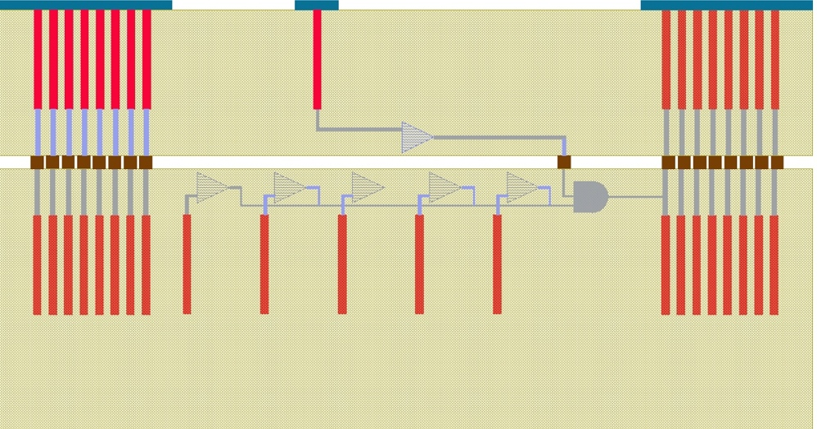
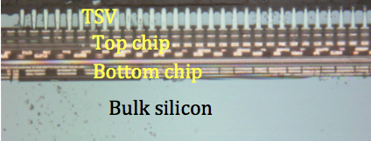
VICTR Chip
The VICTR chip is designed to
demonstrate the principles of a
track trigger sensor/ROIC
64 5 mm top tier “long strip”
64 x 5 array 1 mm bottom tier “short strip”
Part of Fermilab 3DIC run
Modified FEI4 (Atlas) front end
Misaligned bond interface

Slide 24
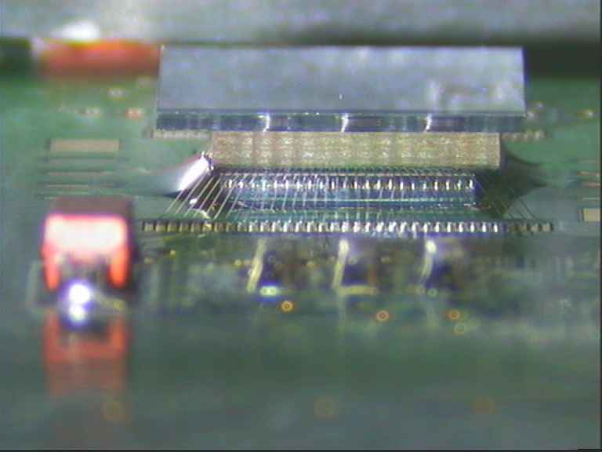
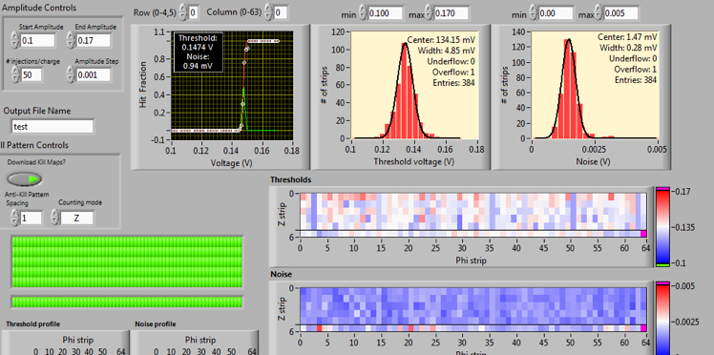
3DIC Results - VICTR
Threshold
Noise
Noise
Short strip tier
Long strip tier

Slide 25
2.5-D Implementation
Central region carries digital signals
And z information between chips
Interposer
with analog
signals
1D Chip
1D Chip
Pixel tier
Carbon Foam
Flex interconnect
Long Strip tier
~10 cm
1D Chip – long strip signals pass through flex
Long strip are now ½ module length

Slide 26

The overlapped sensor on the bottom allows for all of the assembly operations to be done on a plane except for the final foldover
An extended overlap could solve the issue of z communication by extending the long strips into the other half
PCB/flex
ROICs
Top sensor
Flex interconnect
To PCB
bottom sensor
R. Lipton
26

Slide 27
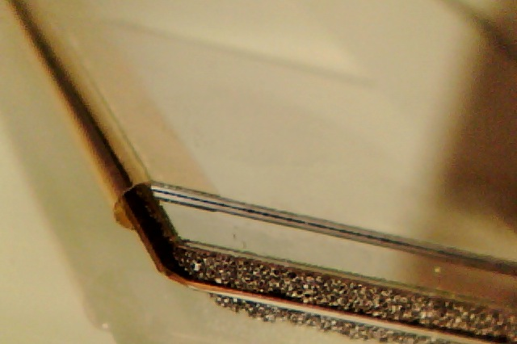
Module
Carbon foam/flex based
design
Flex
foldover
Dummy ROIC
Carbon foam
Dummy
sensors
Kapton
spacers

Slide 28
Large Area Arrays
Seamless, pixelated detectors deployed in large areas are important (crucial) for many applications in HEP, x-ray imaging and Nuclear Physics
There are two possible approaches
  Use the fact that wafer-scale sensors can be fabricated with good yield and bond an array of smaller readout chips to a large sensor
    Interconnect geometry is a central issue
  Fabricate tiles which can be butted on all four sides to fabricate arrays of arbitrary size.

Slide 29
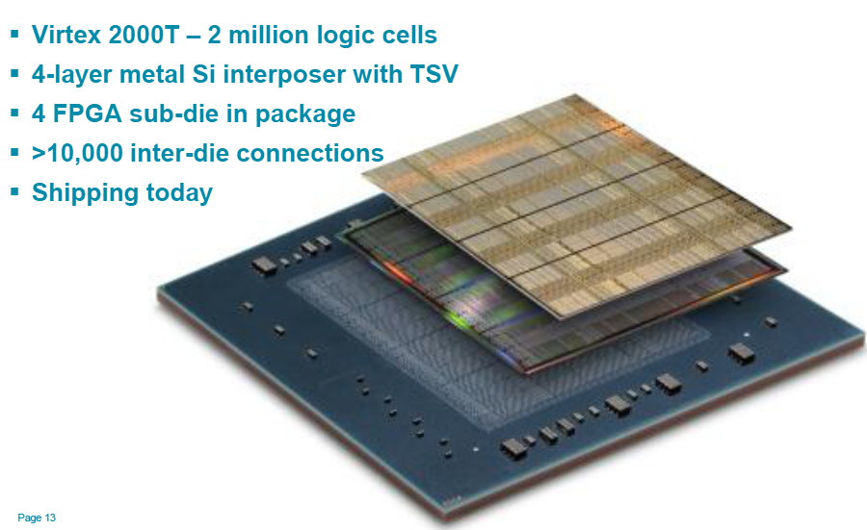
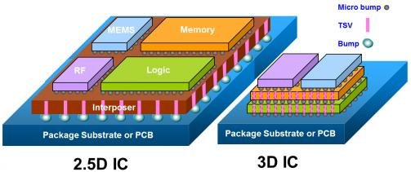
2.5D
Industry is moving first toward “2.5-D”
This technology utilizes through-silicon vias on an “interposer” to connect multiple chips
Finer pitch, higher speed better
thermal expansion match than PC board technologies

Slide 30
Why 2.5D for HEP?
A 2.5D substrate allows us to match large area sensors to chips limited by CMOS reticules to 2-3 cm on a side
Can be an enabling technology for large area sensors and focal plane arrays
These can also be very important for very high bandwidth trigger and memory systems – such as an AM-based track trigger.
ROIC
interposer
Wafer Scale Sensor

Slide 31
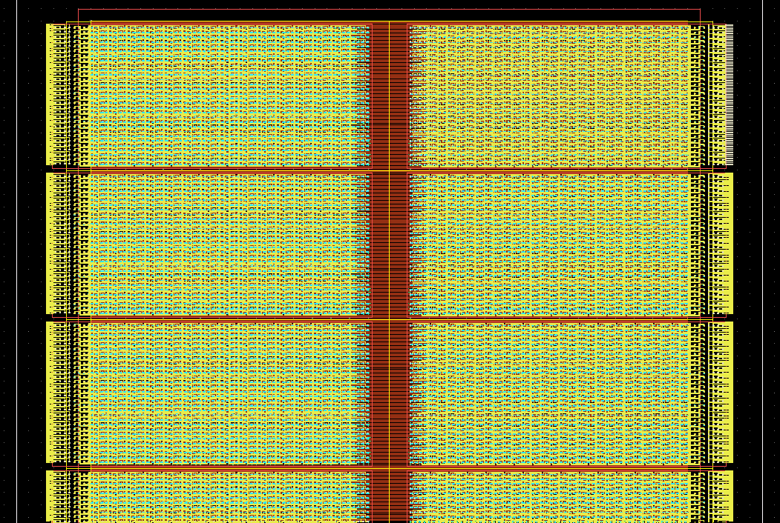
2.5 D Design for CMS

Slide 32
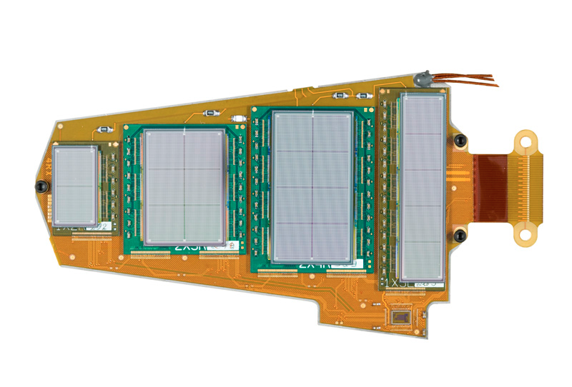
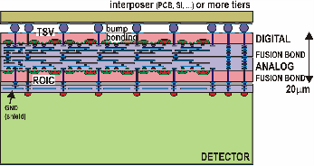
Combining the two 3Ds
CMS FPIX Plaquette
Low cost, large area, thin, pixelated sensor planes with no dead regions.
Decouple bond and array yields
3D provides backside interconnect to eliminate peripheral bond connections
Sensors can be processed to have “active edges” using deep reactive ion etch so assemblies can be tiled.
166 mm
117 mm
76 mm
28 mm
SiD (ILC) Outer pixel disk

Slide 33
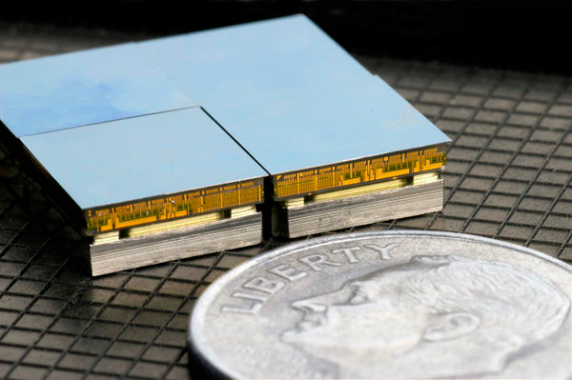
How can we do it with 3D?
Combine active edge technology with 3D electronics and oxide bonding with through-silicon vias to produce fully active tiles.
These tiles can be used to build large area pixelated arrays with good yield and reasonable cost
Tiles can populate
complex shapes
with optimal tiling and
low dead area
Only bump bonds are
large pitch backside
interconnects
High density and
geometrical flexibility
MIT-LL 4 side buttable imager
readout
IC and pads
200 micron
Buried
oxide
sensor
trenches
Handle wafer
VTT Active Edge sensor

Slide 34
Tiling sensors
Needs a robust, planar
wafer-wafer bond to allow
thinning and topside
processing
Demonstration Project
underway using active edge sensors from VTT, dummy ROICs from Cornell, Ziptronix
wafer-wafer DBI bond

Slide 35
Cheaper Alternative
Die 2
CMOS Wafer
Die 1
Process active edge after 3D integration
  No complex SOI structure
  No TSVs necessary
  “Standard” plasma dicing
  LBNL moderate temperature “pizza process” implant and anneal
Sensor wafer
3D bond
CMOS Wafer
Sensor wafer
Etch
CMOS Wafer
Thin, Expose top contacts, singulate
Implant and anneal
CMOS Wafer

Slide 36
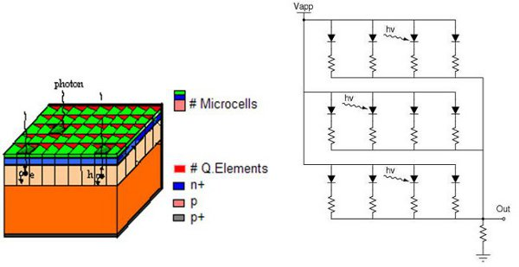
3D for SiPM
The Silicon Photomultiplier is a transformational technology in light detection
Array Geiger mode APDs - typically or’ed using an analog network but it is inherently digital
A fully digital SiPM could be built by bonding a 3D CMOS readout to a SiPM wafer
Low RC -> very fast
Active (fast) quenching
circuitry
Position resolution at the
subpixel level
Ability to turn off noisy pixels
Large fill factor

Slide 37
Digital SiPM Concept
conceptual view of digital 3D SiPM
top tier = SiPM wafer thinned to 6-10 μm
Front illumination
TSV
Bonding interface between tiers
(Deptuch)
bottom tier = ROIC wafer full
thickness ~700 μm

Slide 38
Large area SiPM tracking
A central problem with silicon diode-based detectors is the power needed for the front end electronics
(S/N)² ~ Q_{s}²(1/(4kTΔf) (g_{m}/C_{d}²)
Constant rise time - maintain ratio of g_{m}/C_{d}
Constant signal/noise maintain ratio Sqrt(g_{m})/C_{d}
Constant time resolution- maintain ratio t_{r}/(S/N) ~sqrt(g_{m}) - just depends on drain current
All of this adds mass
A device with intrinsic amplification would avoid all these problems.
But SiPMs – even 3D SiPMs are too noisy (unless cooled..)

Slide 39
3D 2-Tier SiPM Tracker
Ask for a coincidence between two thinned SiPM layers
  Use 3D integration to mate 2 SiPMs and require hit in top and bottom tier
  Response could be very fast - <100 ps since all capacitances are low
  Can be thinned to a few microns/layer (only need enough charge to initiate an avalanche)
  Subpixel hit resolution ~15 micron
TSV
Coarse SiPM Tier
Fine SiPM Tier
Coincidence and active quench

Slide 40

The 3D Commandments
1 | Thou shalt minimize mass | Device thinning technologies, SOI based sensors
2 | Thou shalt have high bandwidth | High interconnect density with TSVs
3 | Thou shalt be radiation hard | TSV availability in .130, .065 μm technology, Thinning technologies
4 | Thou shalt not dissipate power | Low interconnect capacitance
5 | Thou shalt have complex functionality | Tiers of optimized electronics
6 | Thou shalt maximize resolution (minimize pitch) | Very fine pitch copper and oxide bonding technologies
7 | Thou shalt minimize dead regions | TSV connectivity, active edge
8 | Thou not covet thy neighbors signals | Interconnect flexibility
9 | Thou must be affordable | ??? – where is industry going
10 | Thou shalt be fast | Reduced interconnect RLC, better cooling contact

Slide 41


Transformational Technologies
NA11 - ~ 1982
CMS ~ 2008

Slide 42

R&D Issues
TSV
  Availability of foundries for via first or middle
    Global Foundries, TSMC, IBM …
  Development of technologies for via
  middle or via-last
    Novati, Allvia, IPEDIA, LETI, RTI …
Interconnect
  Large scale DBI bonding availability
  Post processing of cu studs
Post-Process
  Yield of TSV reveal
  Other options for topside interconnect
Packaging of 3D modules
Industry direction – Current trends are to 2.5 D passive silicon interposer with TSV – with true 3D in niches
2.5D Stack

Slide 43
Summary
Fermilab does not have the fabrication infrastructure available at multipurpose labs
  This is an incentive for us to work closely with industry and utilize industrial innovation for HEP
Particle Physics is a small customer for the $300B semiconductor industry, but we have a role to play
  As first adopters of promising technologies
  As developers of new concepts which utilize emerging technologies
  As partners in innovation
To do this we must have the ability and will to take risks
It’s never as easy as it sounds
But it’s worth the effort…

Slide 44


The Road to 3D
a

Slide 45
2.5D Interposer

Slide 46


The Hype Cycle
a

Slide 47
K0-p0vv
Nothing in – nothing out
Large area finely pixelated tracker/calorimeter
Mass not so important
Speed is

Slide 48




3D Geometry
Chip designers:
Tom Zimmerman
Gregory Deptuch
Jim Hoff

