Slide 1

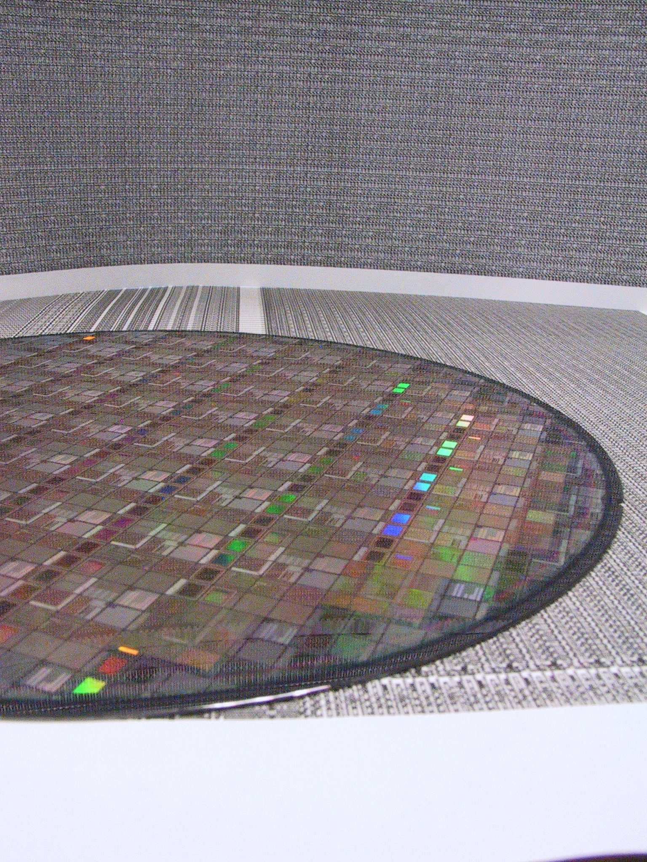
A Perspective on Manufacturing 2.5/3D
Bob Patti, CTO
rpatti@tezzaron.com

Slide 2
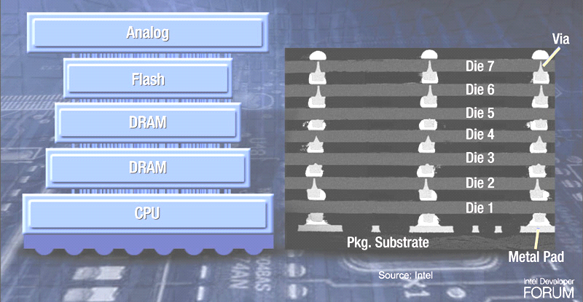

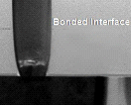
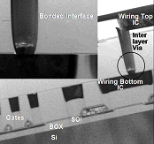
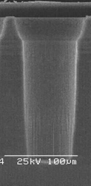

Span of 3D Integration
Rich and Varied Technologies
Packaging
Wafer Fab
Analog
Analog
Flash
Flash
Tezzaron
3D-ICs
100-1,000,000/sqmm
1000-10M Interconnects/device
DRAM
DRAM
DRAM
DRAM
CPU
CPU
CMOS 3D
3D Through Via Chip Stack
CMOS 3D
IBM/Samsung
IBM
1s/sqmm
Peripheral I/O
Flash, DRAM
CMOS Sensors
100,000,000s/sqmm
Transistor to Transistor
Ultimate goal

Slide 3
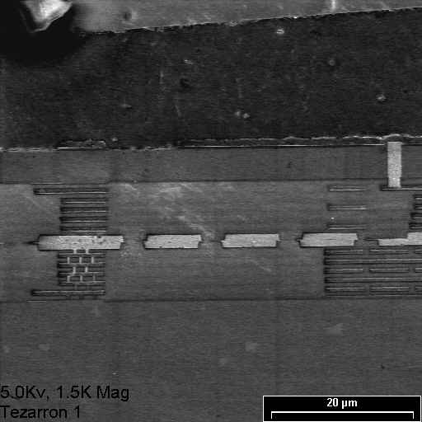
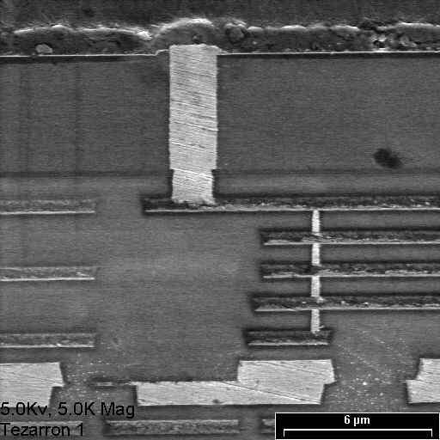
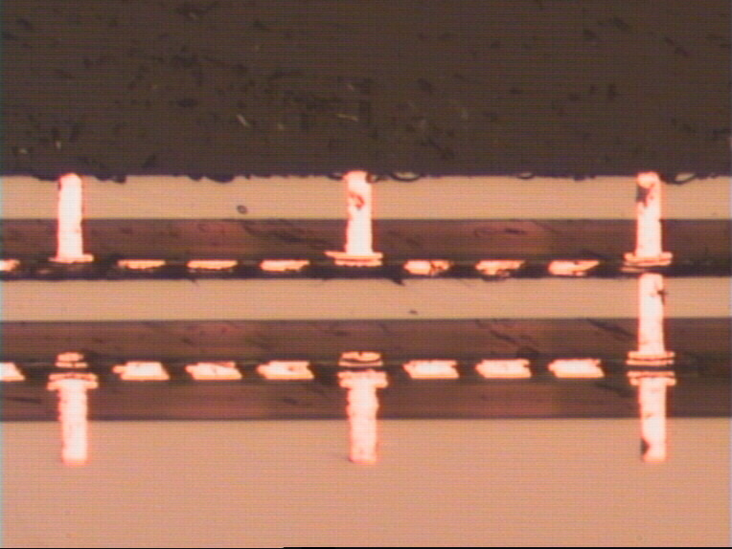
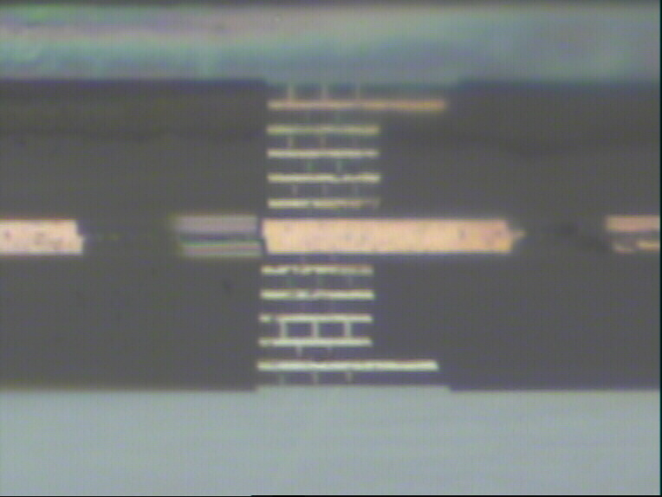
3rd Si thinned to 5.5um
2nd Si thinned to 5.5um
SiO₂
1st Si bottom supporting wafer

Slide 4
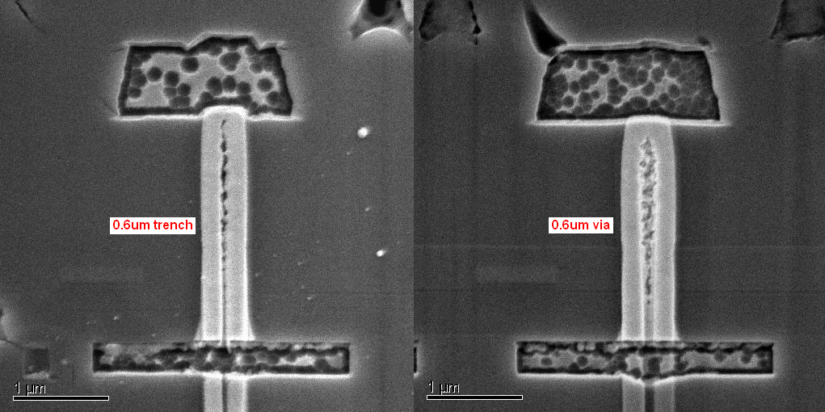
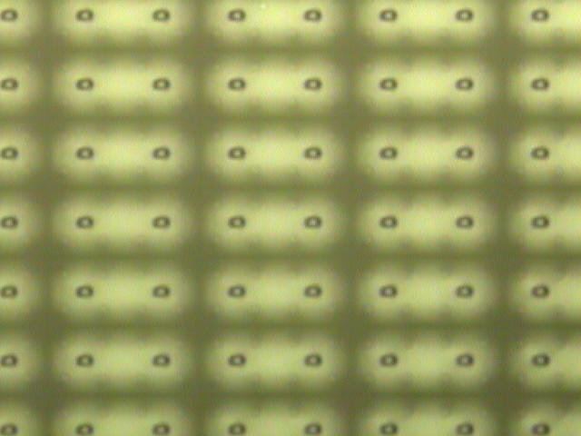
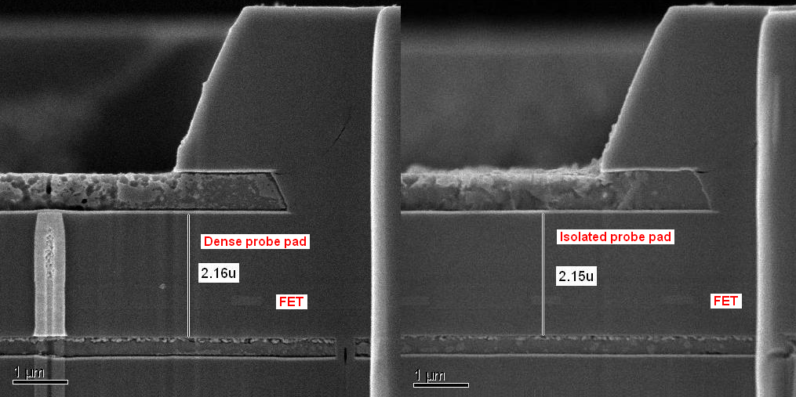
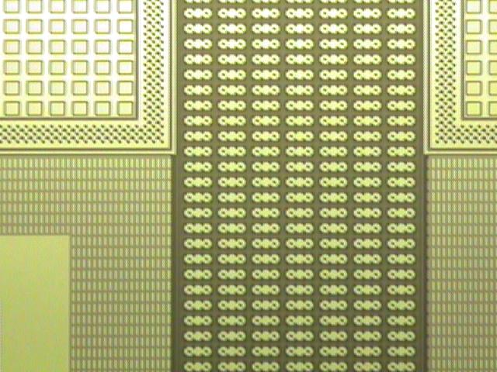
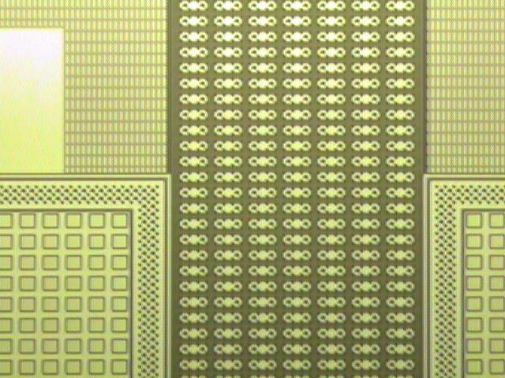
0.6um SOI TSV
120K TSVs

Slide 5
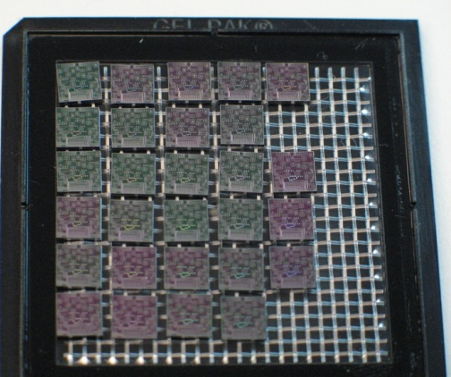
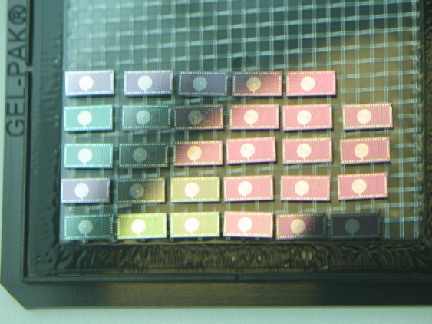
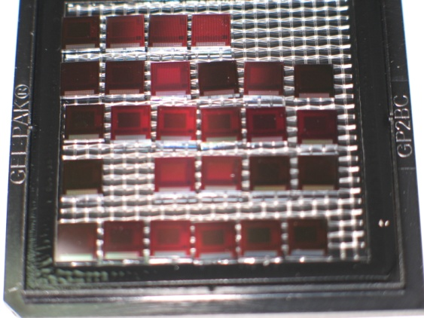
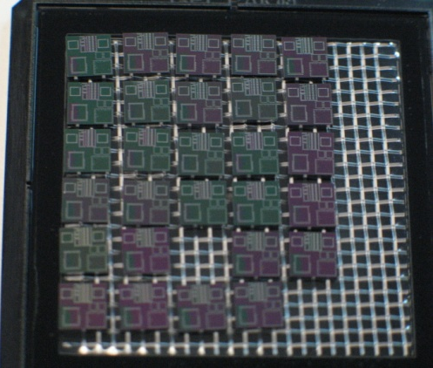
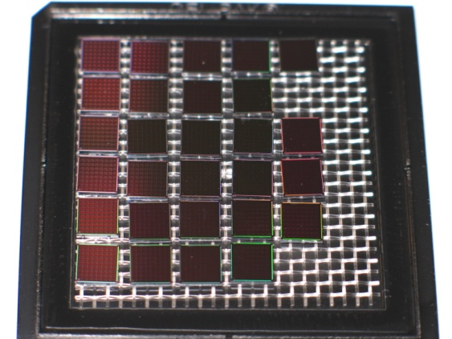
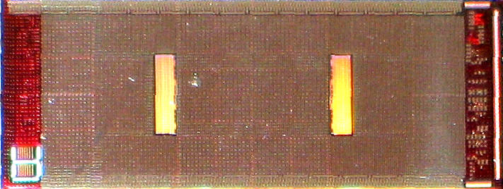
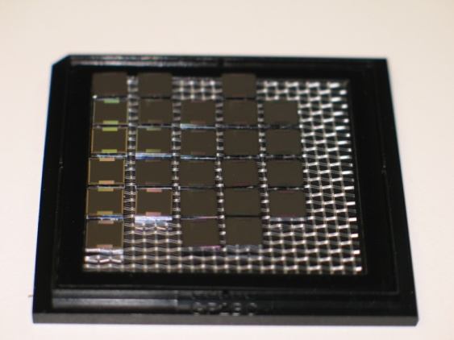
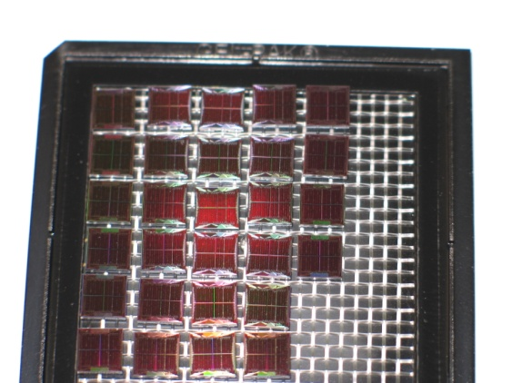
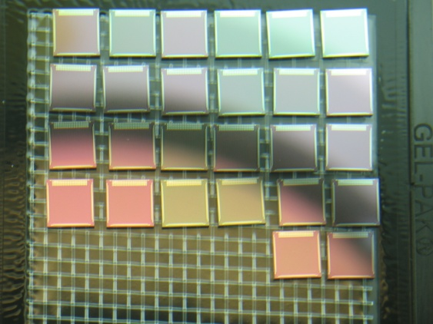
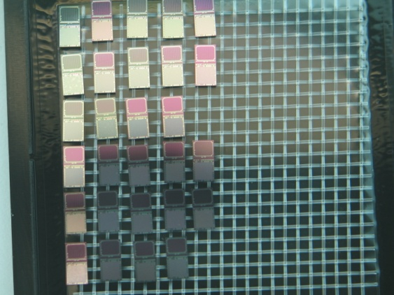
Tezzaron 3D Devices

Slide 6
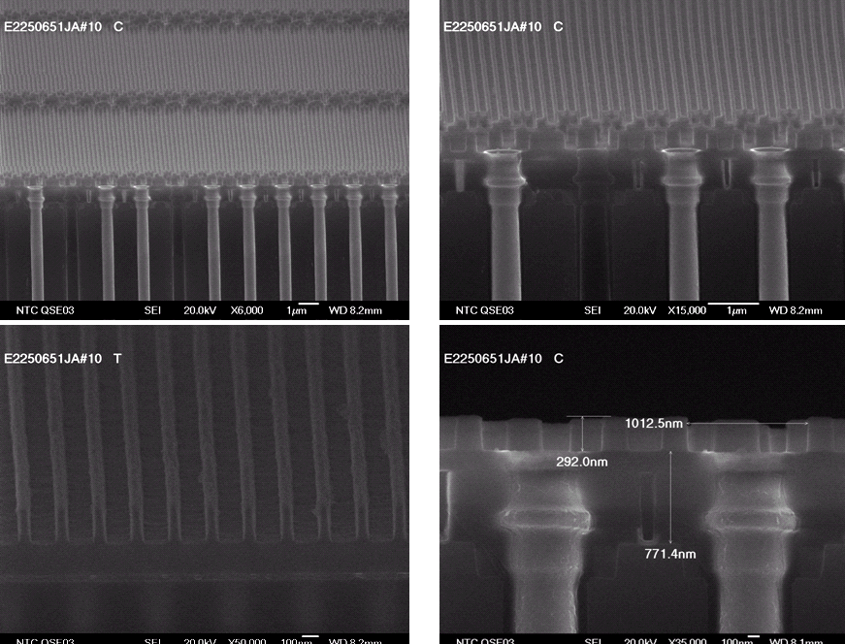
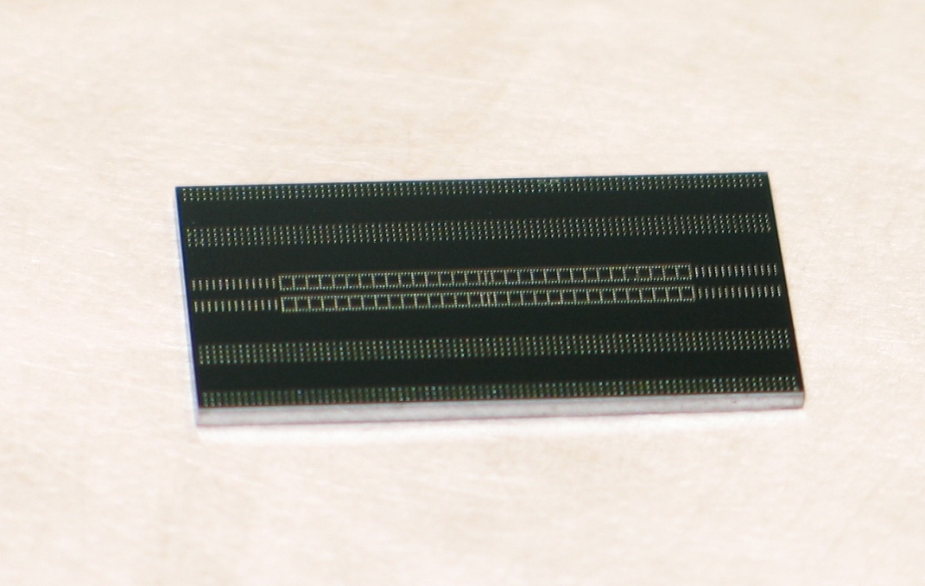
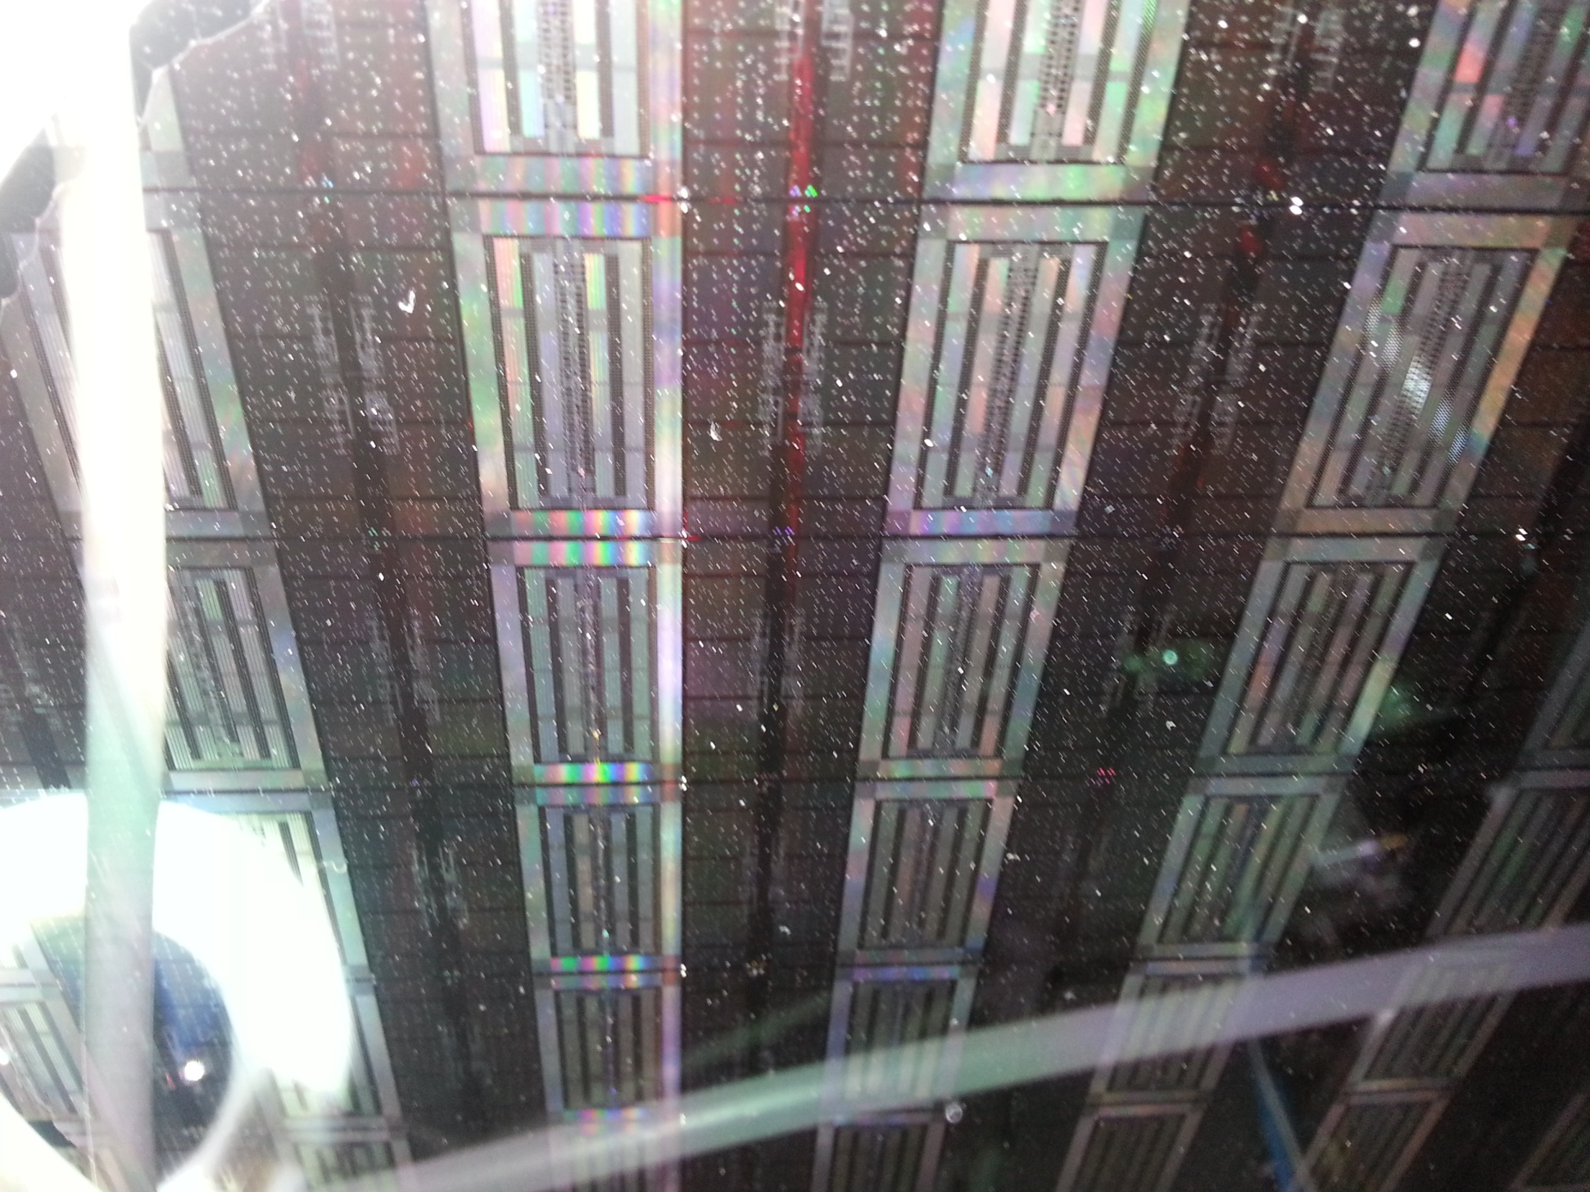
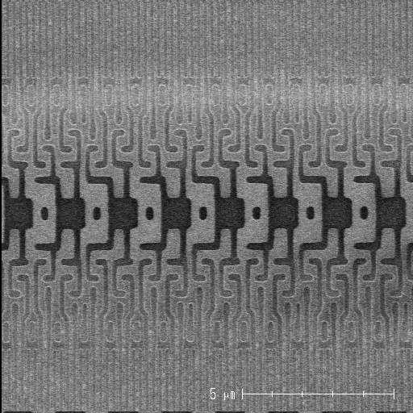
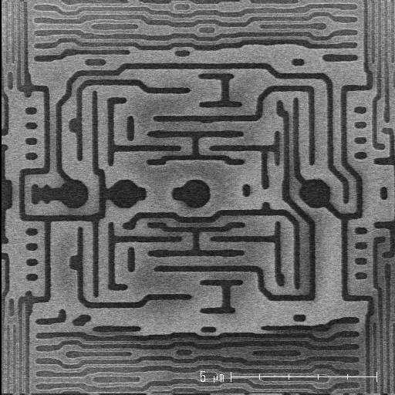
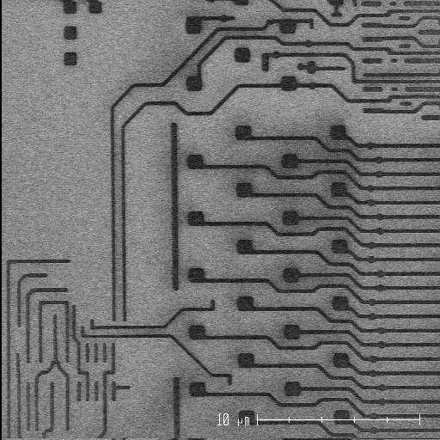
3D DRAMs
Octopus I
1-4Gb
16 Ports x 128bits (each way)
@1GHz
  CWL=0 CRL=2 SDR format
  5ns closed page access to first data (aligned)
  12ns full cycle memory time
  >2Tb/s data transfer rate
Max clk=1.6GHz
Internally ECC protected, Dynamic self-repair, Post attach repair
115C die full function operating temperature
Octopus II
4-64Gb
64-256 Ports x 64bits (each way)
@1GHz
  5-7ns closed page access to first data (aligned)
  12ns full cycle memory time
  >16Tb/s data transfer rate
  4096 banks
  2+2pJ/bit

Slide 7
Gen4 “Dis-Integrated” 3D Memory
DRAM layers
4xnm node
2 million vertical connections per lay per die
Controller layer contains: senseamps, CAMs, row/column decodes and test engines. 40nm node
I/O layer contains: I/O, interface logic and R&R control CPU. 65nm node
Better yielding than 2D equivalent!

Slide 8
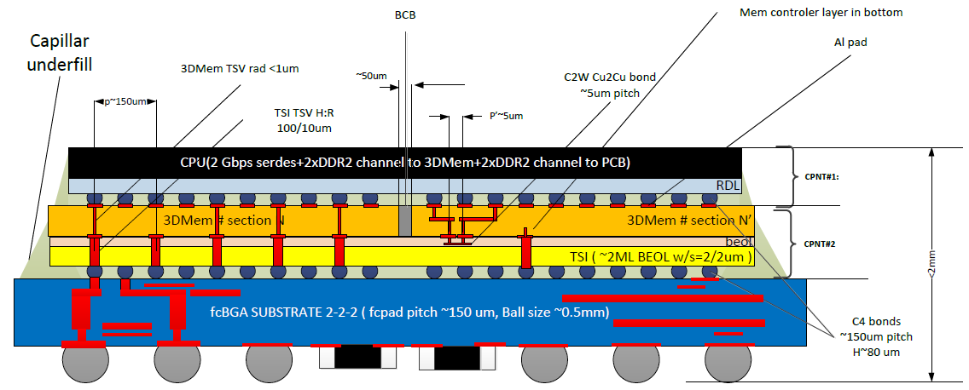
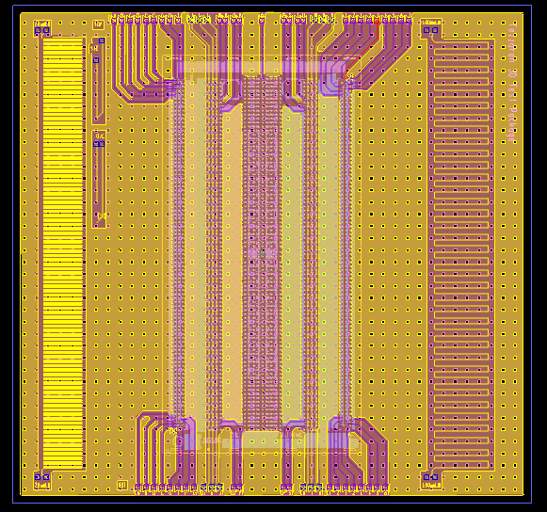
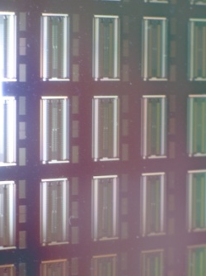
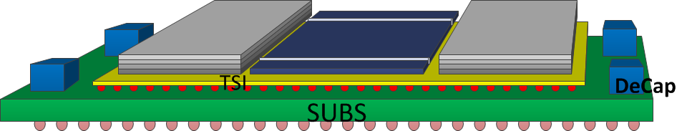
2.5/3D in Combination
IME A-Star / Tezzaron Collaboration
IME A-Star / Tezzaron Collaboration

Slide 9
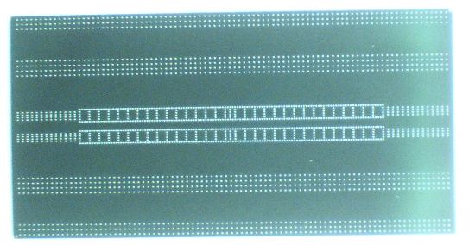
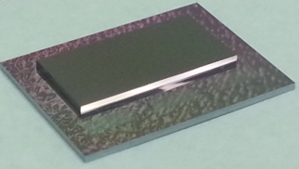
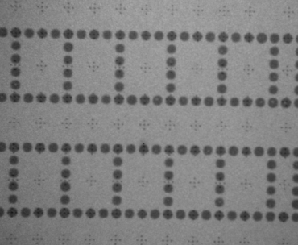
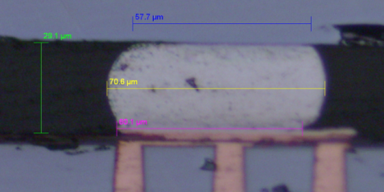
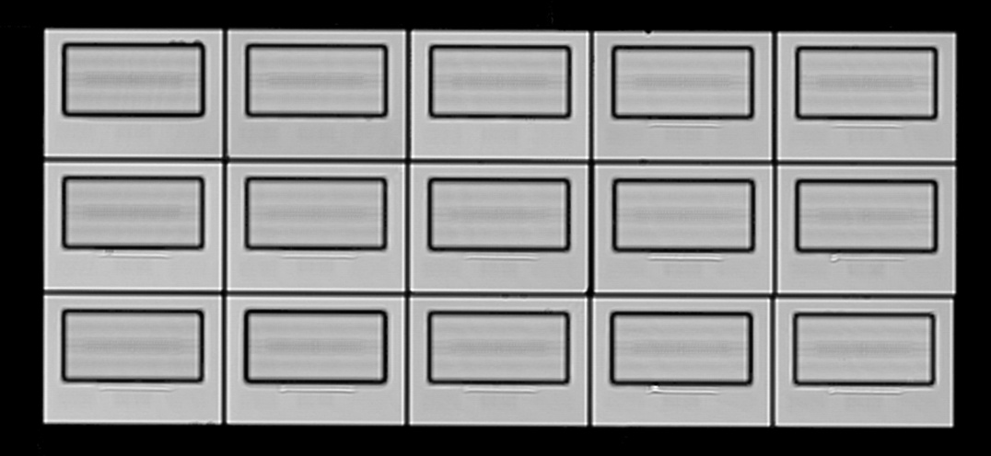
Tezzaron Dummy Chip C2C Assembly
Memory die
C2C sample
X-section of good micro bump
CSCAN showed no underfill voids (UF: Namics 8443-14)
X-ray inspection indicated no significant solder voids

Slide 10
What is Important?

Slide 11
TSV Pitch ≠ Area ÷ Number of TSVs
TSV pitch issue example
  1024 bit busses require a lot of space with larger TSVs
  They connect to the heart and most dense area of processing elements
  The 45nm bus pitch is ~100nm; TSV pitch is >100x greater
  The big TSV pitch means TOF errors and at least 3 repeater stages
1024 bit bus
Single layer interconnect
10um TSV
20um Pitch
1um TSV
2um Pitch
FPU

Slide 12
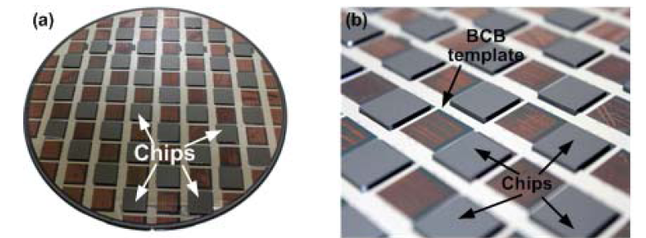
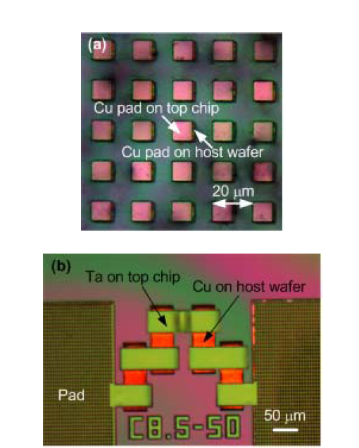
Die to Wafer – 2.5D
RPI/Dr. James Lu
KGD
Multilayer capability
Incremental risk buy down
Extends SOC concepts

Slide 13

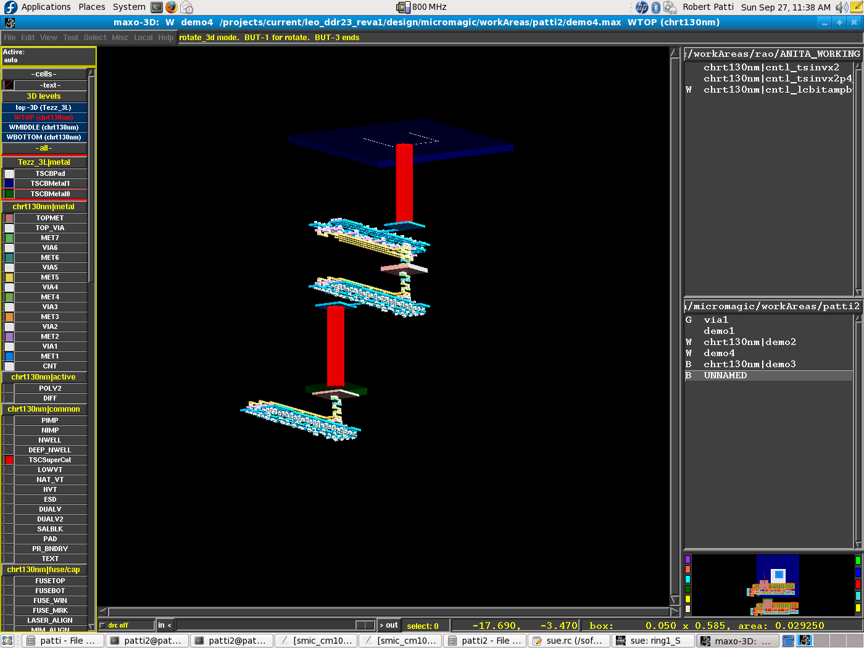
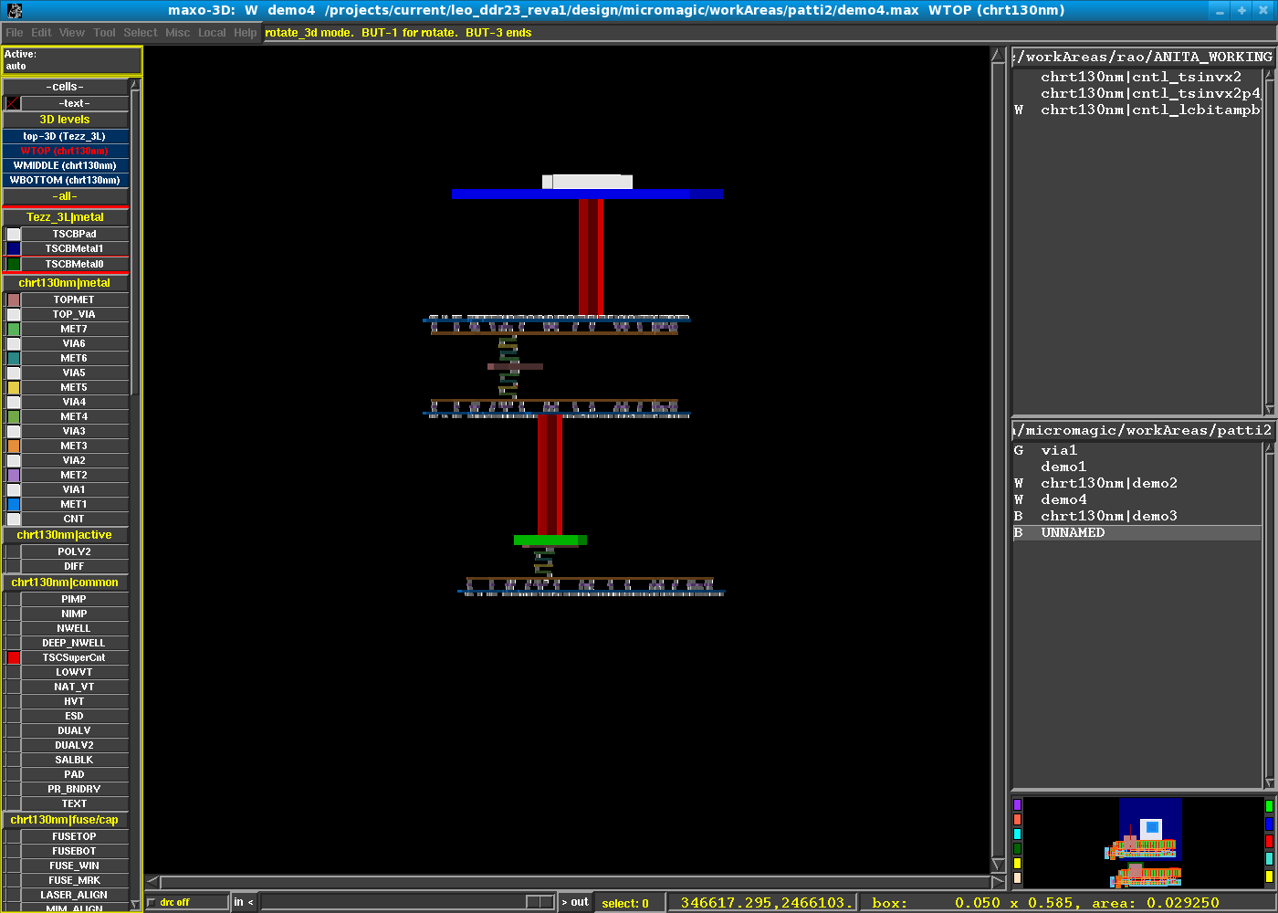
Tools
MAX-3D by Micro Magic, Inc.
Fully functional 3D layout editor.
Mentor and Tezzaron Optimize Calibre 3DSTACK for 2.5/3D-ICs
Independent tech files for each tier.
Saves GDSII
as flipped or rotated.
Custom output streams for 3D DRC / LVS.
DRC, LVS, Transistor synthesis, Crossprobing.
Multiple tapeouts, 0.35um-45nm
>20GB, ~10B devices

Slide 14
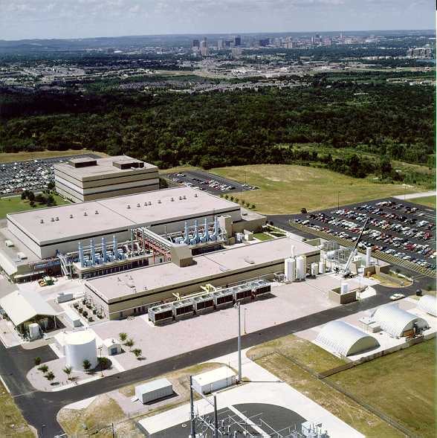
Tezzaron/Novati 2.5/3D Technologies
“Volume” 2.5D and 3D Manufacturing
Interposers
  High K Caps
  Photonics
  Passives
  Power transistors
Development of More than Moore Technologies
  microfluidics
  integrated sensors
  image enhancement technologies
Cu-Cu, DBI®, Oxide, IM 3D assembly

Slide 15

Facility Overview
Capabilities
Over 150 production grade tools
68000 sq ft Class 10 clean room
24/7 operations & maintenance
Manufacturing Execution Systems (MES)
IP secure environments, robust quality systems
ITAR registered
Full-flow 200mm silicon processing, 300mm back-end (Copper/Low-k)
Process library with > 25000 recipes
Novel materials (ALD, PZT, III-V, CNT, etc)
Copper & Aluminum BEOL
Contact through 193nm lithography
Silicon, SOI and Transparent MEMS substrates
Electrical Characterization and Bench Test Lab
Onsite analytical tools and labs: SIMS, SEM, TEM, Auger, VPD, ICP-MS, etc
ISO 9001:2008 13485:2013
TRUST 2013

Slide 16
The Road Ahead…

Slide 17



Near End-of-Line TSV Insertion
M8
TM
M7
M6
2x,4x,8x Wiring level
~.2/.2um S/W
M5
M5
M4
M4
M3
W
M2
SIN
M1
poly
STI
TSV is 1.2µ
Wide and ~10µ deep
5.6µ

Slide 18
3082901CMP1 - Edge

Slide 19
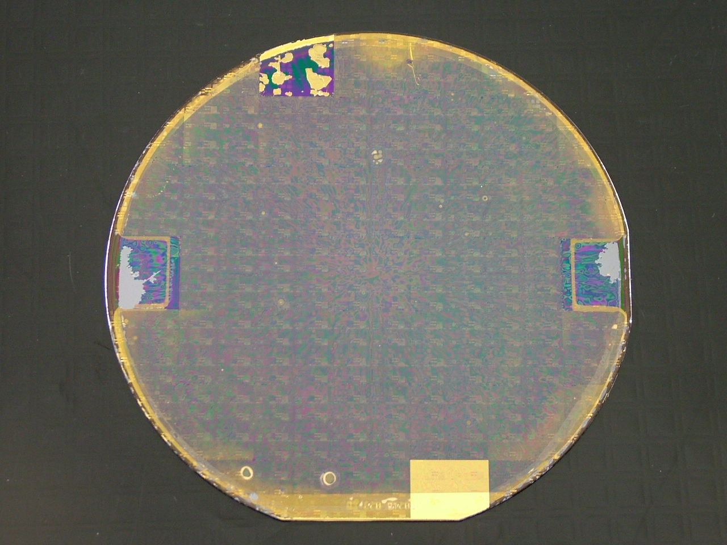
100mm InP/CMOS

Slide 20
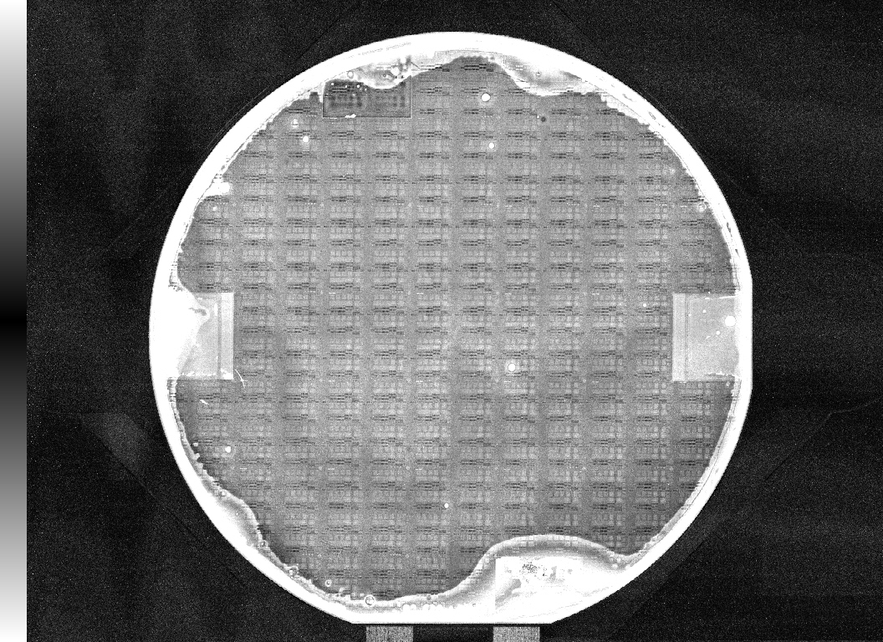

Slide 21
Embedded Die to Wafer with Wafer Cap

Slide 22
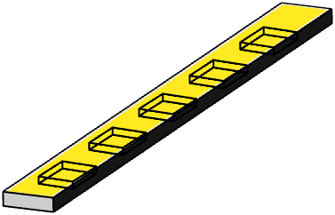
Dummy strip with pad cuts and Al bond pads
Sensor
Analog
Digital
TSV Sensor Driver Strip
Host Wafer / Motherboard

Slide 23
DBI Die to Wafer Attach

Slide 24
Die to Wafer in Process

Slide 25
Die Placement Finished

Slide 26
DBI Add TSV Silicon Strips for Receiving Sensor Driver Connections

Slide 27
DBI Add Dummy Silicon Strips with TSVs at pads for Wire Bonding and to Prevent Thinning Process Rounding Off Die Edges

Slide 28
Thin Die and Dummy Strips to Analog TSVs and then Backside Process Analog Layer and Sensor Driver Connection Strips

Slide 29
Populate Sensor Die using Microbump or DBI

Slide 30
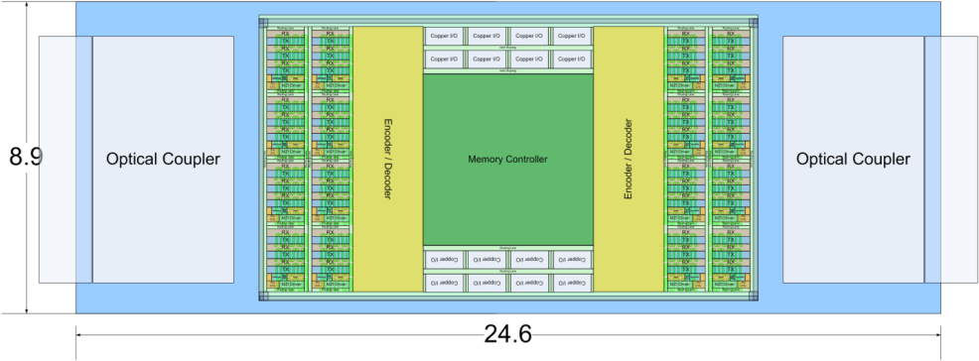
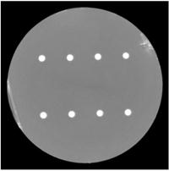
Photonics for Short Haul
14nm FF Chip
16x100G Optical Transceivers
  8 Optical I/O per Couplers
Four optical power supplies
Photonic Interposer with TSVs

Slide 31
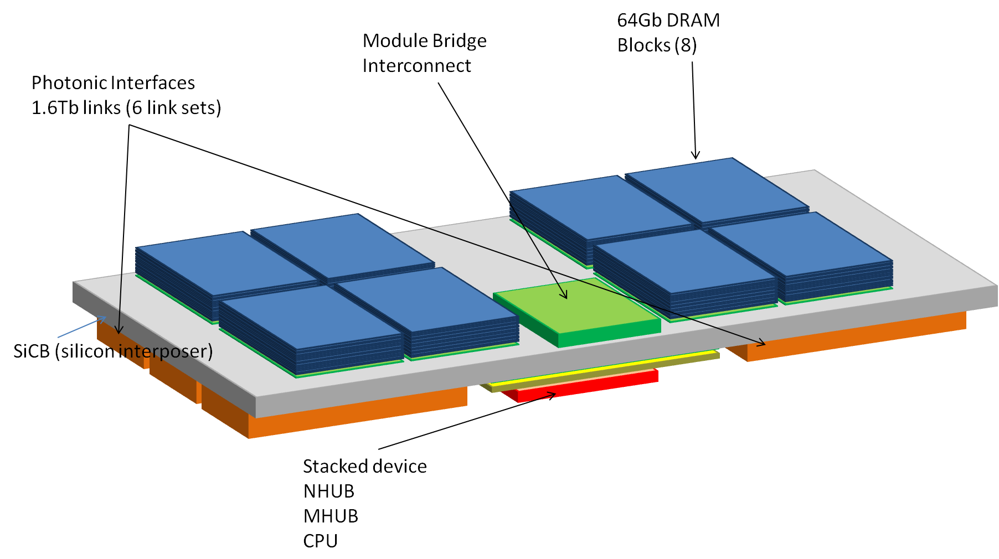
Double Sided Silicon Interposer

Slide 32

Integrating Fluidics into 3D:
Liquid Cooling
It’s a MEMS, 2.5D SOC/SIP future…
Notes:
Of course as these 3D assemblies become more dense with more layers, ultimately power dissipation becomes a critical issue. A 2 phase liquid cooling solution is being prototyped already. The design goal is to remove up to 400 watts of heat per cooling block layer. With this option, large server processor and memory stack combinations are possible.

Slide 33



“5.5D” Systems
SIP/SSIP
  Power Conversion
  Cooling
  Photonics
Optimization
  Extending to power
Mixed PCB/IC Metaphor

Slide 34

Summary
Industry has the momentum
  Generating tools and technology
  Problems are now deemed solvable
3D is proving value
  There is production and it is expanding
CMOS to MEMS
CMOS to sensors
Sensors
Computing
MEMS
Communications

