Slide 1




Surface Commissioning of the DMTPC 4-Shooter Directional Dark Matter Detector
Shawn Henderson
on behalf of the
DMTPC Collaboration
February 19, 2013
Research Techniques Seminar

Slide 2
Surface Commissioning of the DMTPC 4-Shooter Directional Dark Matter Detector
Shawn Henderson
on behalf of the
DMTPC Collaboration
February 19, 2013
Research Techniques Seminar

Slide 3
Surface Commissioning of the DMTPC 4-Shooter Directional Dark Matter Detector
Outline
Introduction
Directional Sensitivity Measurements
Future plans
Directional detection
The DMTPC collaboration
The 4-shooter detector
High gain ²⁵²Cf neutron study
Low gain & pressure AmBe neutron study
Directionality with alpha tails
Future WIPP deployment

Slide 4
Surface Commissioning of the DMTPC 4-Shooter Directional Dark Matter Detector
Outline
Introduction
  Directional detection
  The DMTPC collaboration
  The 4-shooter detector
Directional Sensitivity Measurements
Future plans

Slide 5
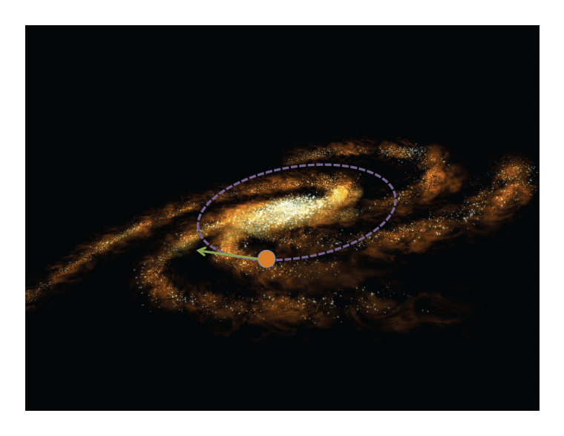
The WIMP wind
Solar motion results in an
apparent dark matter wind

Slide 6
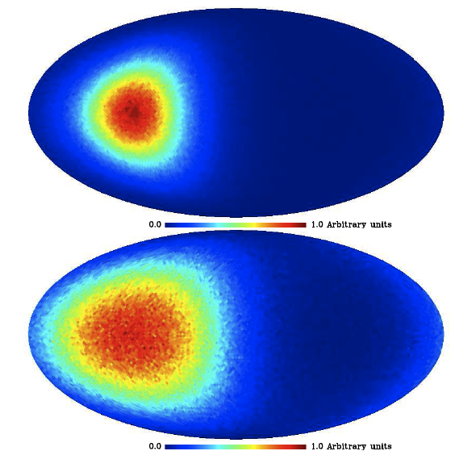
WIMP direction is imprinted on nuclear recoil
direction
Billard, J. et al., 2010, Phys. Lett. B, 691, 156-162
WIMP flux in the case of an isothermal spherical halo
Cygnus
WIMP-induced recoil distribution
¹⁹F target
100 GeV/c² WIMP
5 keV<E_{R}<50 keV
Cygnus
The Case for a Dark Matter Detector and the Status of Current Experimental Efforts,
Ahlen, S. et al., Int. J. Mod. Phys. A. 25, 1, 2010

Slide 7
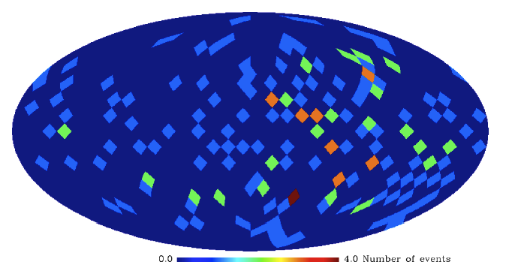
Hierarchy of directional sensitivity
CF4 gas mass density is
3.72 g/l
At 1/10 of atm,
0.372 g/l
Si mass density is
2.3290 g·cm⁻³
stretch goal
Numbers assume a 100 GeV mass WIMP and a 20 keVr nuclear recoil detection threshold.
A. Green and B. Morgan,
Astropart. Phys. 27: 142-149, 2007
full 3D vector
1/12
axial 3D vector
Detection
possible even with
nonzero background
sensitivity
Goal: do this as well as we can
full 2D vector
“Head-Tail”
1/2
sensitivity
axial 2D
vector
1/30
sensitivity
Billard, J. et al., 2010, Phys. Lett. B, 691, 156-162

Slide 8
The DMTPC Collaboration
http://dmtpc.mit.edu
H. Choi, C. Deaconu, P. Fisher (PI), S. Henderson, W. Koch, J.P. Lopez, H. Tomita
Massachusetts Institute of Technology
A. Dushkin, H. Wellenstein (PI)
Brandeis University
R. Eggleston, P. Giampa, J. Monroe (PI),
G. Muraru
University of London Royal Holloway
I. Jaegle, S. Ross, S. Vahsen (PI)
University of Hawaii
J. Battat (PI), V. Gregoric, K. Hartung,
K. Recine, E. de Souza
Bryn Mawr College
Papers:
Dujmic et al. NIMA 584 (2007)
Kaboth et al. NIMA 592 (2008)
Dujmic et al.
Astropart.Phys.30:58-64 (2008)
Caldwell et al.
arXiv:0905.2549 (2008)
Roccaro et al. NIMA 608 (2009)
Ahlen et al. IEEE Trans. Nucl. Sci. (2009)
Ahlen et al., Phys.Lett. B695 (2011)
J. Lopez et al. NIM A 696 (2012)
undergraduate graduate student post-doc professor

Slide 9
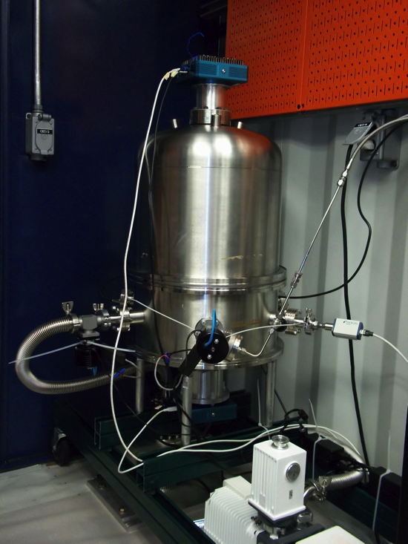
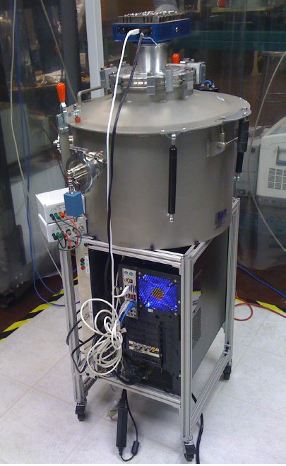
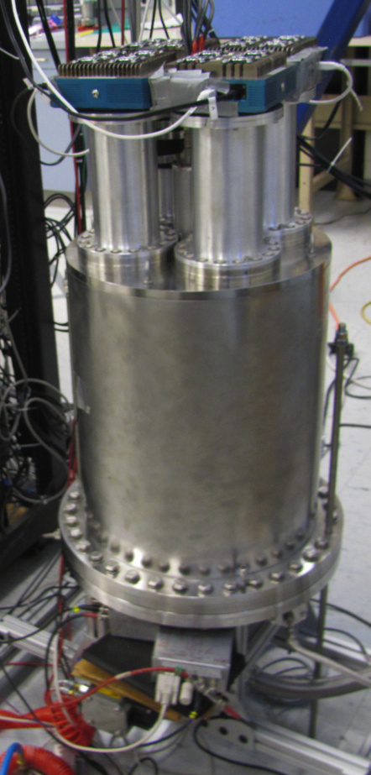
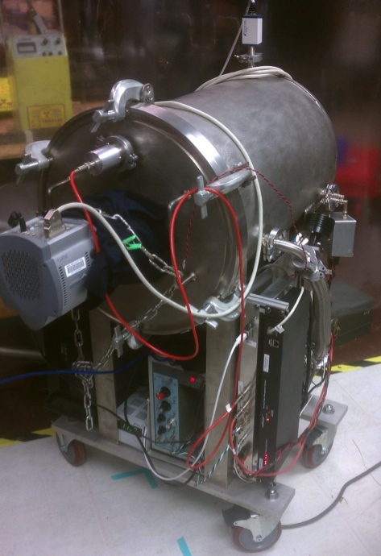
arXiv:1108.4894
T
The “10L”
2x 5L TPCs, CF4
Underground @ WIPP taking data
The “4-Shooter”
18L TPC
4x CCD
Sea-level @ MIT
taking initial suite
of calibration
data
Raytheon
50L TPC, pure CF₄ and He+CF₄ mix
@ MIT; focused on neutron detection
50 cm drift length
R&D Vessel/DCTPC
6L TPC, He+CF₄ mix
@ Double Chooz
measuring
cosmogenic
neutrons
S. Ahlen et al., Phys. Lett. B695
(2011) 124-129
DMTPC
Dark Matter Time Projection Chamber

Slide 10

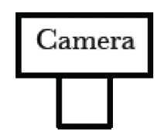

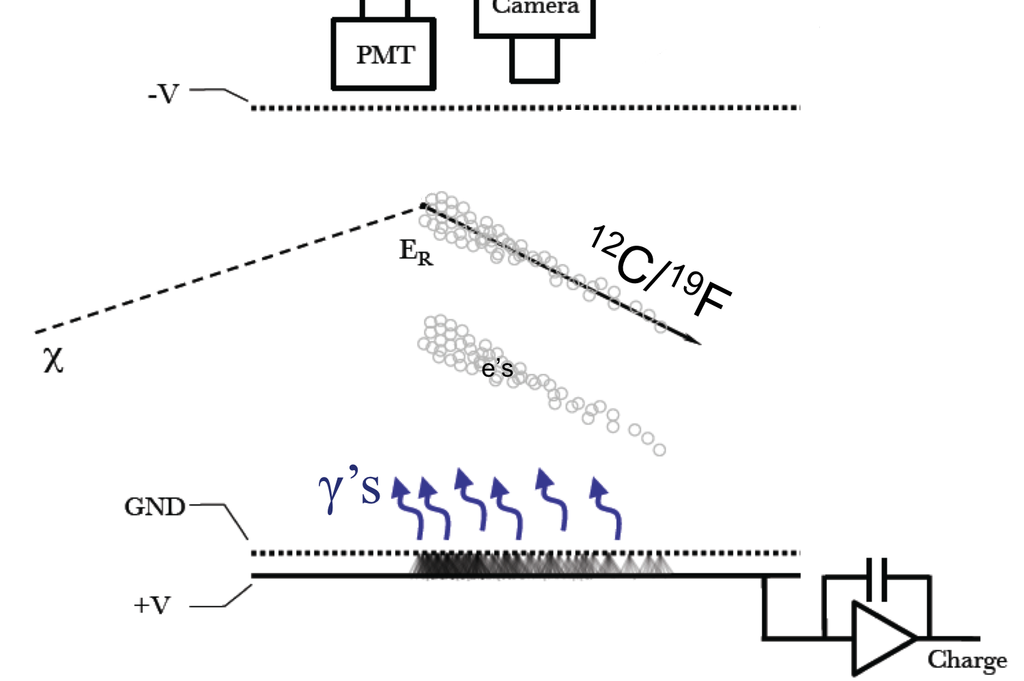

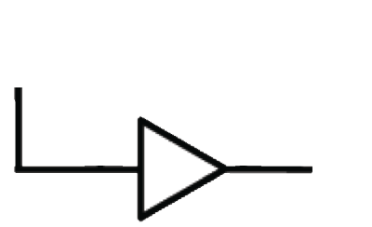
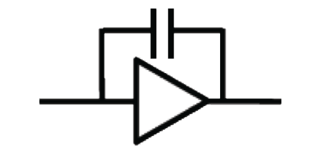

4x
x4
3x
3x
Sensors
outside
of active
volume
CF₄
@ 75 Torr
GND
Mesh
Anode
Veto

Slide 11
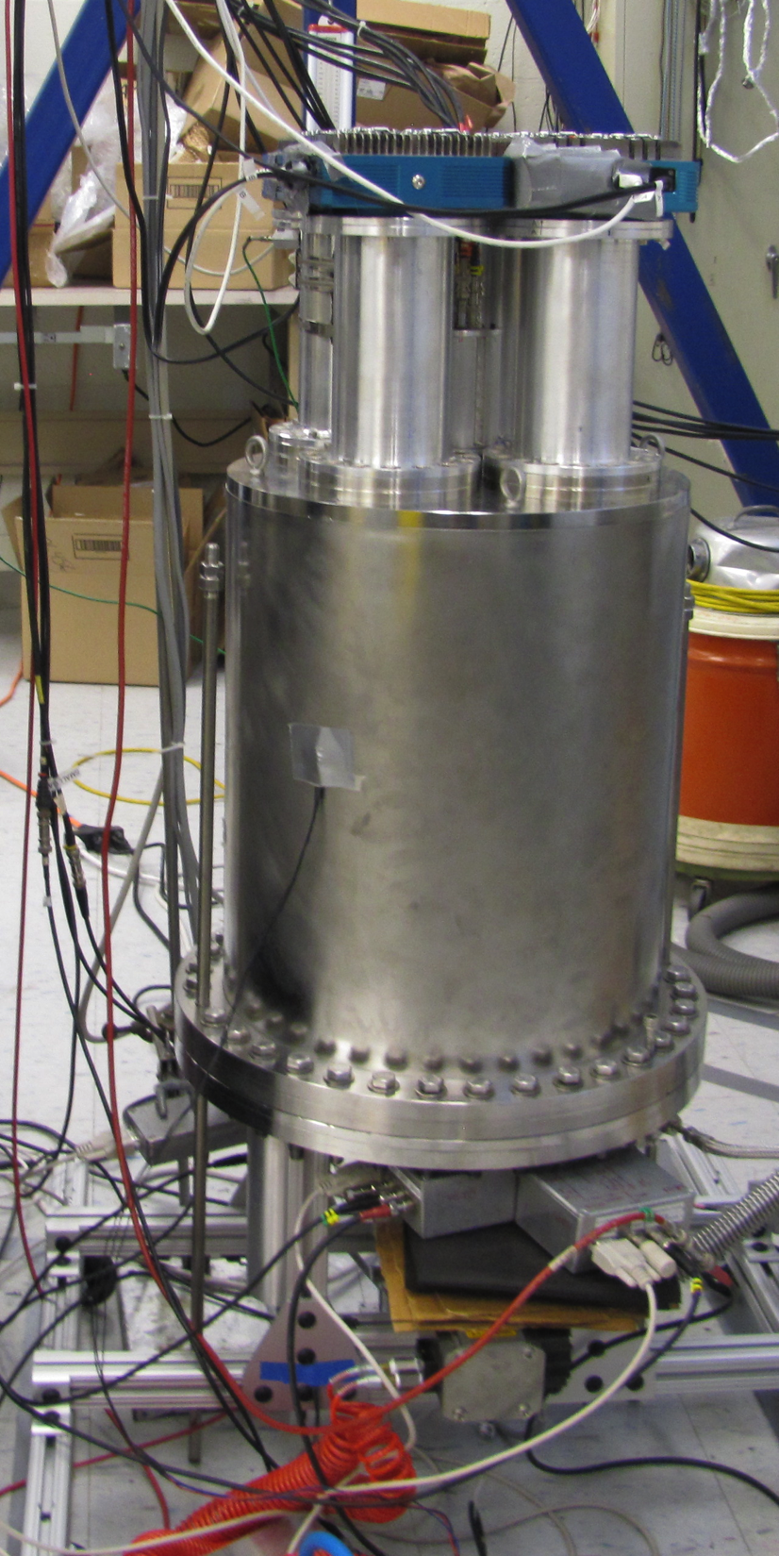
The “4-Shooter”
45-75 Torr CF₄
18L, 6.6 gm
-5 kV drift
650V-720V anode
Spin-dependent
WIMP Search on ¹⁹F
large spin-dependent-p
coupling
4x CCDs
PMTs
TPC

Slide 12
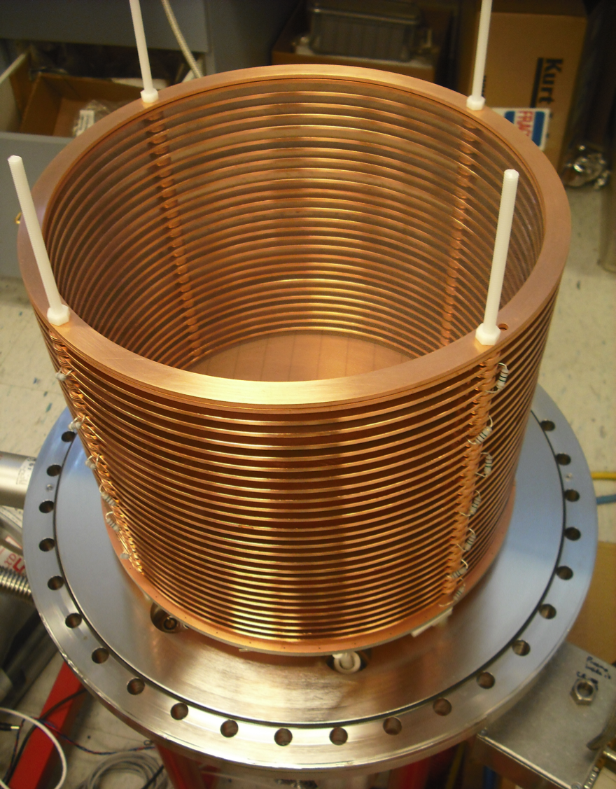
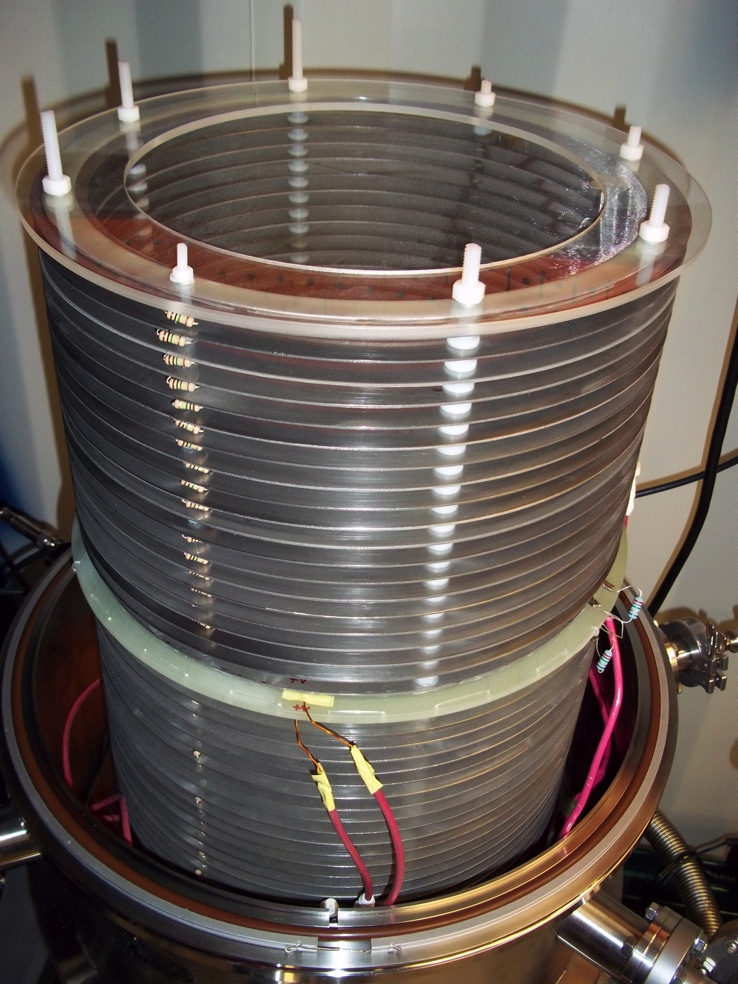
Careful cleaning and materials selection
29 cm
Minimal materials – much lower backgrounds
Environmental α rate 19x smaller

Slide 13
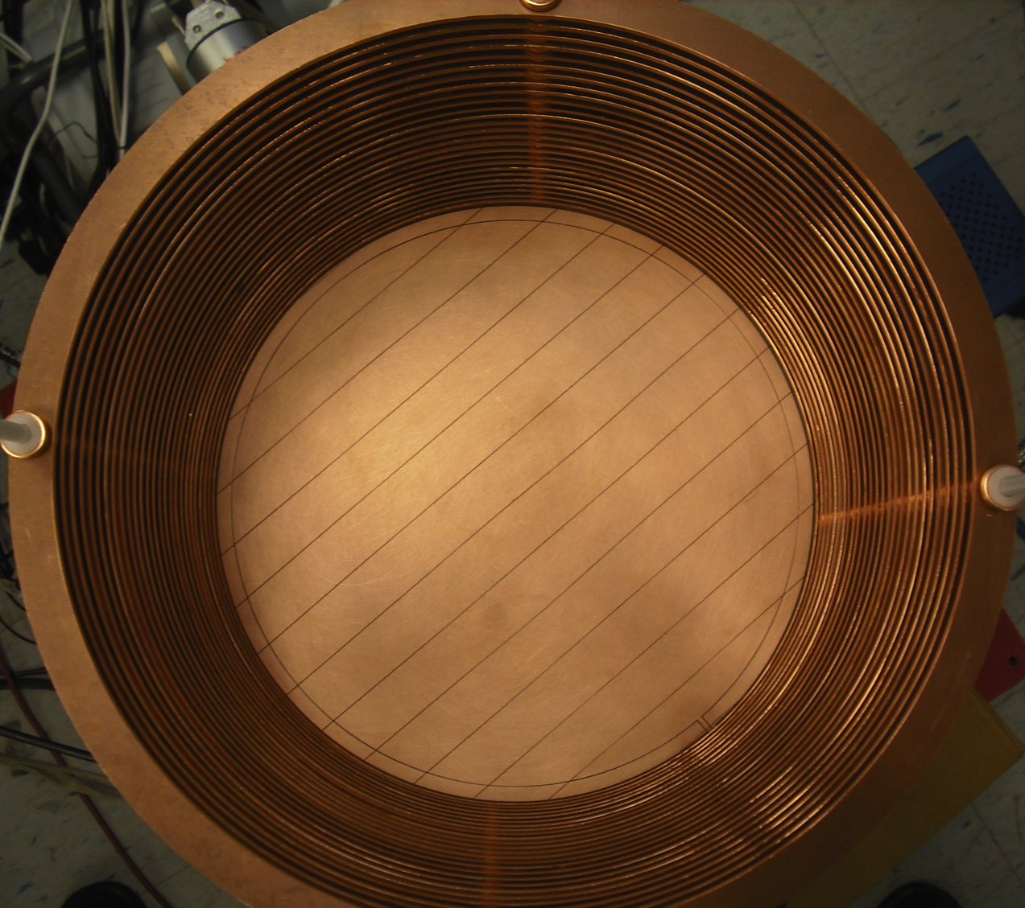
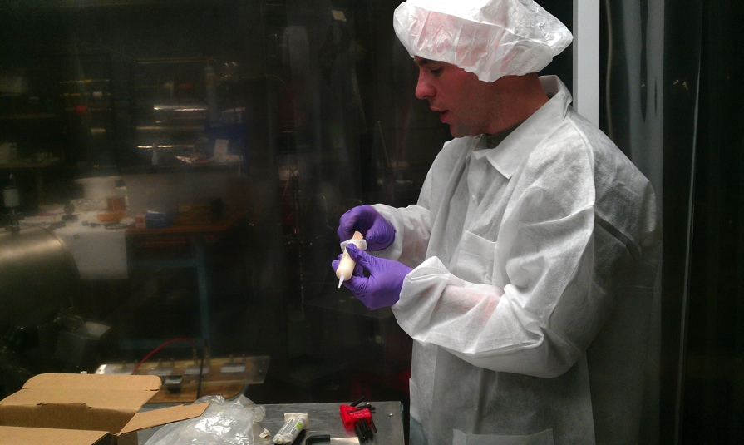
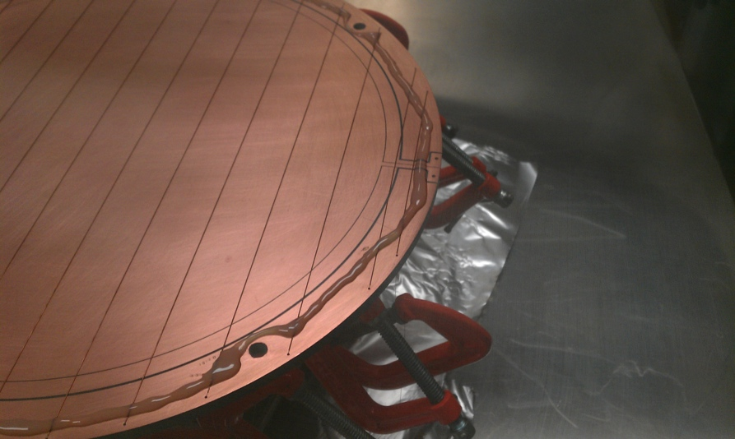
γ
e⁻
Amplification Stage
Home-brew
Small # of materials
Assembled in cleanroom
SS Mesh
430 μm
Cu
G-10
1”
not to scale
fused silica spacers
Cathode mesh 80% transparent
29.2 cm

Slide 14
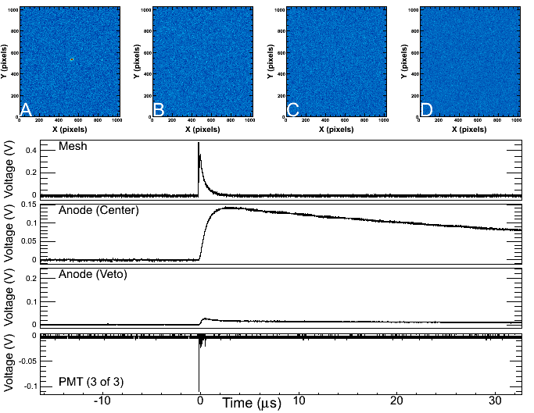
Alazar ATS860 - 8 Bit, 250 MS/s PCI Digitizer

Slide 15
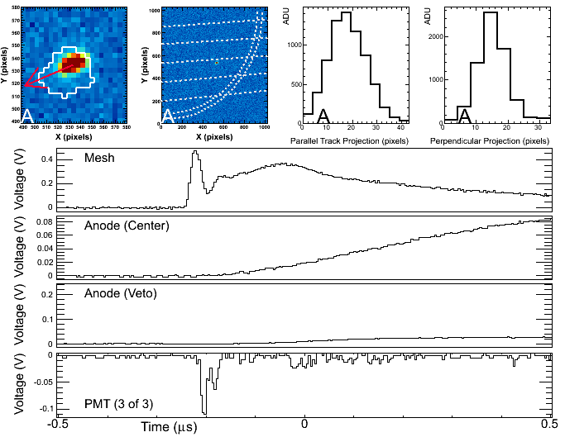

Slide 16
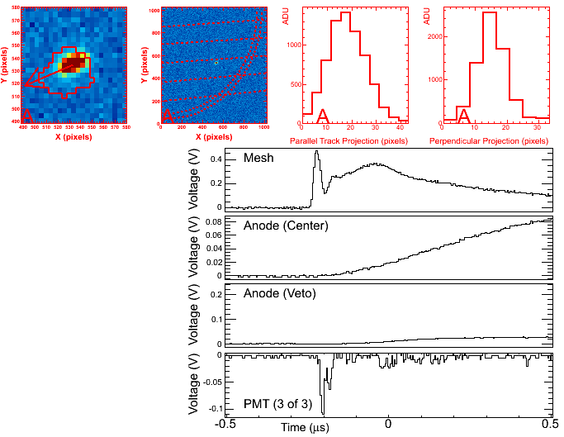
CCD
CCD
PMT

Slide 17
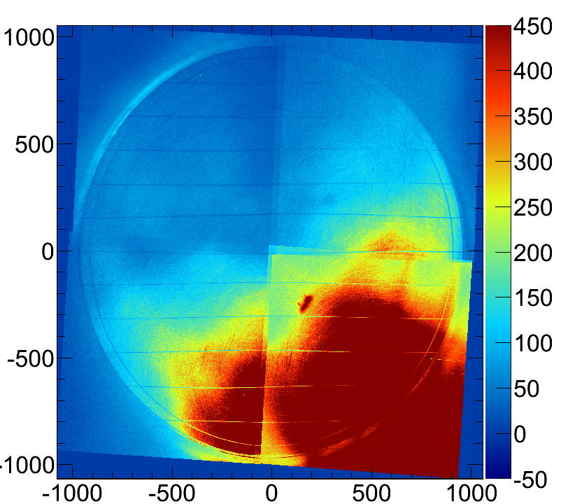
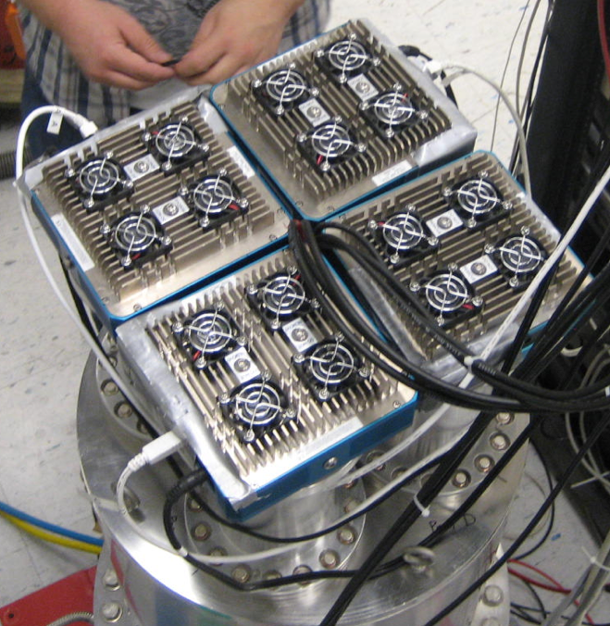
CCD Readout
Alta U6 CCDs
1024x1024, 24μm pixels
1”x1”, 1.05 Mpixel chip
Binned 4x4 in hardware
Shutter-less operation
Canon telephoto lenses
FD 85mm f/1.2
LED
Must stitch 4 camera images
into 1 composite image

Slide 18
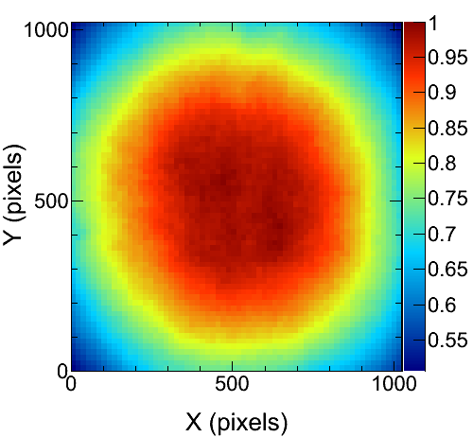
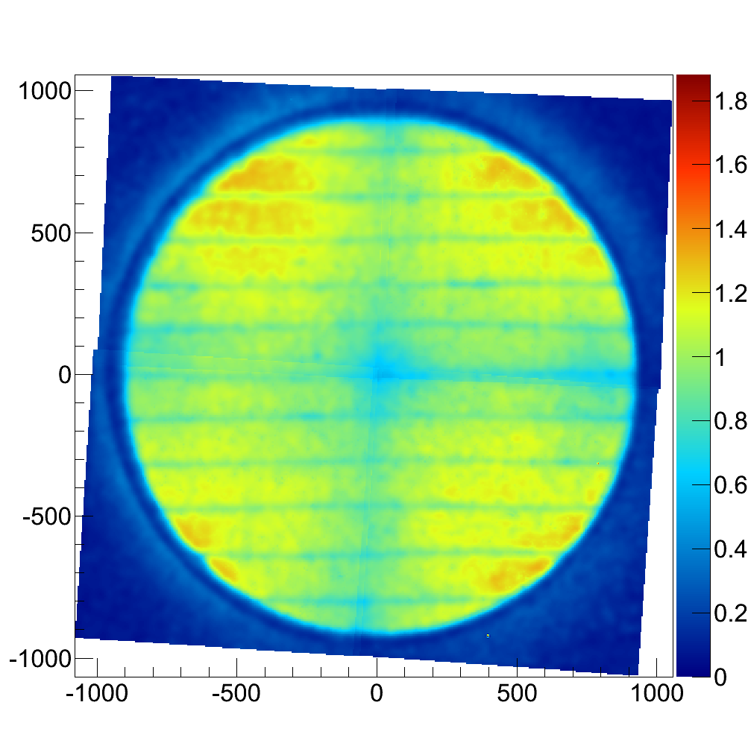
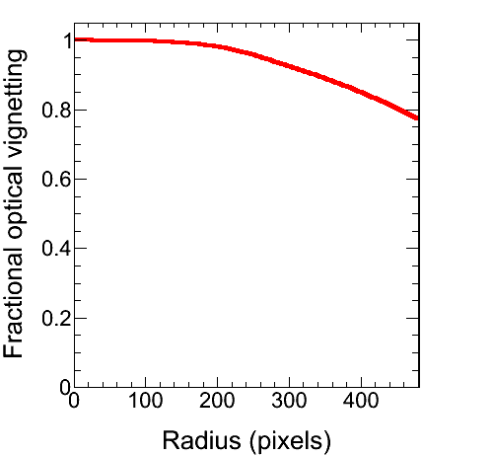
CCD Spatial Gain Correction
122 keV γ’s
λ=4.2 m
⁵⁷Co
CCD optical flat field
showing radial fall-off
CCD gain(X,Y) measured using a ⁵⁷Co γ
source to generate spatially uniform signal

Slide 19
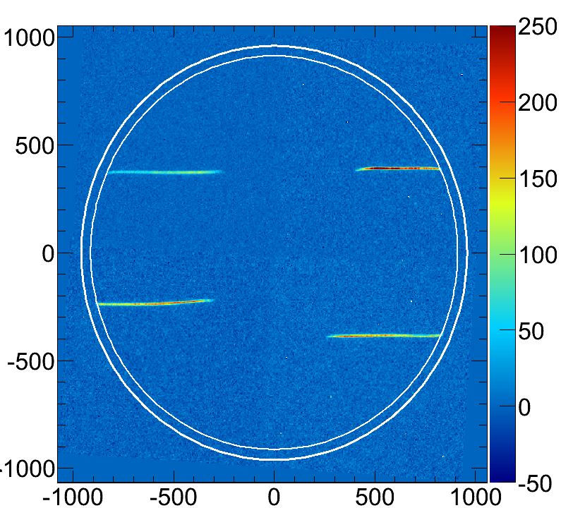
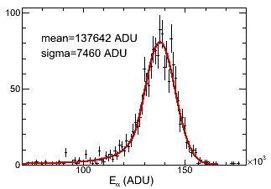
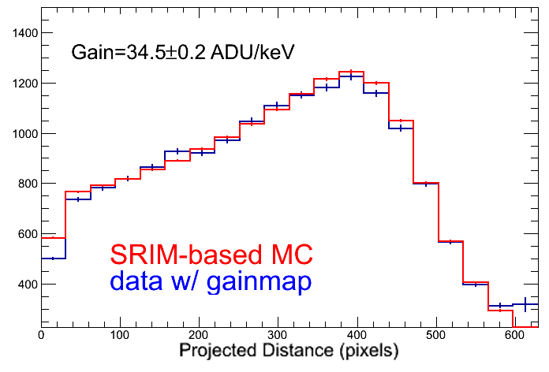
CCD Energy Calibration
CCD B
σ_{E}=5.4%
3.8 MeVα
Crystal ball fit to 1 CCD’s
²⁴¹Am α energy spectrum
CCD D
α direction
ADU
Projected distance from start of track (mm)
²⁴¹Am α source calibration; α’s in all 4 cameras
²⁴¹Am α energy vs range
data-MC agreement

Slide 20
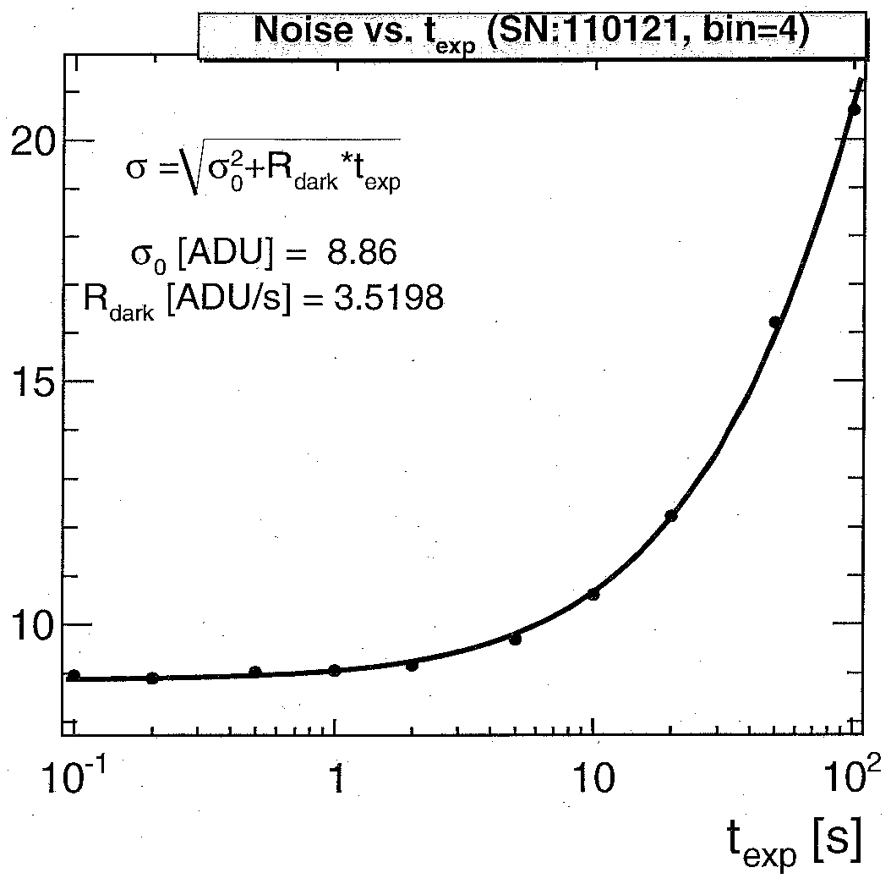
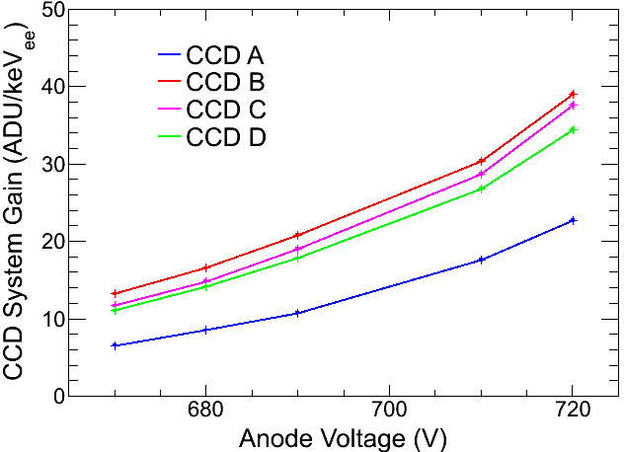
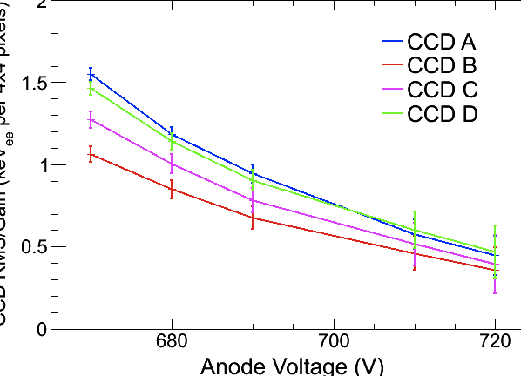
CCD System Gain
CCD System Noise (ADU)
operating
point
CCD RMS noise VS exposure
CCD gain from ²⁴¹Am α
calibrations at 720V on the anode is
23, 34, 38 & 39 ADU/keV
Read noise for 1 sec exposures
binned 4x4 in hardware is
9, 11, 12 & 13 ADU
Noise equivalent energy (keV_{ee}/bin)
CCD noise/gain, a rough
estimate of N/S in energy

Slide 21
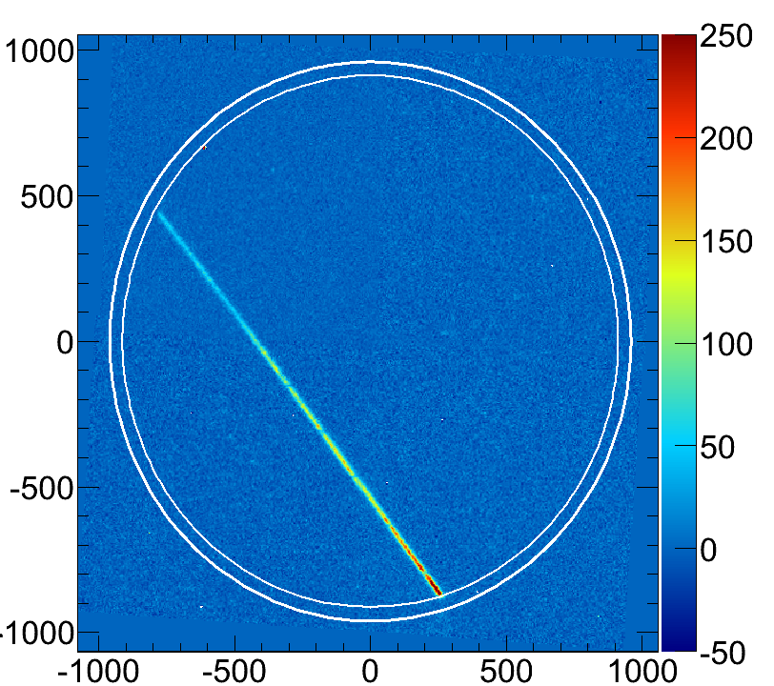
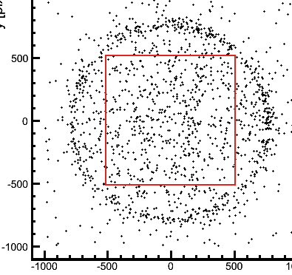
The benefits of material selection
Mostly;
OFHC Cu, Acetal,
SS and G-10
Some;
DP460EG epoxy, kodial glass,
fused silica, kapton, resistors
Careful cleaning of
all parts
We see the whole field cage!
19x
improvement
10L
data
4sh α rate 11 mHz
10L α rate 210 mHz

Slide 22
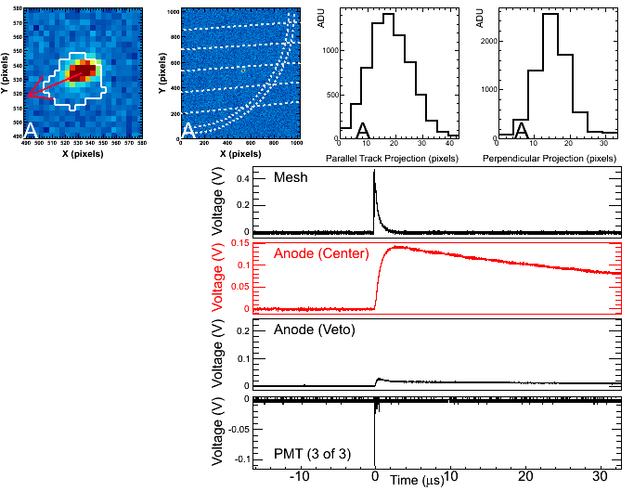
CCD
CCD
PMT

Slide 23
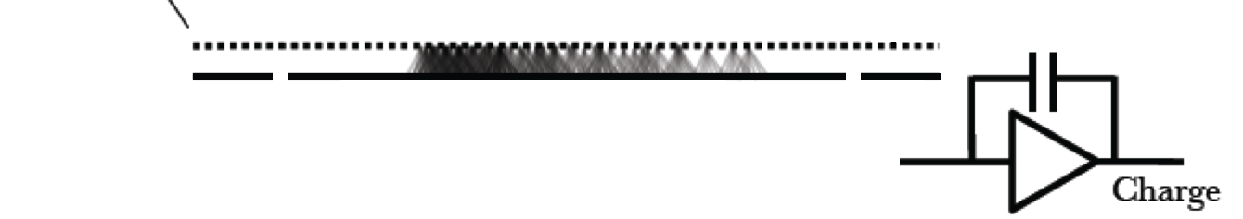
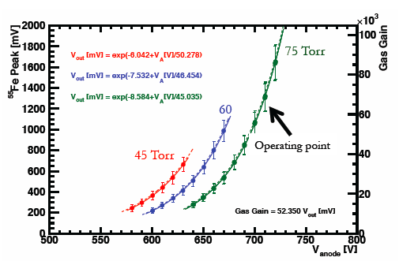
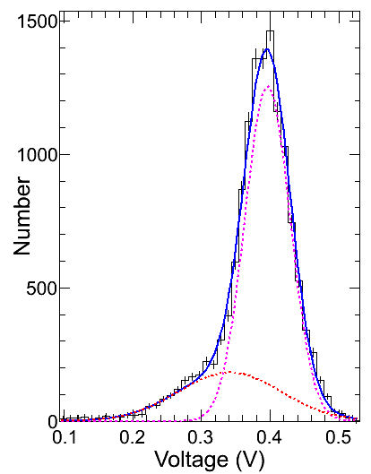
Anode charge readout (Gain)
CREMAT
CR-113
1.5 mV/pC
assumes W_{CF4}=34 eV
W_{CF4}=54 eV also appears
in the literature
G. F. Reinking et al, J. Appl. Phys. 60, 499 (1986)
Charge on anode using ⁵⁵Fe source and spectroscopy
amplifier
A. Sharma, SLAC-JOURNAL-ICFA-16-3, 1998
σ_{E}=8%
@720V
⁵⁵Fe
operating
point
Gas gain is 71,200 ± 1100

Slide 24
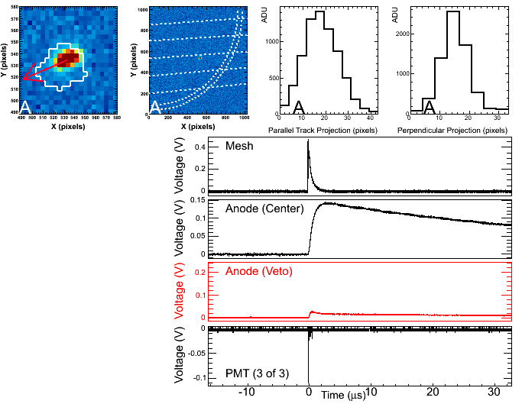
CCD
CCD
PMT

Slide 25
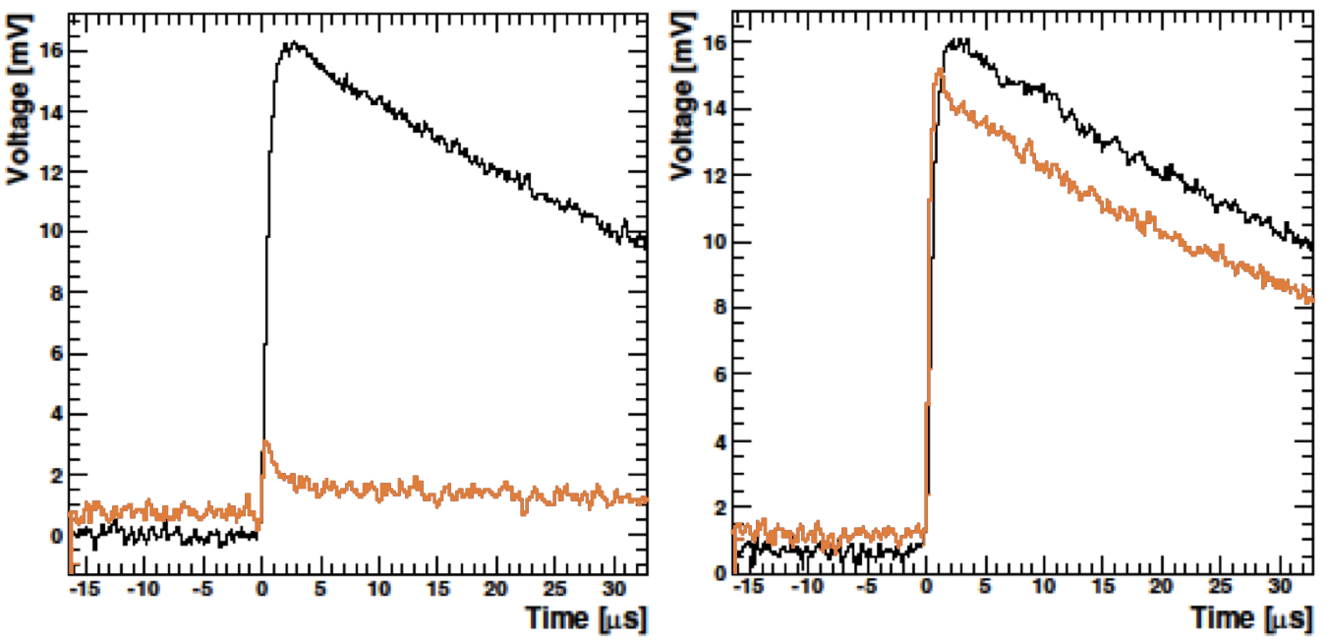
Veto charge readout
CREMAT
CR-112
13 mV/pC
J. Lopez et al. NIM A 696, 121-128 (2012)
R&D
Data
R&D
Data
Anode
Veto
75 keV_{ee}
α track
60 keV_{ee}
e⁻
Demonstrated reduction of 17x for
40 keV_{ee} < E < 200 keV_{ee} ¹³⁷Cs dataset using veto only

Slide 26
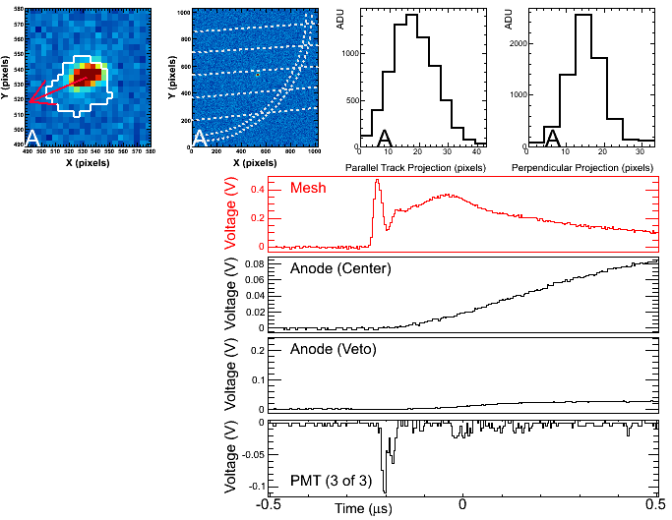
CCD
CCD
PMT

Slide 27
Mesh Fast Readout
avalanche
e⁻s
ions
n
electrons collected quickly (ns)
¹⁹F
ions
avalanche ions take longer (μs)
because of CF₄ ion mobility
e⁻
e⁻s
ΔZ
ions
Current
Rise time of e⁻ current
pulse depends on track ΔZ
ns
μs
Time

Slide 28
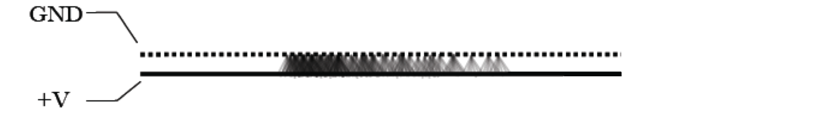
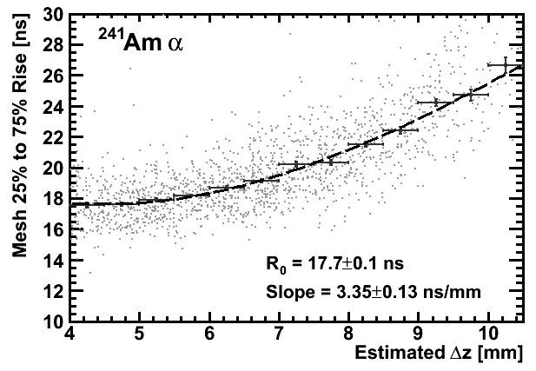
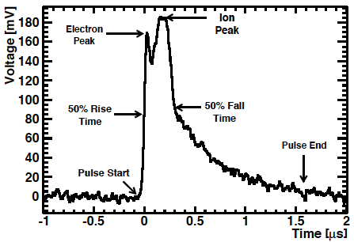
Route2Electronics
HS-AMP-CF
Mesh Fast Readout (Δz)
Voltage
DC-350 MHz
80x Gain
²⁴¹Am α
J. Lopez et al. NIM A 696, 121-128 (2012)
cathode
Δz
R&D
Data
R&D
Data
75% Rise Time
25%
Rise Time
Δz, estimated from 2D ²⁴¹Am range in CCD (mm)
Larger Δz yields a
longer rise time
115 keV_{ee}

Slide 29
Mesh Fast Readout
γ energy deposition much less spatially localized
More likely to deposit energy in veto
γ
ΔZ
e⁻
Current
Rise time of e⁻ current pulse
much wider in time for γ’s
μs
Time

Slide 30
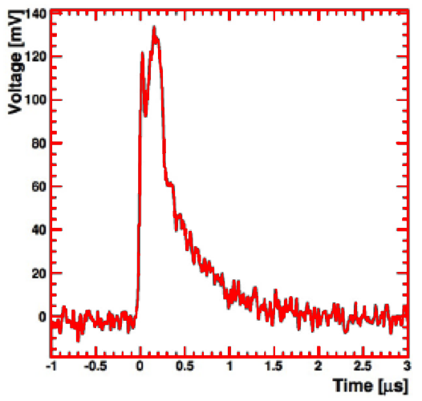
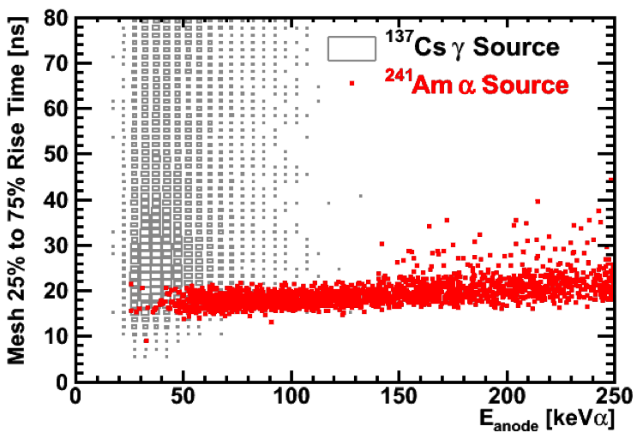
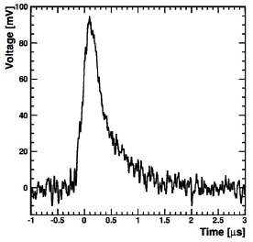
PID with Mesh Readout
The last
75 keV_{ee} of
an ²⁴¹Am α
R&D
Data
R&D
Data
¹³⁷Cs γ
60 keV_{ee}
Demonstrated rejection of Cs-137 γ’s
between 40 keV_{ee} < E < 200 keV_{ee} of
10⁵ (90% CL upper-limit) using
CCD+veto+mesh
R&D
Data
J. Lopez et al. NIM A 696, 121-128 (2012)

Slide 31
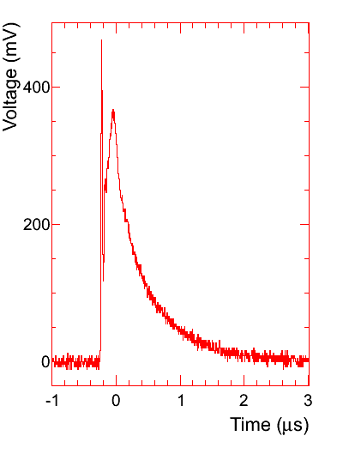
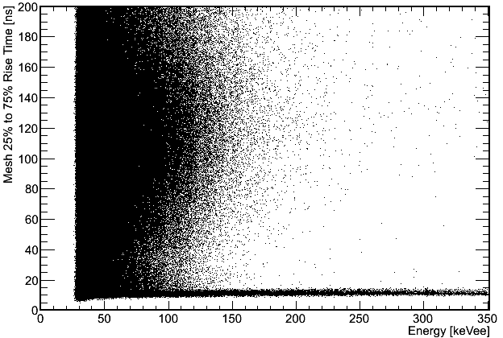
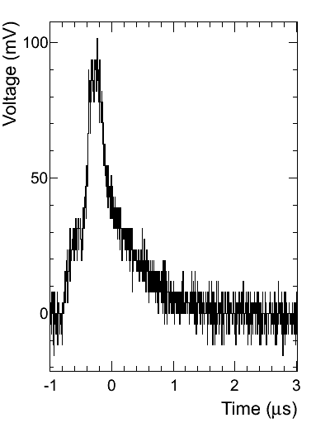
PID in the 4-shooter
²⁵²Cf
neutron
γ’s
²⁵²Cf nuclear recoils
γ
We hope to demonstrate even greater γ-NR rejection power in the 4-shooter

Slide 32
Surface Commissioning of the DMTPC 4-Shooter Directional Dark Matter Detector
Outline
Introduction
Directional Sensitivity Measurements
  High gain ²⁵²Cf neutron study
  Low gain & pressure AmBe neutron study
  Directionality with alpha tails
Future plans
Directional detection
The DMTPC collaboration
The 4-shooter detector
High gain ²⁵²Cf neutron study
Low gain & pressure AmBe neutron study
Directionality with alpha tails
Future WIPP deployment

Slide 33
How well can we measure Head-Tail?
… for low energy nuclear recoils like those expected to be
generated in WIMP scatters?
Strategy: place neutron source at 2 positions in lab and quantify ability to measure Head-Tail at energies low enough to be interesting for a dark matter search.
n
n
Φ

Slide 34
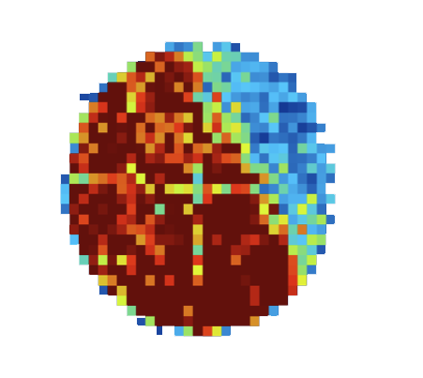


²⁵²Cf calibration
²⁵²Cf source
position #1
Beam profile evident in
found track positions
intensity
VS
position
4-Shooter
PRELIMINARY
2D
²⁵²Cf source
position #2
Good range vs. energy
Agreement with SRIM

Slide 35










174 keV_{ee}
303 keV_{ee}
177 keV_{ee}
150 keV_{ee}
153 keV_{ee}
292 keV_{ee}
194 keV_{ee}
359 keV_{ee}
251 keV_{ee}
67 keV_{ee}

Slide 36


The Raether Limit
²⁴¹Am Bragg peaks
sparking induced by low z-tracks
²⁵²Cf neutrons
75 Torr
CF₄
(px)
At very high gain, all tracks have large transverse widths.
The Raether Limit avalanches containing ~10⁷ electron-ion pairs leads to a discharge
A. Bressan et al., NIMA 424 (1999) 321-342

Slide 37


AmBe neutron study
Lower activity than
The ²⁵²Cf source
-5 kV drift
670V anode
lower gas gain
1,864,000 images
3,363,398 charge triggers
8,591 NR candidates
60 Torr
Assessment of Head-Tail
sensitivity for low energy recoils
in progress

Slide 38

374 ADU
482 ADU
573 ADU
763 ADU
809 ADU
840 ADU
868 ADU
1011 ADU
1144 ADU
1273 ADU
1354 ADU
7131 ADU

Slide 39
Low energy alpha-ends
Very similar to low energy C and F
recoils
²⁴¹Am
α
Caveat Emptor(s):
1) They must drift
the full field cage,
so these tracks
undergo a lot of
diffusion.
2) He ions have
a much larger expected range than C or F ions since range goes like Z⁻².

Slide 40

16 mV
17 mV
21 mV
27 mV
31 mV
37 mV
46 mV
55 mV
56 mV
56 mV
107 mV
148 mV

Slide 41
Low energy alpha-end head-tail
60% correct at 35 mV. 10° axial angular resolution above 35 mV.

Slide 42
Surface Commissioning of the DMTPC 4-Shooter Directional Dark Matter Detector
Outline
Introduction
Directional Sensitivity Measurements
Future plans
  WIPP deployment
Directional detection
The DMTPC collaboration
The 4-shooter detector
High gain ²⁵²Cf neutron study
Low gain & pressure AmBe neutron study
Directionality with alpha tails
Future WIPP deployment

Slide 43




WIPP
Waste Isolation Pilot Plant
Carlsbad, NM
1.6 km.w.e.
Funded by
NSF & DoE
to build a m³
detector

Slide 44


WIPP
Waste Isolation Pilot Plant
Carlsbad, NM
1.6 km.w.e.
DMTPC 10L, 1 yr, 50 keV threshold
DMTPC m³, 1 yr, 50 keV threshold
sensitivity
aa
DMTPC
4SH
DRIFT IId (2011)
PICASSO (2010)
DMTPC
m³
COUPP (2011)
SIMPLE (2011)
Year
COUPP
SIMPLE
DMTPC 4SH U/G
XENON10
PICASSO
NAIAD
DMTPC m³ U/G
DRIFT IId sensitivity estimate
aa

