Slide 1
Challenges for Particle Detectors at Future Circular Colliders
EDIT, Fermilab, Mar. 6th, 2018
W. Riegler, CERN

Slide 2
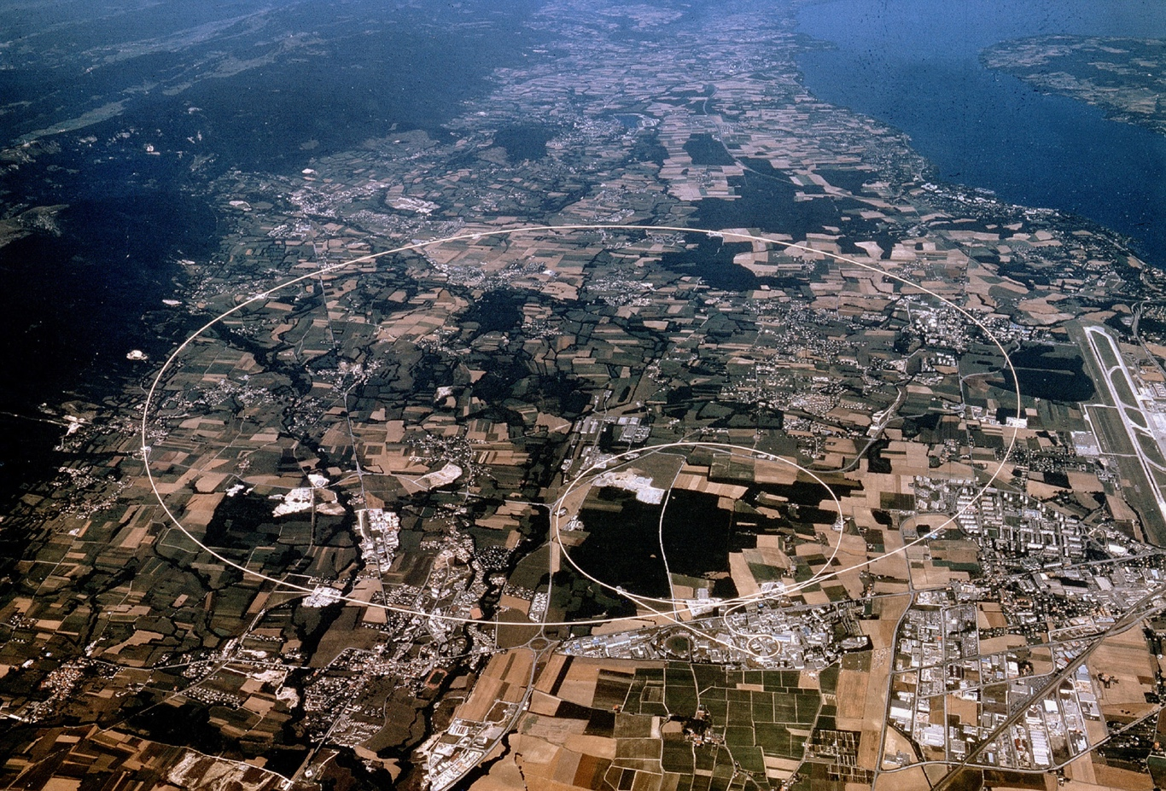
Large Hadron Collider at CERN, Geneva, 14TeV pp collisions
27km
8.3T dipoles
p=0.3xRxB
1983 First concept
2009 First physics
2025 Luminosity upgrade
2035 End of exploitation

Slide 3
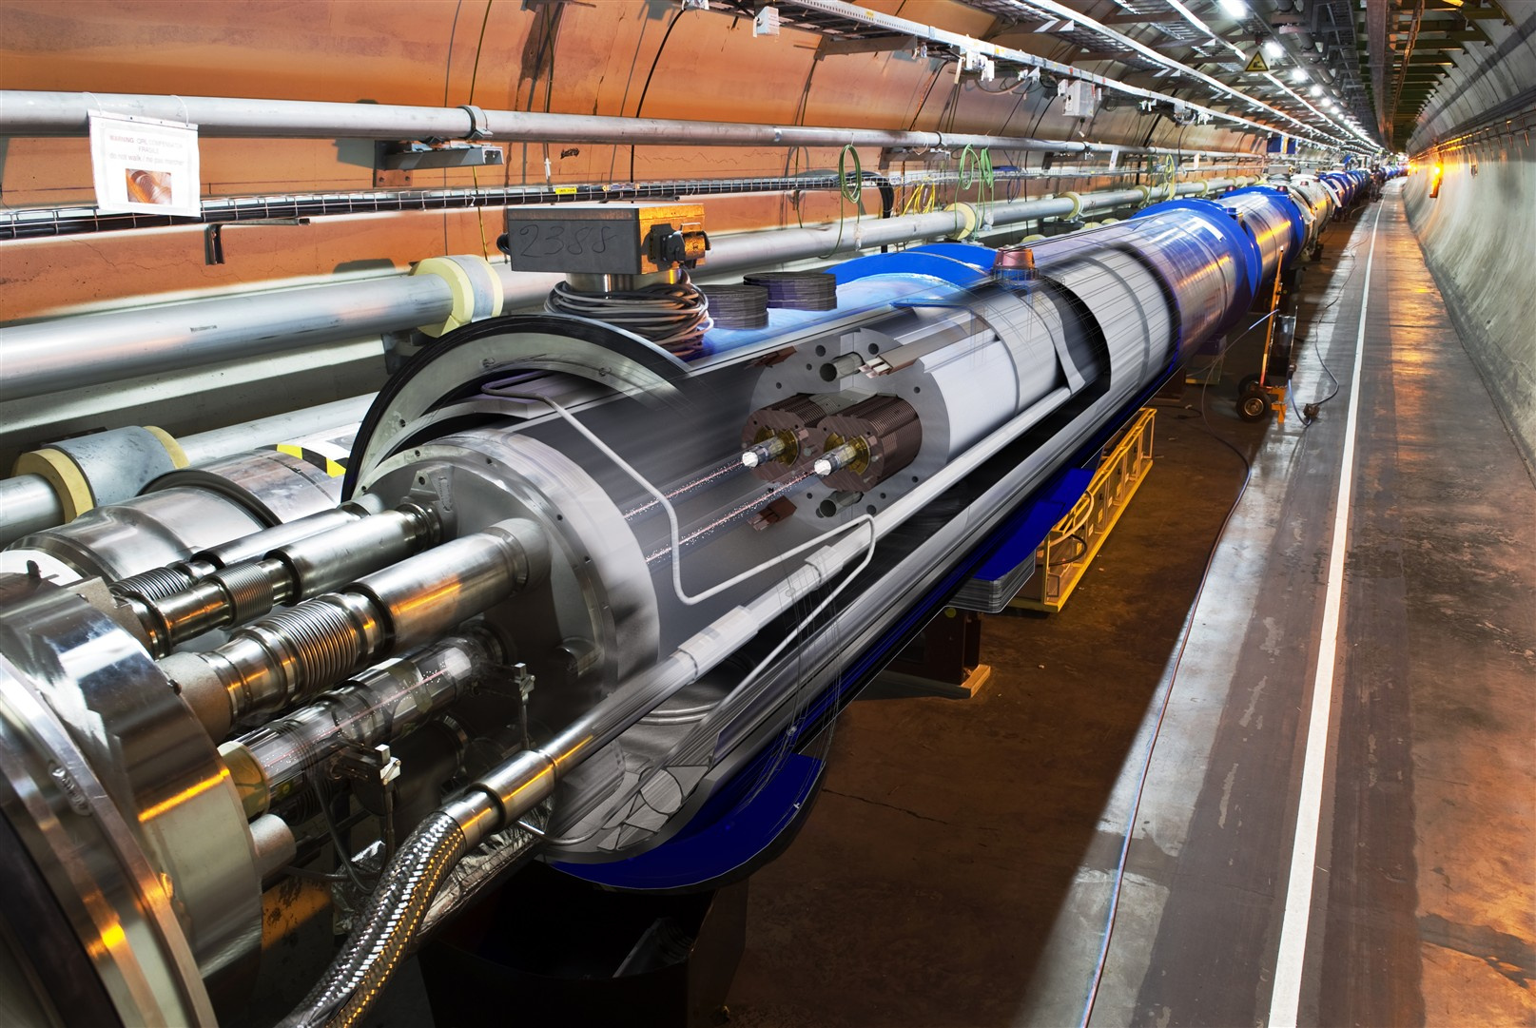
Large Hadron Collider at CERN, Geneva, 14TeV pp collisions
27km
8.3T Dipoles

Slide 4
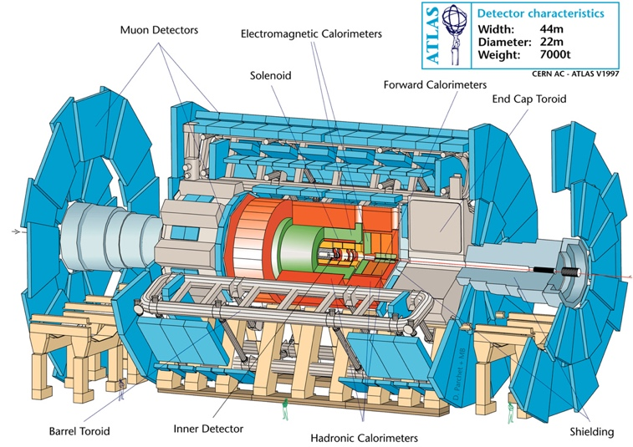
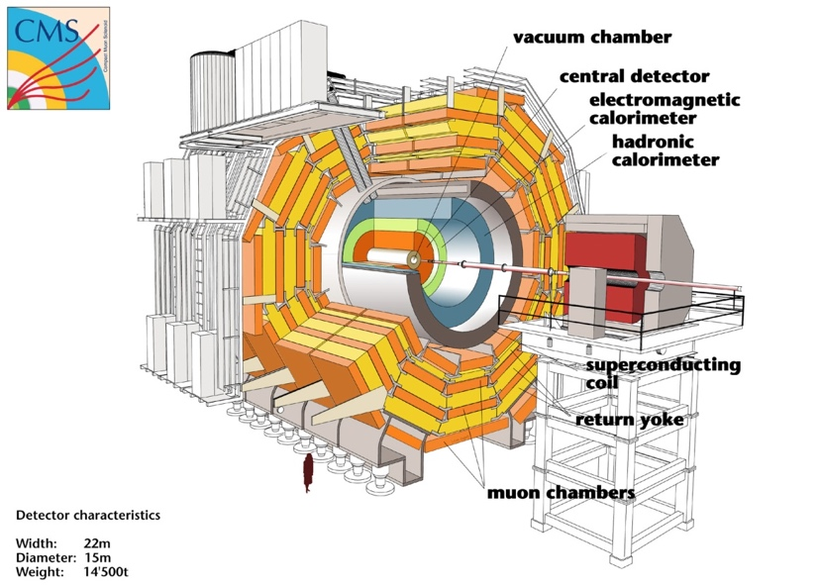
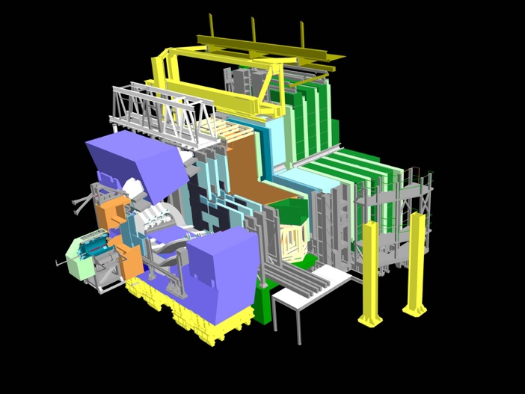
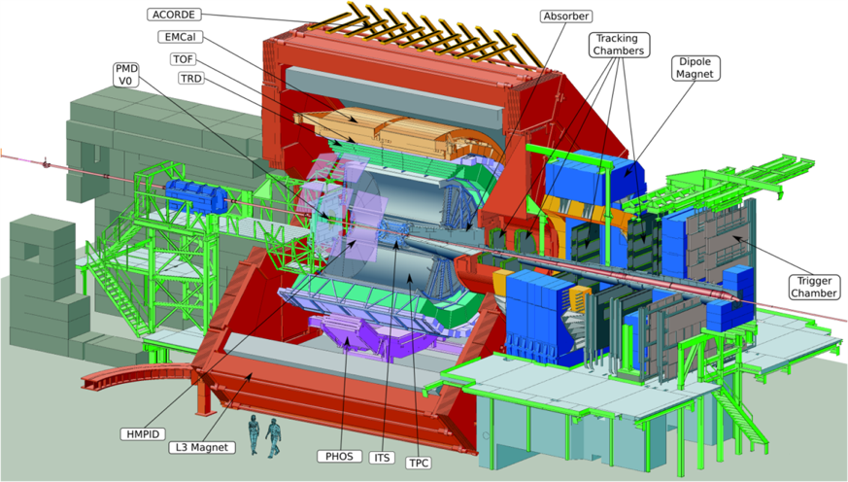
ATLAS, CMS, ALICE, LHCb

Slide 5
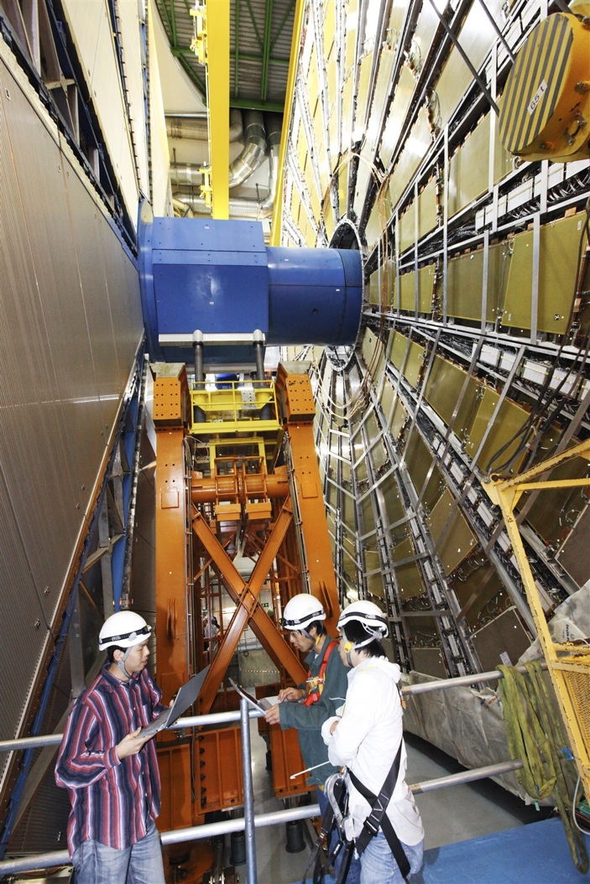
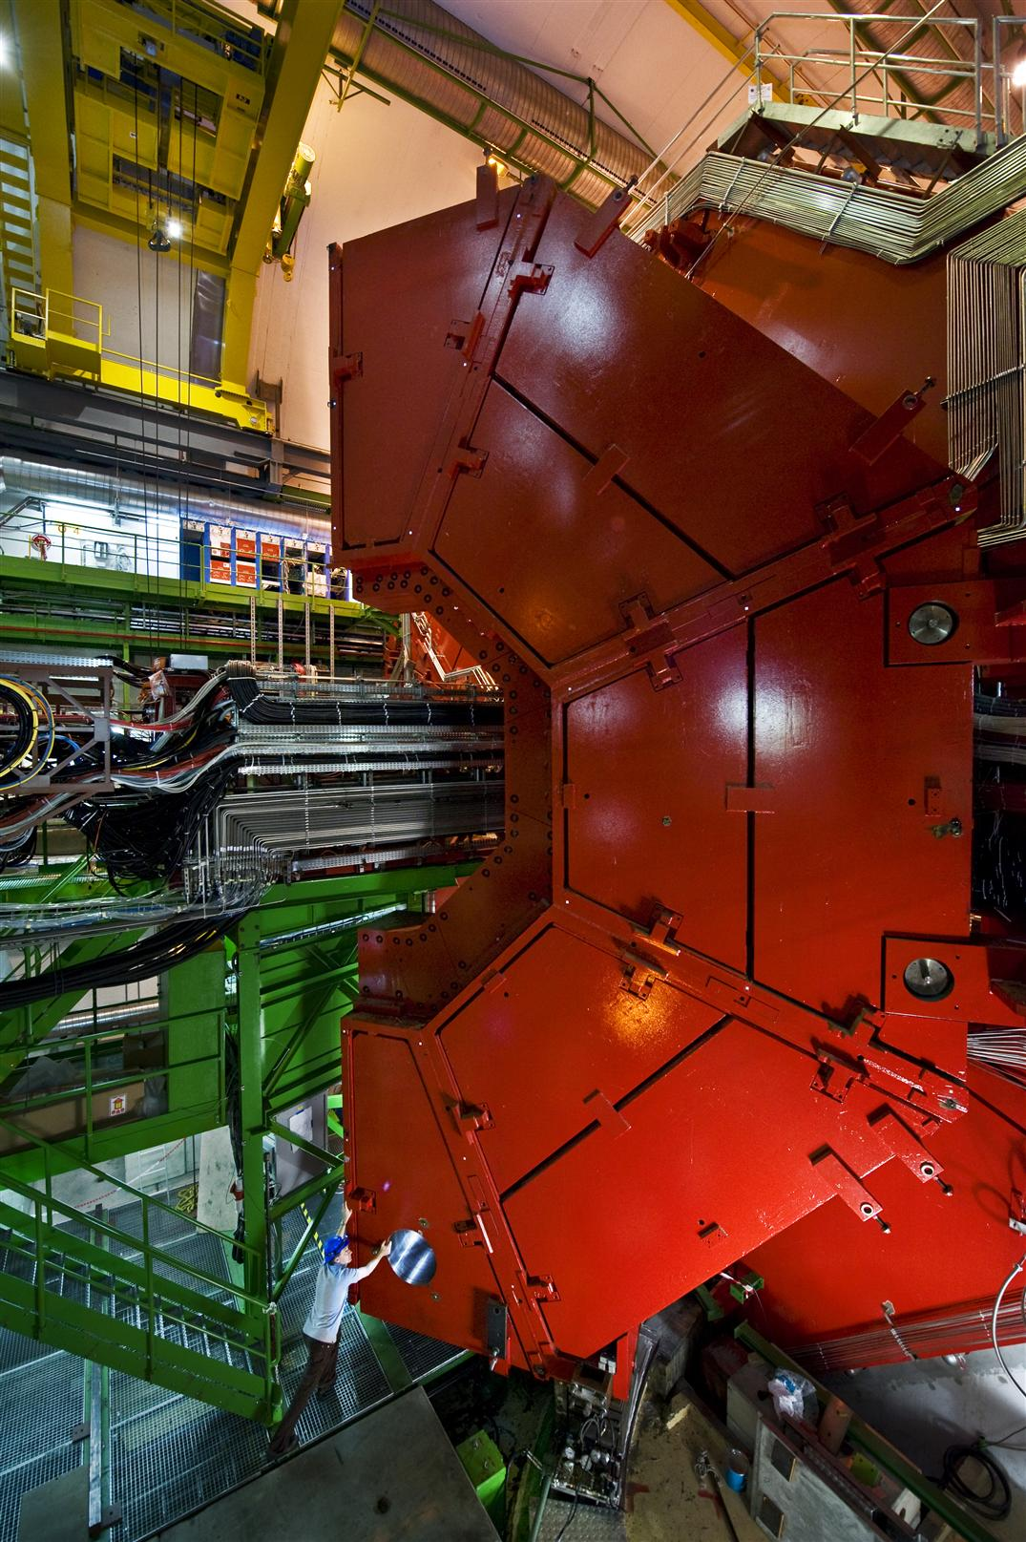
ATLAS, ALICE

Slide 6
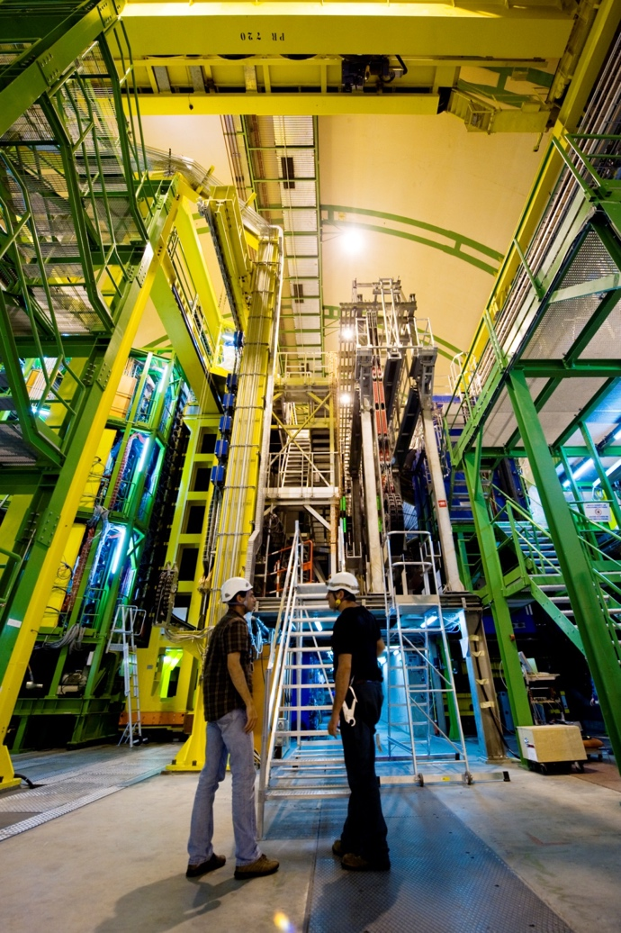
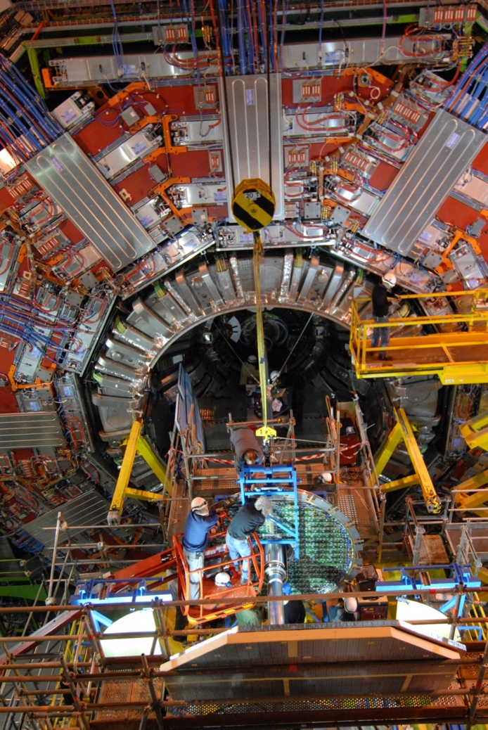
CMS, LHCb

Slide 7
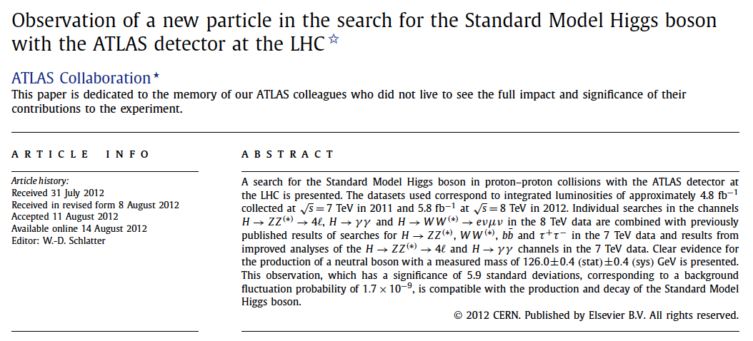
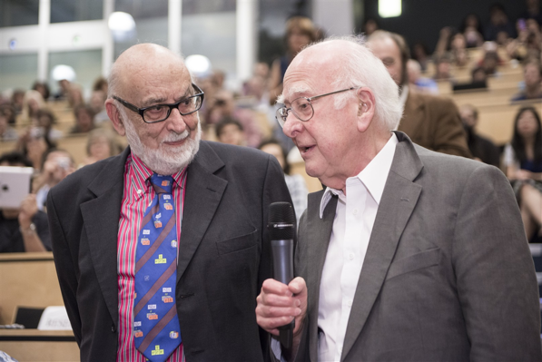
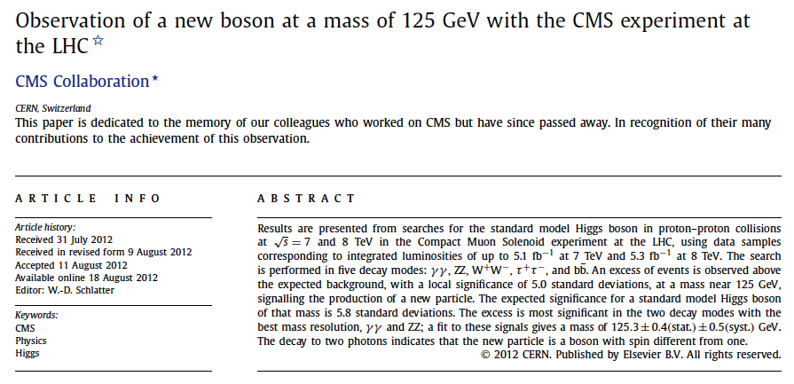
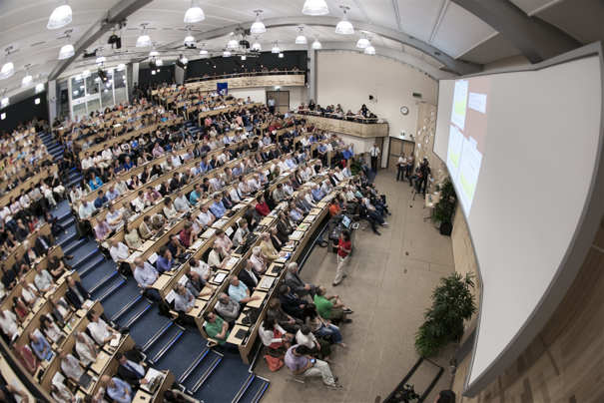
July 4th 2012

Slide 8
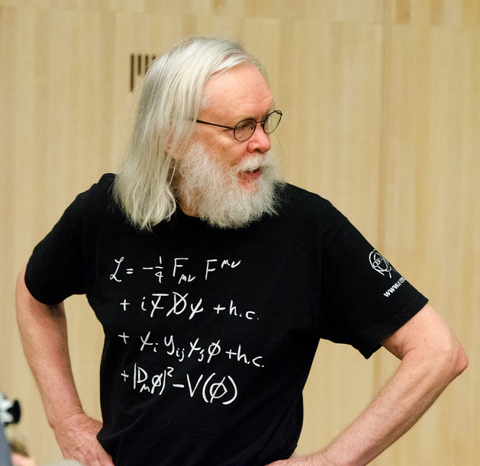
The Standard Model of Particle Physics

Slide 9
Some very biased statistics from an experimentalist
91 Persons got Nobel Prices related to the development of the Standard Model
59 Experiment
33 for Standard Model Experiments
13 for Standard Model Instrumentation and Experiments
3 for Particle Physics Instrumentation
1 for Relativity Experiment (Michelson)
9 for Quantum Mechanics Experiments
32 Theory
23 for Standard Model Theory
9 for Quantum Mechanics Theory

Slide 10
What next ?

Slide 11

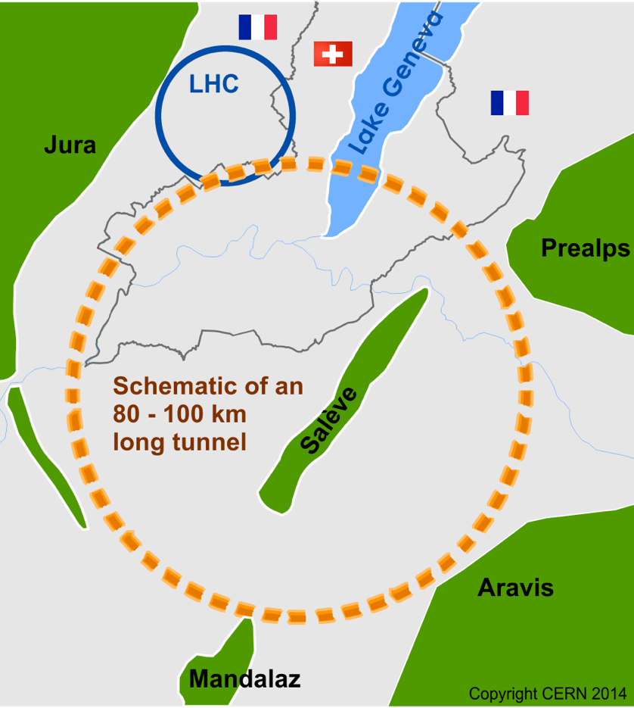
Future Circular Collider Study
International FCC collaboration (CERN as host lab) to study:
pp-collider (FCC-hh)
  main emphasis, defining infrastructure requirement
  ~16 T ⇒ 100 TeV pp in 100 k
  ~100 km tunnel infrastructure in Geneva area, site specific
e⁺e⁻ collider (FCC-ee) as potential first step
p-e (FCC-he) option, integration one IP, e from ERL
High Energy LHC (HE-LHC) with FCC-hh technology
(LHC Ring 8→16T, 14→28TeV)

Slide 12
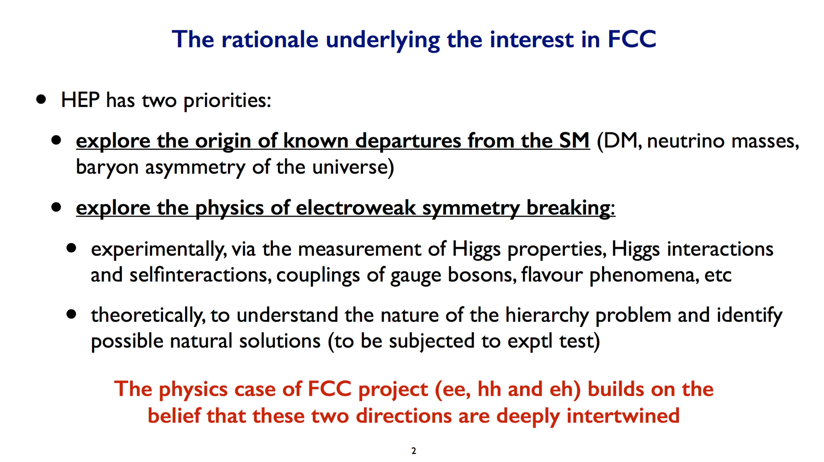
M. Mangano, Oct. 2017

Slide 13
Conceptual Design Report
1 – PHYSICS
2
Hadron
Collider
Summary
3 – Hadron Collider Comprehensive
Required for end 2018, as input for European Strategy Update
Common physics summary volume
Three detailed volumes FCChh, FCCee, HE-LHC
Three summary volumes FCChh, FCCee, HE-LHC
Physics opportunities across all scenarios
Accelerator
Injectors
Technologies
Infrastructure
Operation
Experiment
eh
4
Lepton
Collider
Summary
5 – Lepton Collider Comprehensive
Accelerator
Injectors
Technologies
Infrastructure
Operation
Experiment
6
High Energy LHC
Summary
7 – High Energy LHC Comprehensive
Accelerator
Injectors
Infrastructure
Refs to FCC-hh, HL-LHC, LHeC

Slide 14
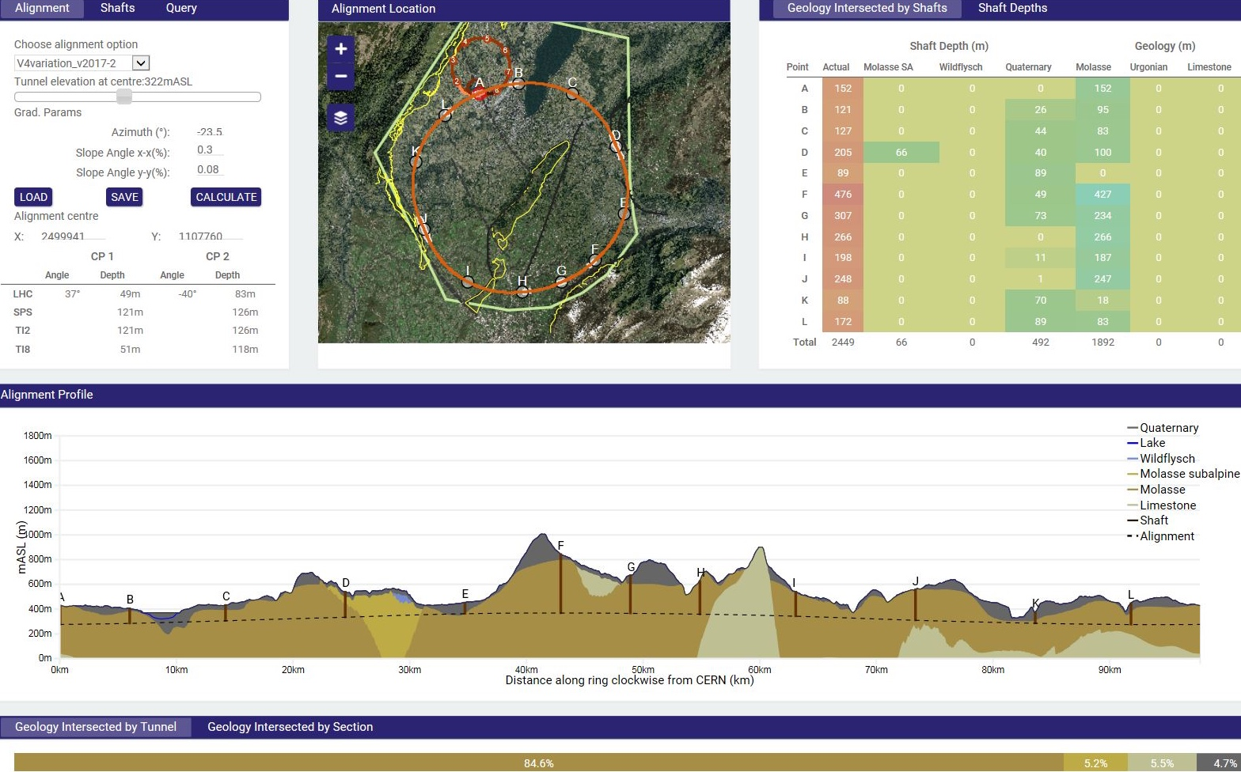
CE tunnel implementation study
Optimisation criteria:
tunneling rock type,
shaft depth accessibility
surface points, etc.
Tunneling:
Molasse 90%,
Limestone 5%,
Moraines 5%
Implementation:
90-100 km fits well geological situation in Geneva basin
Shallow variant, 30 m below lake-bed
Connected with LHC or SPS

Slide 15
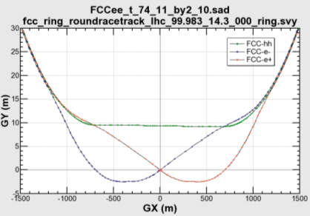

Same home for ee and hh
11.9 m
IP
30 mrad
FCC-hh/
ee Booster
9.4 m
0.6 m
Common
RF (tt)
FCC-ee Booster
Common
RF (tt)
e⁺
e⁻
Max. separation of 3(4) rings is about 12 m:
wider tunnel or two tunnels are necessary around the IPs, for ±1.2 km.
IP
Two separate rings for e⁺ and e⁻ (# bunches)
A booster for continuous top-up (lifetime)
Asymmetric interaction region (SR)
Crossing angle 30 mrad
Two main IP’s in A, G for both machines

Slide 16
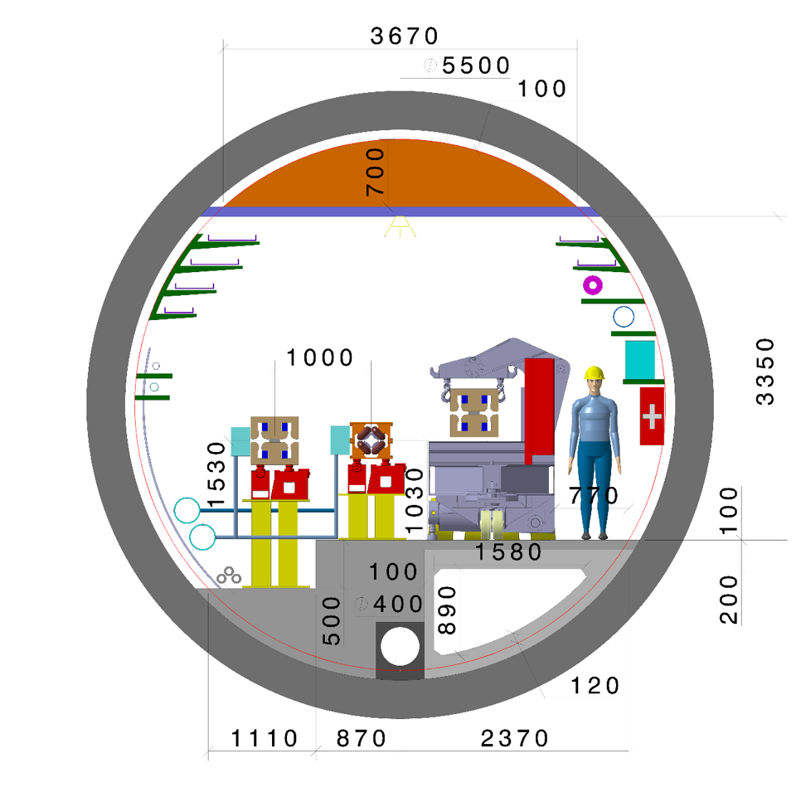
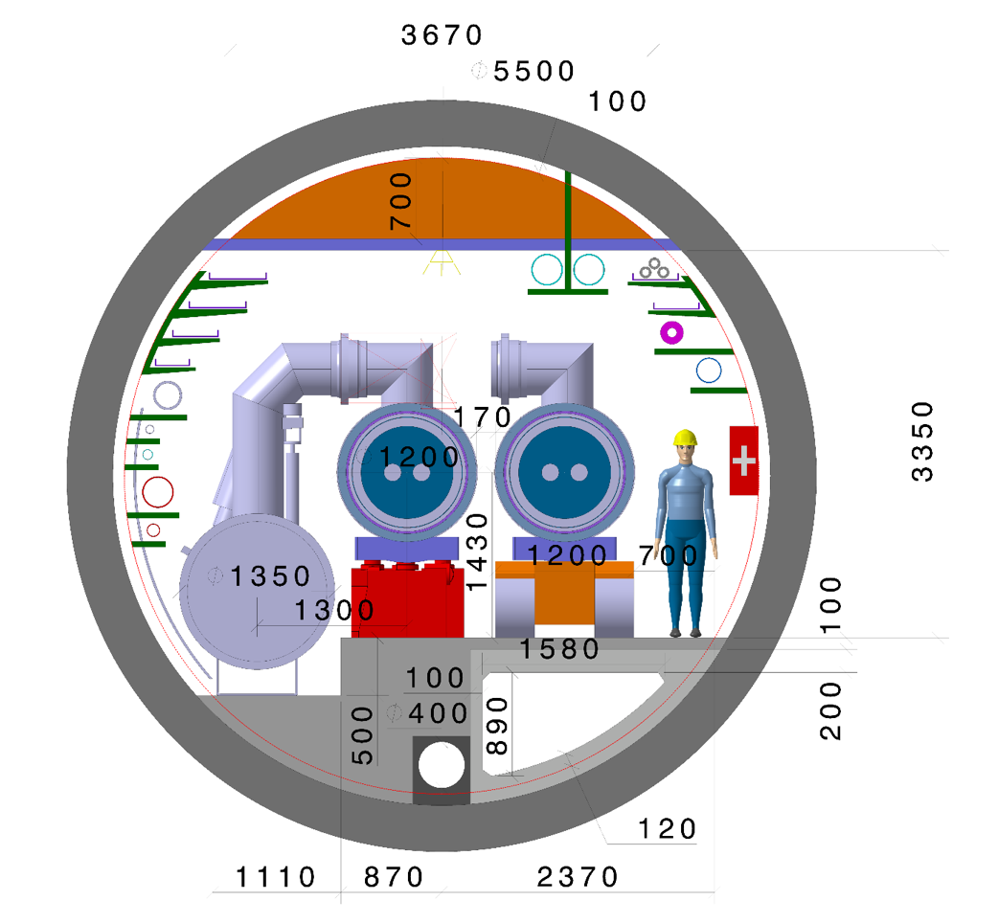
FCC tunnel integration
5.5 m diameter
FCC-ee
FCC-hh

Slide 17
lepton collider luminosities
LEP × 10⁵ !
FCC
FCC-ee:
Ultimate precision with
  100 000 Z / second (!)
    1 Z / second at LEP
  10 000 W / hour
    20 000 W in 5 years at LEP
  1 500 Higgs bosons / day
    10-20 times more than ILC
  1 500 top quarks / day
… in each detector
CEPC
CLIC
ILC

Slide 18
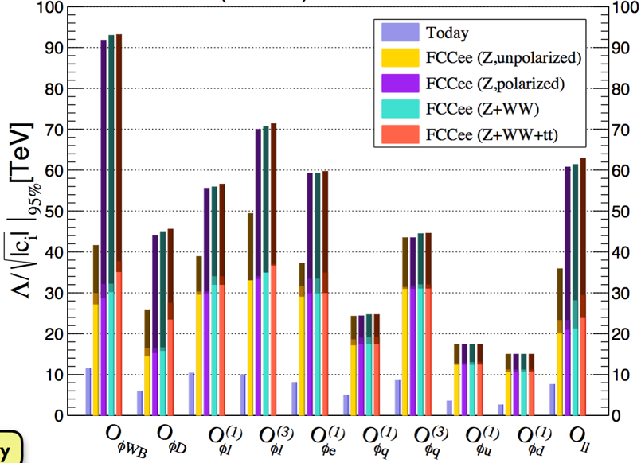
Global Fit and sensitivity to new physics
Combining all EW measurements
  In the context of the SM … and beyond
  New physics: blue and red ellipses may not overlap
    Or even better, data may not fit to the SM
FCC-ee projections
No theory uncertainties
Λ (TeV)
w/o theory uncertainties
LHC ?
with current
theory uncertainties
Today
SM with m_{H} = 125 GeV
J. De Blas, Jan. 2017
no m_{Z} or no α_{QED}
LEP + m_{H} @ LHC
no m_{Z} or no α_{QED}
Requires 10-fold improved theory calculations
Points to the physics to be looked for at FCC-hh
Today: Λ > 5-10 TeV
After FCC-ee: Λ > 50-100 TeV ?

Slide 19
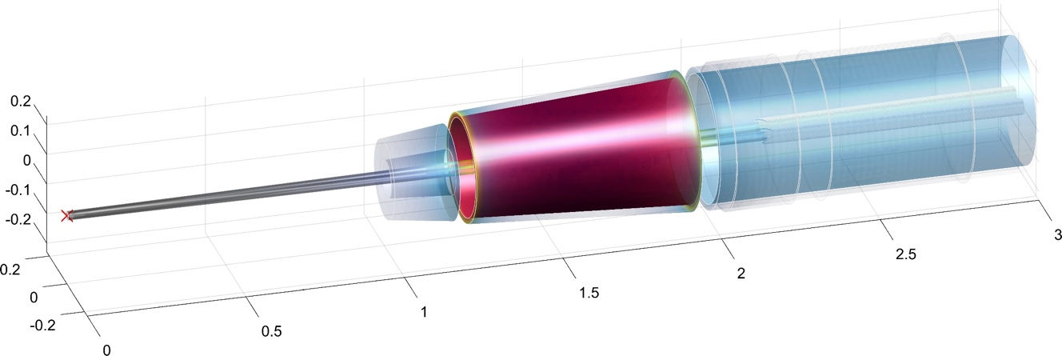
Requirements and constraints
Minimize adverse effects from the detector
  Emittance blow-up from detector magnetic field (beam crossing at angle)
    Requires a compensating solenoid even closer to the IP
      Which in turn limits the detector magnetic field to 2T
    And a magnetic shielding around the final focus quads
    Not much room left for the luminosity counter (with low-angle Bhabha e⁺e⁻→ e⁺e⁻)
      Front face at 1.2 m from the IP (typically twice closer to IP than at LEP)
Shielding solenoid
Compensating solenoid
Beam pipes
2m
Luminosity counter
3 m
2 m
1 m
Final focus quads

Slide 20

FCC-pp collider parameters
parameter | FCC-hh |  |  | HE-LHC | HL-LHC | LHC
collision energy cms [TeV] | 100 |  |  | 27 | 14 | 14
dipole field [T] | 16 |  |  | 16 | 8.33 | 8.33
circumference [km] | 97.75 |  |  | 26.7 | 26.7 | 26.7
beam current [A] | 0.5 |  |  | 1.12 | 1.12 | 0.58
bunch intensity [10¹¹] | 1 |  | 1 (0.2) | 2.2 (0.44) | 2.2 | 1.15
bunch spacing [ns] | 25 |  | 25 (5) | 25 (5) | 25 | 25
synchr. rad. power / ring [kW] | 2400 |  |  | 101 | 7.3 | 3.6
SR power / length [W/m/ap.] | 28.4 |  |  | 4.6 | 0.33 | 0.17
long. emit. damping time [h] | 0.54 |  |  | 1.8 | 12.9 | 12.9
beta* [m] | 1.1 | 0.3 |  | 0.25 | 0.20 | 0.55
normalized emittance [μm] | 2.2 (0.4) |  |  | 2.5 (0.5) | 2.5 | 3.75
peak luminosity [10³⁴ cm⁻²s⁻¹] | 5 |  | 30 | 25 | 5 | 1
events/bunch crossing | 170 |  | 1k (200) | ~800 (160) | 135 | 27
stored energy/beam [GJ] | 8.4 |  |  | 1.3 | 0.7 | 0.36

Slide 21

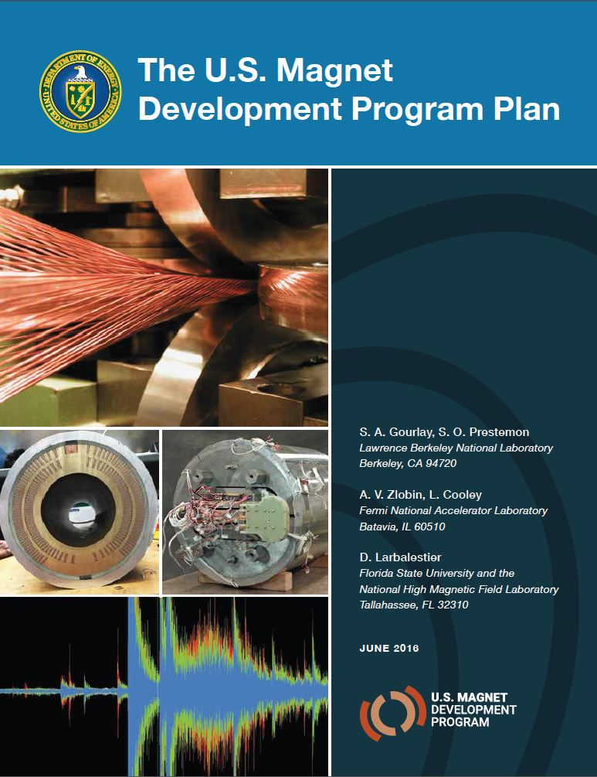
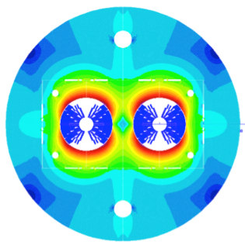
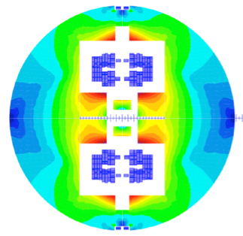
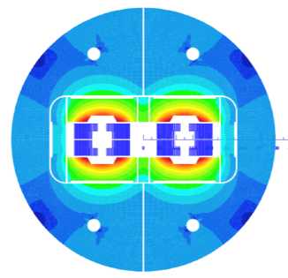
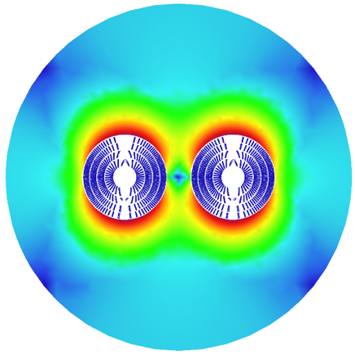
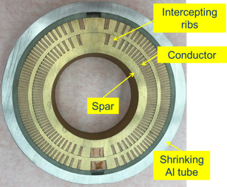
16 T dipole design activities and options
H2020
Cos-theta
Common coils
Canted
Cos-theta
Blocks
INFN
CIEMAT
LBNL
CEA
PSI
FNAL
Short model magnets (1.5 m lengths) will be built from 2017 - 2022

Slide 22
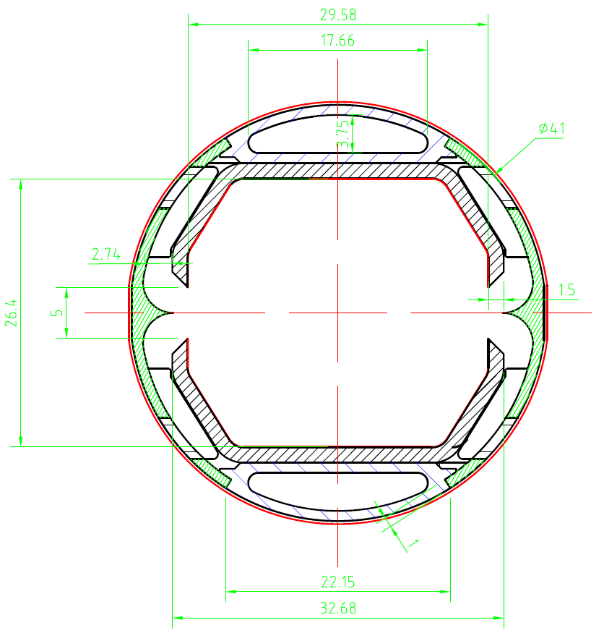
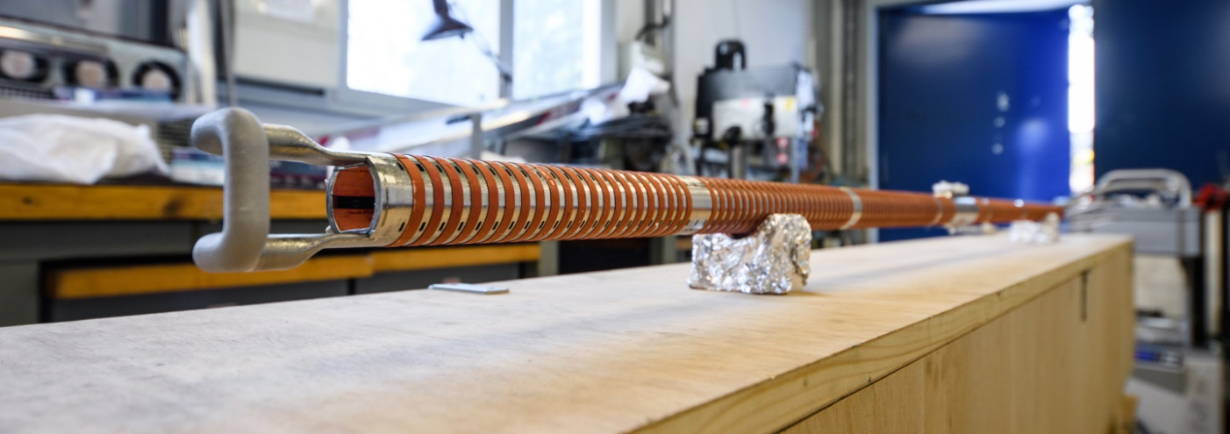
Cryogenic beam vacuum system
One of the most critical elements for FCC-hh
Absorption of synchrotron radiation at ~50 K for cryogenic efficiency (5 MW total power)
Provision of beam vacuum, suppression of photo-electrons, electron cloud effect, impedance, etc.
FCC Beamscreen prototype for test at ANKA:
External copper rings for heat transfer to cooling tubes

Slide 23
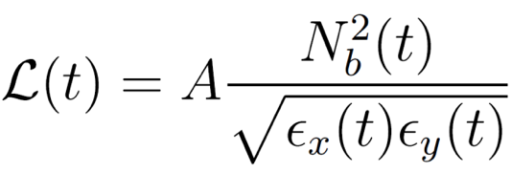





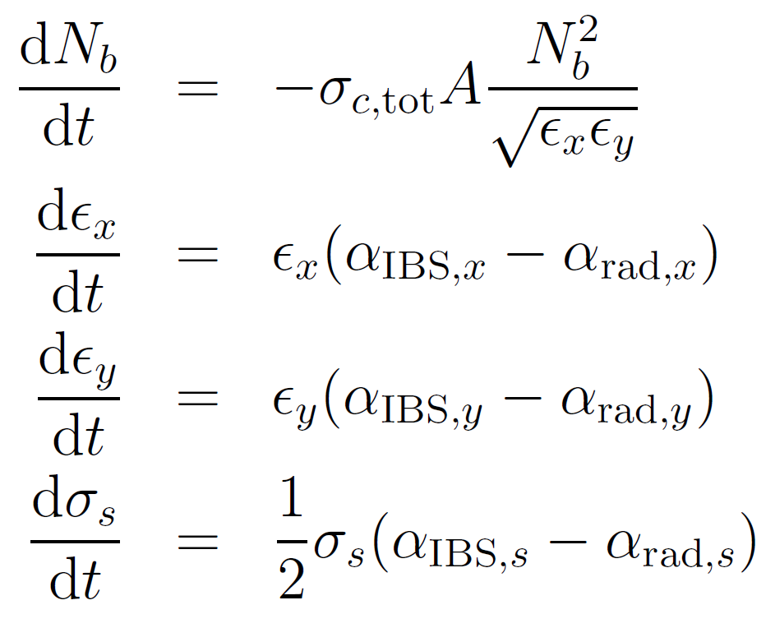




Beam and Luminosity Evolution
During the beams are in collision the instantaneous value of the luminosity will change:
with
: revolution freq.
: no. bunches/beam
: β-function at IP
: no. particles/bunch
: geom. emittances
: bunch length
: total cross-section
: IBS growth rate
: rad. damping rate
The beam evolution with time is obtained by solving a system of four differential equations (dominant effects only shown here, more included in simulations):
Intensity
Hor. Emittance
Ver. Emittance
Bunch Length
J. Jowett, M. Schaumann,
FCC week Washington 2015

Slide 24
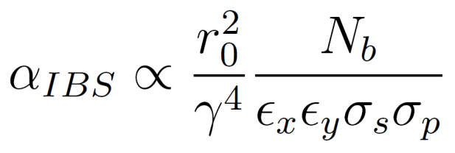
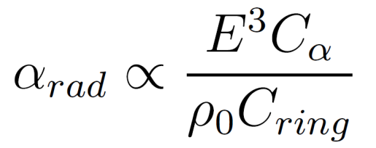
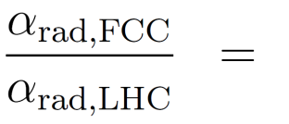
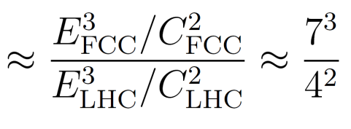
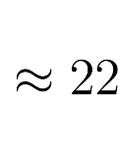
Effects on the Emittance – a new regime
Intra-Beam Scattering (IBS)
(Synchrotron) Radiation Damping
Multiple small-angle Coulomb scattering within a charged particle beam.
A charged particle radiates energy, when it is accelerated, i.e. bend on its circular orbit.
Emittance Growth
Emittance Shrinkage
Growth rate dynamically changing with beam properties:
Damping rate is constant for a given energy:
IBS is weak for initial beam parameters, but increases with decreasing emittance .
Fast emittance decrease at the beginning of the fill,
until IBS becomes strong enough to counteract the radiation damping.

Slide 25
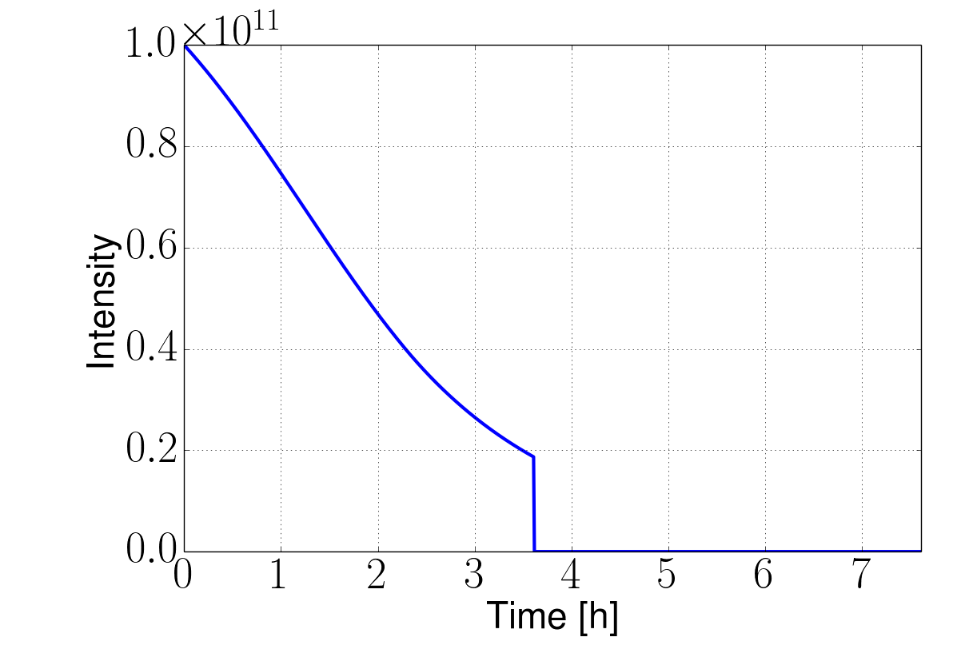
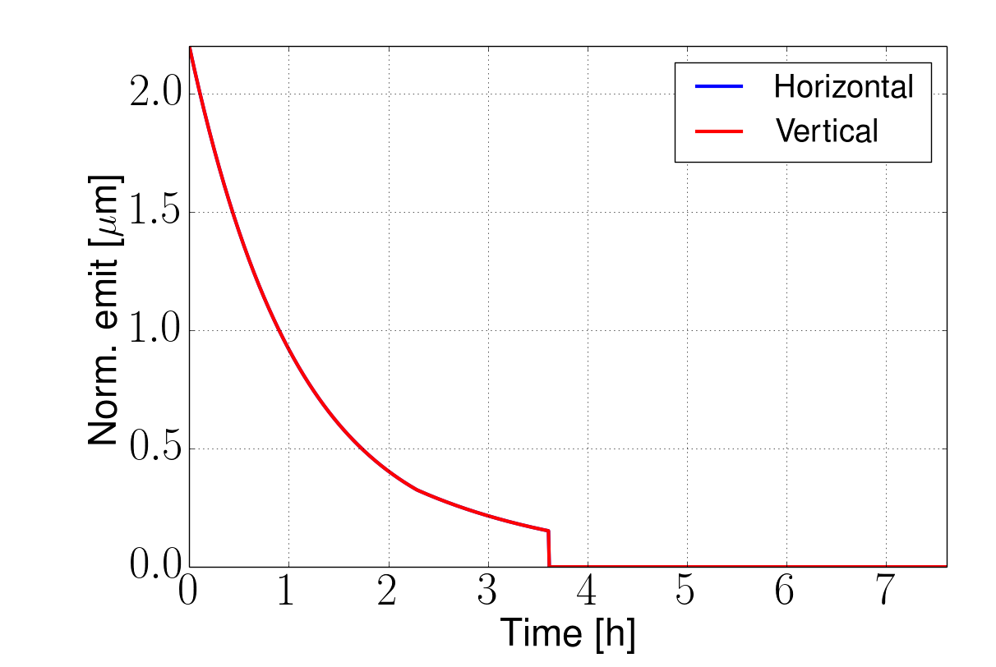
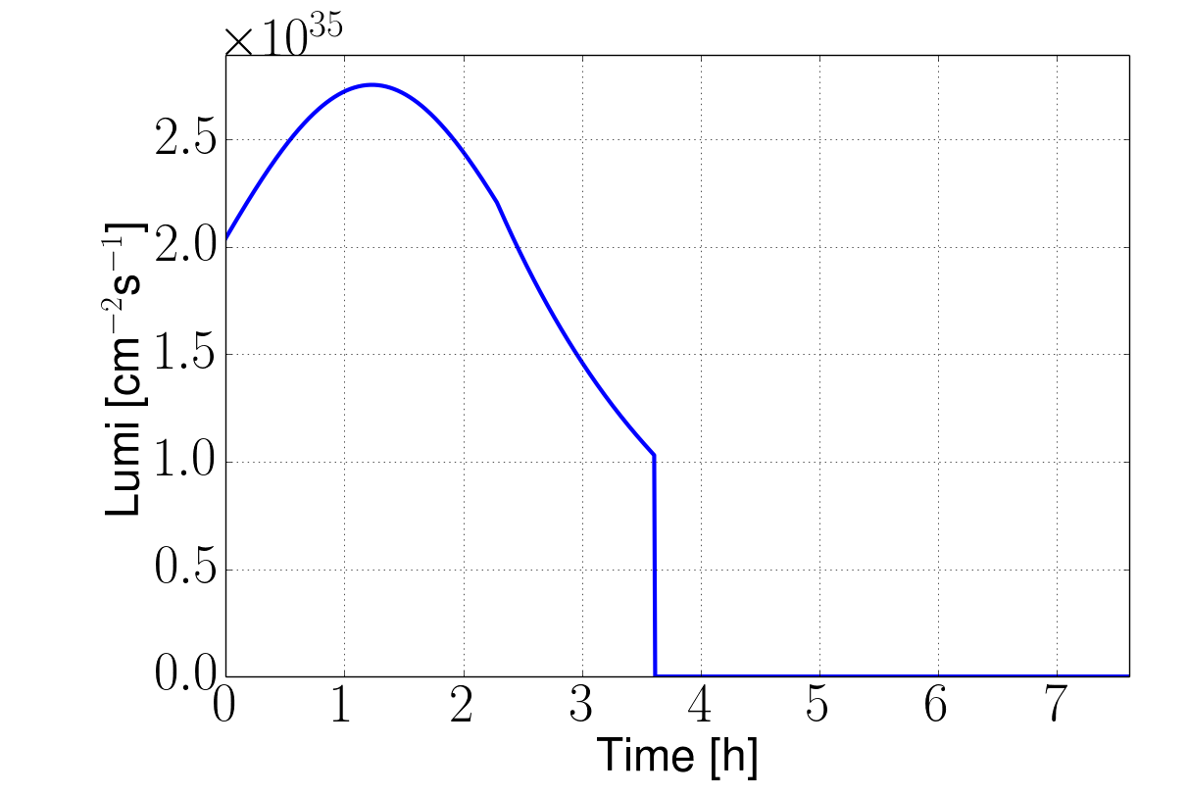
pp Luminosity evolution during a fill
X. Buffat, D.S..
Developed model including most relevant effects
Improvement with more detail planned
Reach 8fb⁻¹/day with ultimate for 25ns spacing
    5ab⁻¹ per 5 year run
Beam is burned quickly
  A reason to have enough charge stored
Ultimate example, 25ns, no luminosity levelling
8fb⁻¹/day
Turn-around time

Slide 26
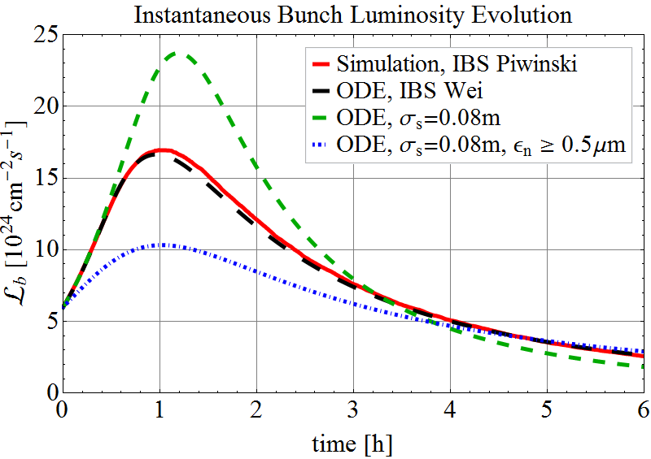
Pb-Pb Luminosity evolution during a fill
FCC-hh is also a very powerful Heavy Ion collider !

Slide 27
Pileup, number of pp collisions per bunchcrossing
LHC: 40
HL-LHC: 140
FCC-hh: 1000
Small time differences between the individual collisions in one BC allow identification with detectors having order 10-20ps time resolution.

Slide 28
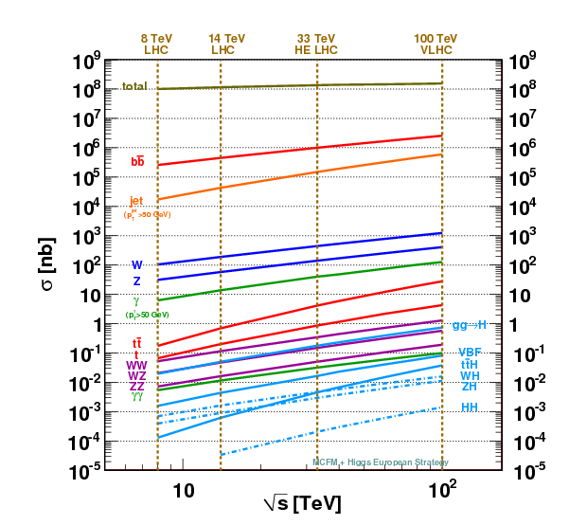
Crossections for key processes
Total crossection and Minimum Bias Multiplicity show only a modest increase from LHC to FCC-hh.
The crossection for interesting processes shows however significant increase !
Interesting stuff is sticking out more !!
Going from pileup of 140 at HL-LHC to pileup of 1000 at FCC does however reduced this possible advantage for triggering.

Slide 29
Physics at a 100 TeV Hadron Collider
Exploration + Higgs as a tool for discovery
How to specify detectors for such a machine ?
ATLAS and CMS are general purpose detectors that were benchmarked with the ‘hypothetical’ Higgs in different mass regions with tracking up to η=2.5.
The Higgs is also key benchmark for the FCC detectors, with highly forward boosted features (100TeV, 125GeV Higgs)
FCC detectors must be ‘general general’ purpose detectors with very large η acceptance and extreme granularity.

Slide 30
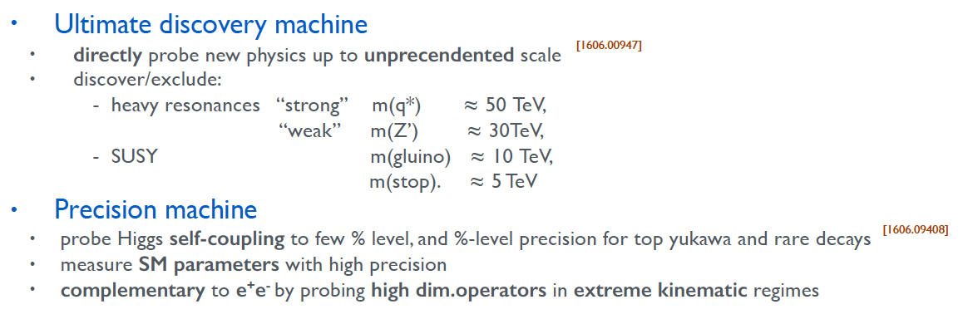
Physics at a 100 TeV Hadron Collider

Slide 31
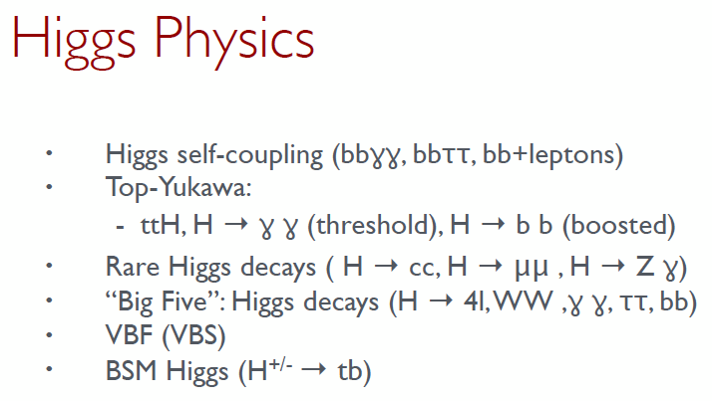
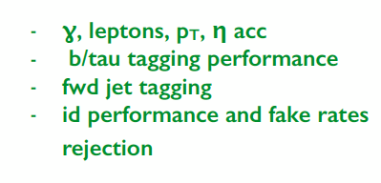
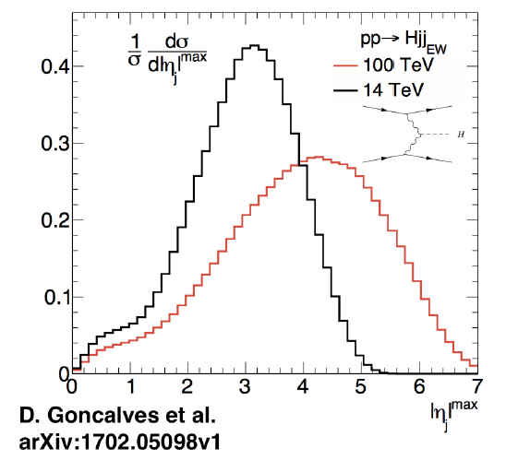
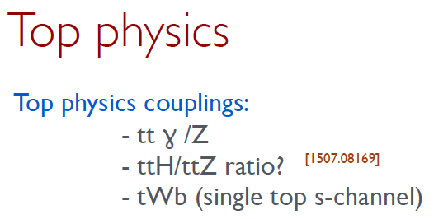
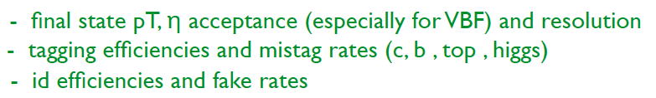
Physics at a 100 TeV Hadron Collider

Slide 32
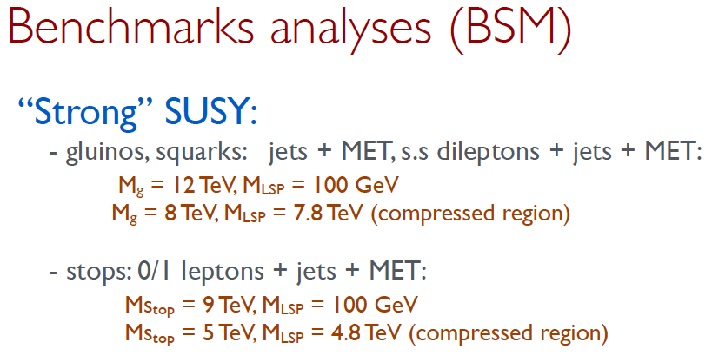





Physics at a 100 TeV Hadron Collider

Slide 33

Detector Specifications

Slide 34

FCC week 2016: Twin Solenoid 6T, 12m bore, Dipoles 10Tm

Slide 35





Magnet systems under consideration
Twin solenoid with dipoles (min. shaft diameter 27.5m)
Partially shielded solenoid with dipoles
Unshielded solenoid with dipoles
Twin solenoid with balanced conical solenoid
Unshielded solenoid with balanced conical solenoid

Slide 36

Reference detector for the CDR
4T 10m solenoid
Forward solenoids
Silicon tracker
Barrel ECAL Lar
Barrel HCAL Fe/Sci
Endcap HCAL/ECAL LAr
Forward HCAL/ECAL LAr
This is a reference detector that ‘can do the job’ and that is used to define the challenges.
The question about the specific strategy for detectors at the two IPs is a different one.

Slide 37


Stray Field
5mT

Slide 38


CDR will discuss performance with forward dipoles
B
B
B
compensation
compensation
B
B
B
B
B

Slide 39



Comparison to ATLAS & CMS

Slide 40


Comparison to LHCb & ALICE

Slide 41

Cavern Length
Q1 TAS Shield
Shield TAS Q1
66m
70m
80m
L*=40m → Distance between Q1&Q1 = 80m
TAS = 3.5m → Distance between TAS & TAS = 70m
TAS Shielding in Tunnel = 2m → Cavern Length = 66m
Cavern length of 66m is compatible with the opening scenario of the present detector.

Slide 42

ATLAS Cavern
12.6m diameter
18m diameter
ATLAS shafts and cavern, with cavern length increased from 50-70m will accommodate the reference detector
A cavern width of 35m would also accommodate the FCC-ee experiments assuming the present footprint with IP shift of 10m.
35m
50m
30m

Slide 43

Charged Particle Fluence @ L=30x10³⁴cm⁻²s⁻¹
  Barrel muon chambers: ~300 cm⁻²s⁻¹ to ~500 cm⁻²s⁻¹
Central tracker:
  first IB layer (2.5 cm ): ~1.2 10¹⁰ cm⁻²s⁻¹
  external part: 3 10⁶ cm⁻²s⁻¹
  Endcap Muon Chambers: 10⁴ cm⁻²s⁻¹

Slide 44



Muon Systems
ATLAS muon system HL-LHC rates (kHz/cm²):
MDTs barrel: 0.28
MDTs endcap: 0.42
RPCs: 0.35
TGCs: 2
Micromegas und sTGCs: 9-10
LHCb
<0.5kHz/cm²
<10kHz/cm²
r>1m rate<500kHz/cm²
HL-LHC muon system gas detector technology will work for most of the FCC detector area

Slide 45

1 MeV neutron equivalent fluence for 30ab⁻¹
Central tracker:
first IB layer (2.5 cm ): ~5-6 10¹⁷ cm⁻²
external part: ~5 10¹⁵ cm⁻²
Forward calorimeters:
  maximum at ~5 10¹⁸ cm⁻² for both the EM and the HAD-calo
  10¹⁶ cm⁻² at R=2 m

Slide 46

Comparison to ATLAS & CMS
The forward calorimeters are a very large source of radiation (diffuse neutron source).
In ATLAS the forward calorimeter is inside the endcap calorimeter, in CMS the forward calorimeter is inside enclosed by the return Yoke.
For the FCC, the forward calorimeter is moved far out in order to reduced radiation load and increase granularity.
→ A shielding arrangement is needed to stop the neutrons to escaping into the cavern hall and the muon system.
2.7
3.0
2.5

Slide 47


Tracker Point Resolution and Multiple Scattering
1 2 3 … N
B
σ … point resolution/plane
X_{tot}/X₀ … total material budget
N equidistant layers
…..
L
Position Resolution
Multiple Scattering,
Equal weighting
≈1.2
Taking into account the correlation (Kalman filter etc.) this number can be reduced to 1.0

Slide 48




Tracker Radius 1.6m, Length 32m

Slide 49




Magnetic Field, Tracking
Forward solenoid adds about 1 unit of η to full lever arm acceptance.
B-field non uniformities deteriorate the tracking by 35-45% with respect to a constant field of 4T, which has negligible impact on performance.

Slide 50

Parametrized Tracking Performance

Slide 51



Pileup of 1000 (25ns Bunchcrossing)
HL-LHC average distance between vertices at z=0 is
≈ 1mm in space and 3ps in time.
For 6 times higher luminosity at FCC-hh (an HE-LHC) this would become
≈ 170μm in space and 0.5ps in time.
x=0.8mm, X₀=35.28cm (Be), p=1GeV
θ₀
Beampipe
η
r = 2.5cm
Beam
Δz
Even having a perfect tracking detector, the error due to multiple scattering in the beampipe for η > 1.7 is already larger than the average vertex distance !
Timing, very clever new ideas needed …

Slide 52

Vertexing at Pileup of 1000, Timing

Slide 53

Calorimetry

Slide 54


Calorimetry
Barrel HCAL in Fe/Sci similar to ATLAS Tilecal
Barrel ECAL, Endcap ECAL/HCAL, Forward ECAL/HCAL are in LAr technology, which is intrinsically radiation hard.
Silicon ECAL and ideas for digital ECAL with MAPS are being discussed.

Slide 55

Calorimeter Granularity

Slide 56


Slide 57


Slide 58

Muon system performance estimate
Three ways to measure the muon momentum
Tracker only with identification in the muon system
Muon system only by measuring the muon angle where it exits the coil
Tracker combined with the position of the muon where it exists the coil
We assume a constant magnetic field inside the coil radius L₁.
The measurement points in the tracker of radius L₀ are equidistant and have all the same resolution σ₀.
The measurement point at L₁ has a position error σ₁ that is given by the multiple scattering inside the calorimeters
(σ_{y} in the following).
The formula for the momentum resolution is given in the next slide.
p_{t}=3.9GeV enters muon system
p_{t}=5.5GeV leaves coil at 45 degrees
L₁
L_{Calo}
L₀

Slide 59





Muon system performance estimate
2) Muon System standalone by measuring the angle of the muon when exiting the coil
1) Inner Tracker of radius L₀ with N+1 equidistant layers of resolution σ₀
3) Combined

Slide 60


Muon Systems
Tracker only with identification in the muon system
Muon system only by measuring the muon angle where it exits the coil
Tracker combined with the position of the muon where it exists the coil
2)
3)
With 50μm position 70μRad angular resolution resolution we find (η=0)
<10% standalone momentum resolution up to 3TeV/c
<10% combined momentum resolution up to 20TeV
1)
All within reach of ‘standard’ muon system technology

Slide 61
Trigger/DAQ
Example: ATLAS Phase2 calorimetry will be digitized at 40MHz and sent via optical fibers to L1 electronics outside the cavern at 25TByte/s to create the L1 Trigger.
Muon system will also be read out at 40MHz to produce a L1 Trigger.
Reading out the FCC detector calorimetry and muon system at 40MHz will result in 200-300 TByte/s, which seems feasible.
40MHz readout of the tracker would produce about 800TByte/s.
Question:
Can the L1 Calo+Muon Trigger have enough selectivity to allow readout of the tracker at a reasonable rate of e.g. 1MHz ?
Un-triggered readout of the detector at 40MHz would result in 1000-1500TByte/s over optical links to the underground service cavern and/or a HLT computing farm on the surface.

Slide 62


ATLAS & CMS @ HL-LHC (2025-2026)
40 MHz
Hardware trigger to reduce events rate by factor 40
Level 1
Level 1
0.5-1 MHz
HLT
HLT
5-10 kHz (2MB/event)
10 kHz (4MB/event)
Storage
Storage
10-20 GB/s
⬅ PEAK OUTPUT ➔
40 GB/s

Slide 63

ALICE & LHCb in LS2 (2019-2020)
40 MHz
40 MHz
50 kHz
No Hardware trigger, all data into HLT !
Reconstruction
+
Compression
5-40 MHz
50 kHz (1.5 MB/event)
20 kHz (0.1 MB/event)
Storage
2 GB/s
⬅ PEAK OUTPUT ➔
75 GB/s

Slide 64
Moore‘s Law
http://www.livescience.com/23074-future-computers.html
“If the doubling of computing power every two years continues to hold, then by 2030 whatever technology we're using will be sufficiently small that we can fit all the computing power that's in a human brain into a physical volume the size of a brain”,
explained Peter Denning, distinguished professor of computer science at the Naval Postgraduate School and an expert on innovation in computing.
"Futurists believe that's what you need for artificial intelligence. At that point, the computer starts thinking for itself.“
Computers will anyway by themselves figure out what to do with the data by 2035.

Slide 65
Strategic R&D
The ATLAS/CMS Phase2 TDRs are being prepared. R&D for Phase2 is coming to an end.
The FCC CDR will be finished by end of 2018.
Strategic detector R&D plans must be discussed now, and put in place by 2019, that push and develop technology towards the next step.
FCC-hh and HE-LHC have very similar detector technology requirements in terms of resolution and radiation hardness.
FCC-hh, FCC-ee, FCC-eh have similar sensor technology requirements in terms of resolution and material budget.
Key technologies are radiation hard silicon sensors, radiation hard Monolithic Active Pixel Sensors (MAPS), Large scale integrated CMOS sensors, high speed low power optical links, radiation hard calorimetry, high precision timing detectors, large scale muon systems, and related electronics etc.

Slide 66
Draft Schedule Considerations
20
22
24
26
28
30
32
34
36
38
40
42
Technical Design Phase
Strategy Update 2026 – assumed project decision
Dipole short models
Dipole long models
SC Magnets
16 T dipole indust. prototypes
16 T dipoles preseries
16 T series production
Civil Engineering FCC-hh ring
FCC-hh
CE TL to LHC
LHC Modification
Installation + test FCC-hh
CE FCC-ee ring + injector
FCC-ee
Injector
Installation + test FCC-ee
HE-LHC
LHC Removal
Installation HE-LHC

Slide 67
Summary
A 100TeV hadron collider with 100km circumference and 16T dipoles is being studied as the next machine to push the energy frontier.
A peak luminosity of 30x10³⁴ cm⁻²s⁻¹ at 25ns bunchcrossing results in a pileup of ≈ 1000.
An integrated luminosity of 20-30 ab⁻¹ results in a fluence of ≈ 10¹⁶-10¹⁸ 1MeVneq/cm² in the tracker volume and the forward calorimeters.
A general purpose reference detector is being studied to set the scale of the challenges for performing experiments at this machine.
We think that detectors can be built that can extract all the physics potential from such a machine, but a high profile R&D programme for detectors and electronics technologies has to be conducted.

